Slide 1
Questions that we are facing in forecasting CME’s arrival
Yuming Wang & Chenglong Shen
STEP Group @ USTC
2013.6.15 Croatia

Slide 2
Forecasting of CME’s geoeffectiveness
Hit the Earth?
When?
How strong?
CME arrival
Size
Direction
Velocity

Slide 3
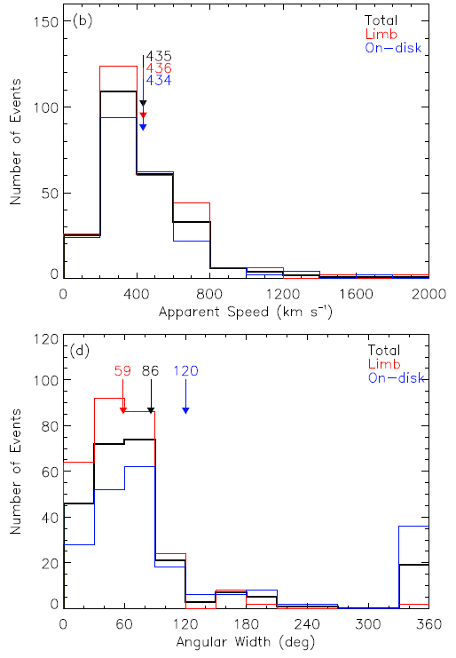
Q1: Hit the Earth?
Size
Direction
Wang et al. JGR, 2011

Slide 4
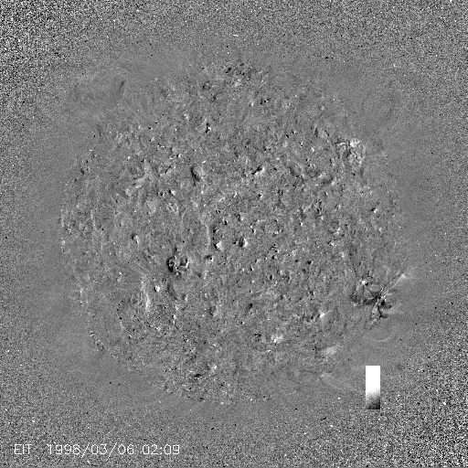
Deflected propagation in corona
(e.g., Gopalswamy et al., 2003; Wang et al., 2011; Shen et al. 2011; Gui et al., 2011; )

Slide 5
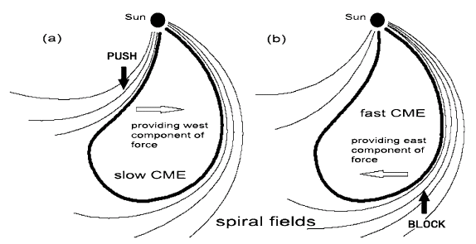
Deflected propagation in IP space
(Wang et al., 2004, 2006)

Slide 6
Can be a reason of:
Fact 1: Not all of geomagnetic storms or ICMEs can be tracked back to theirs CME sources (Webb et al., 2000; Yermolaev et al., 2005; Zhang et al., 2007; Schwenn et al., 2005)
Fact 2: Not all of front-side CMEs can encounter the Earth (Wang et al., 2002; Yermolaev et al., 2005; Wang et al., 2006)

Slide 7
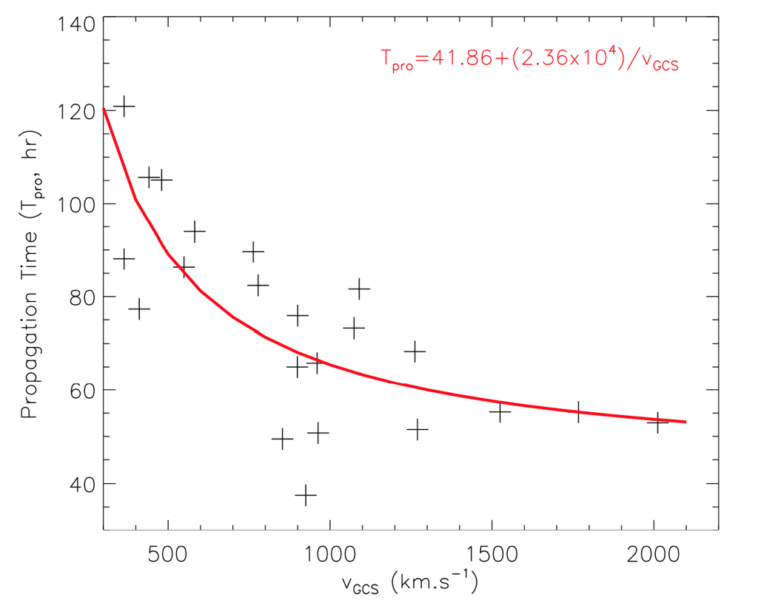
Q2: When hit?
Direction
Velocity
Shen et al., in preparation, 2013

Slide 8
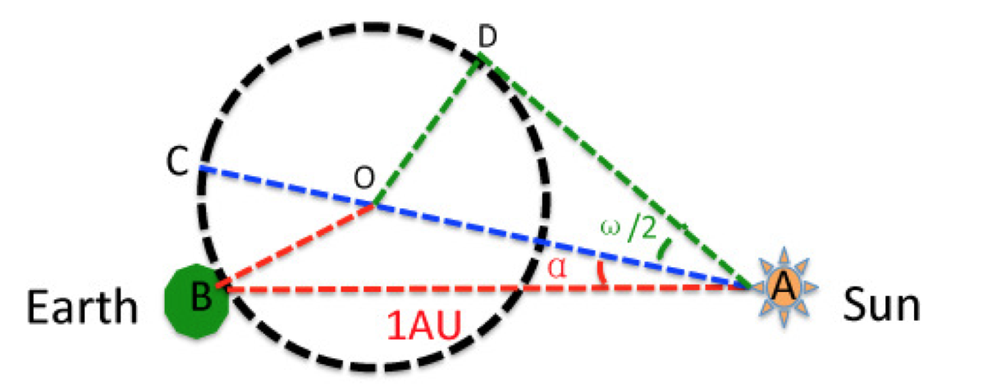
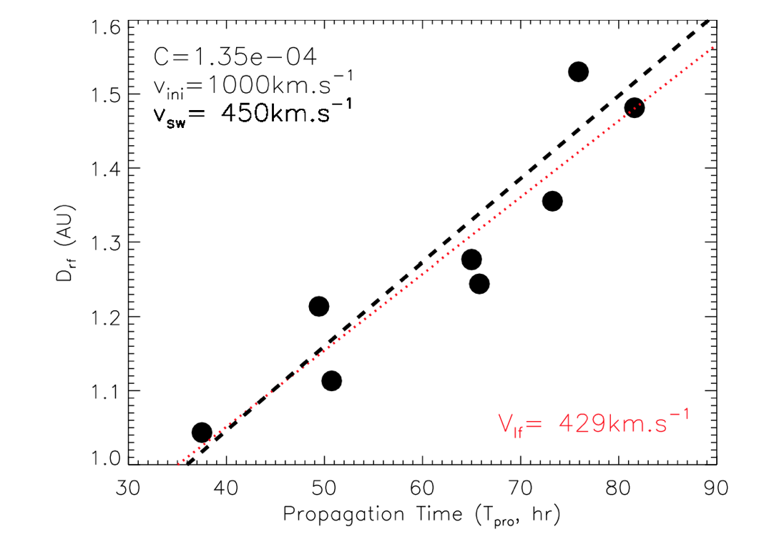
Distance = 1 AU + Δ
(see also: Moestl & Davies, 2013)
Shen et al., in preparation, 2013

Slide 9
Q3: How to get these information?
Size
Angular width
Direction
Halo, full halo
Velocity
Projected speed
If no STEREO

Slide 10
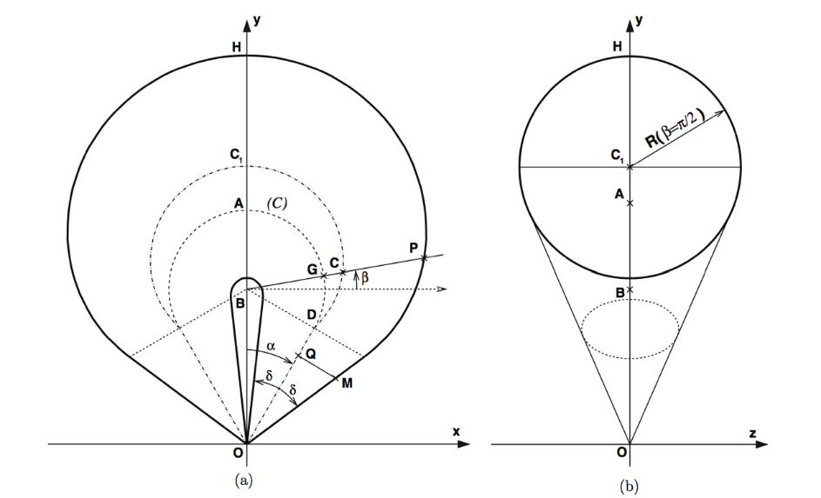
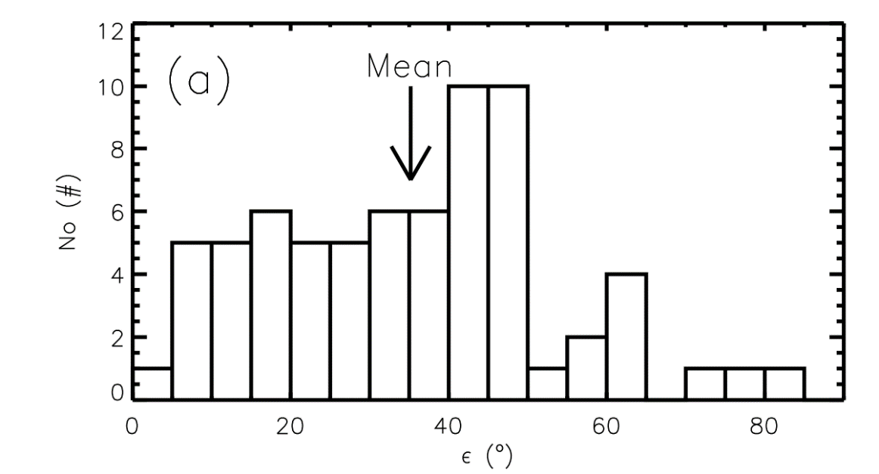
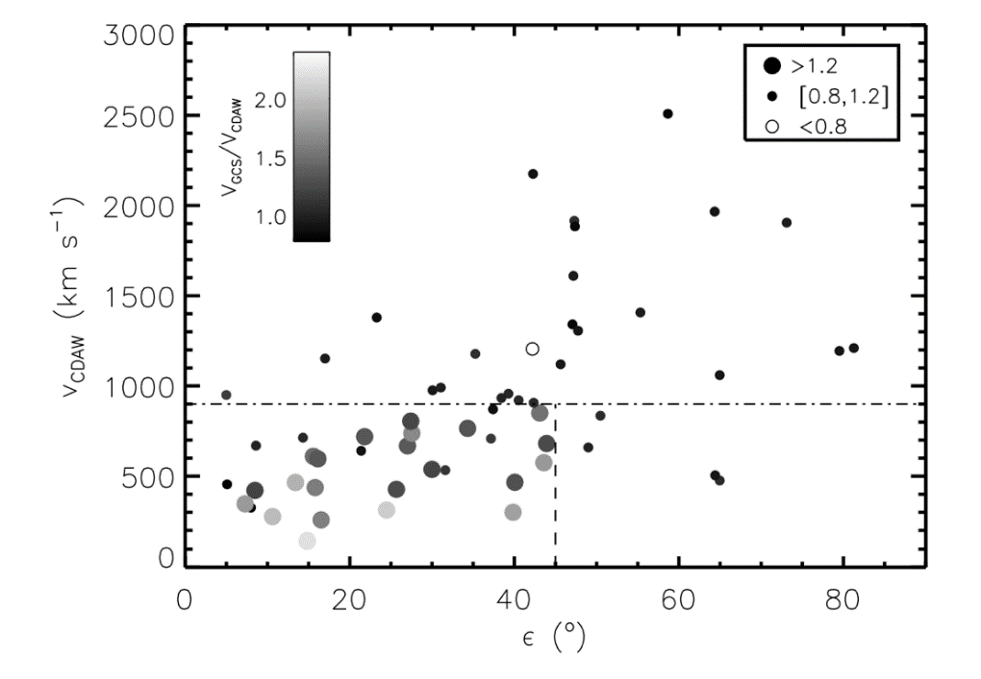
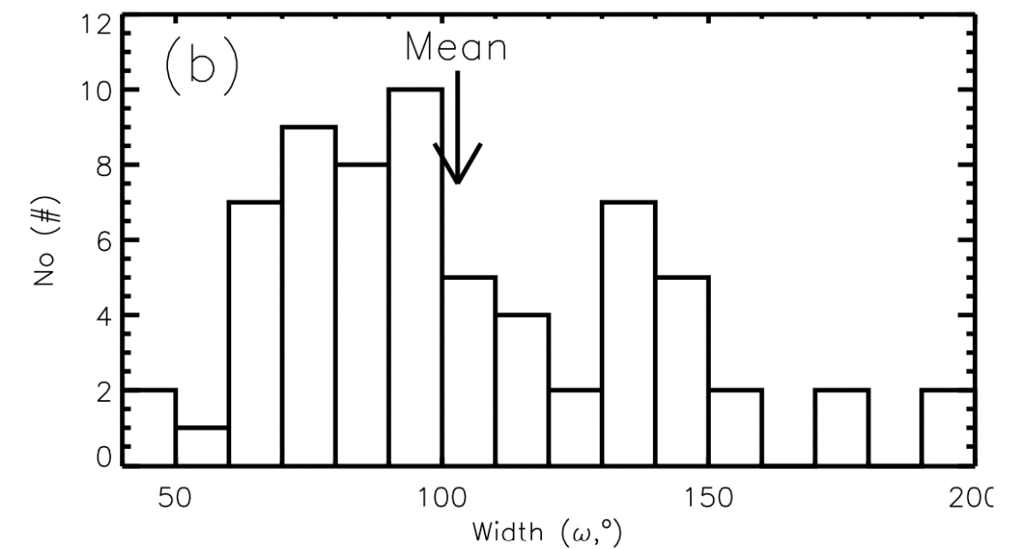
Projection effect may be significant
Full halo CMEs
Thernisien et al., 2006; 2011
Full halo CMEs
Shen et al., JGR, submitted, 2013
(see also e.g., Howard et al., 1982; Burkepile et al., 2004; Vrsnak et al., 2007; Howard et al., 2008; Wang et al., 2011)

Slide 11
Q4: How to get de-projected parameters?
Some promising models:
Size
--- Cone model
Direction
--- Cone model + Deflection model
Velocity
--- Cone model + Drag model

Slide 12
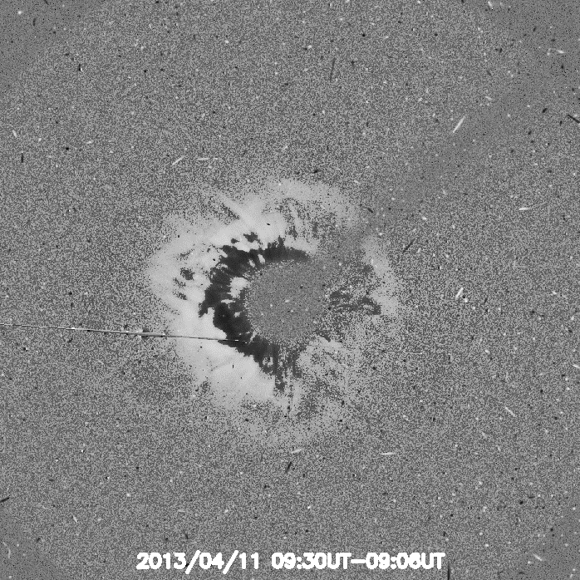
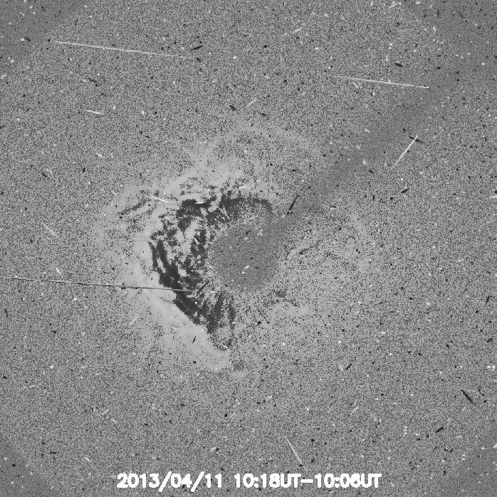
Problem 1: Velocity = Span angle
A challenge for cone model

Slide 13
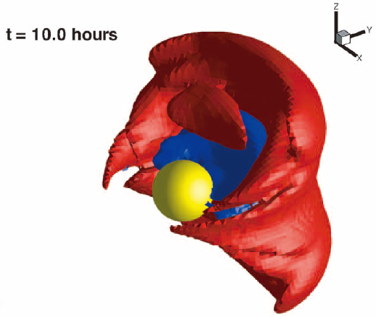
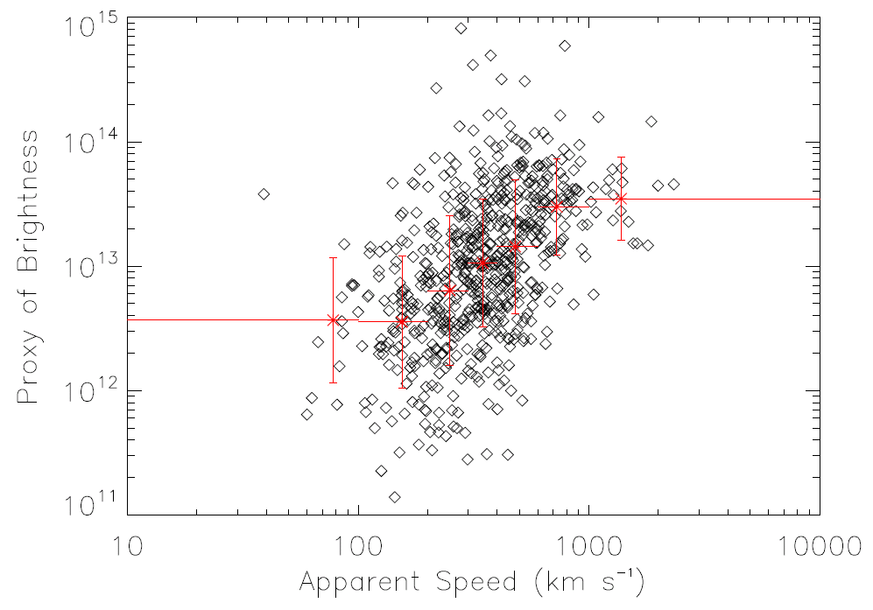
Problem 2: Brightness = CME + SW
Wang et al., JGR, 2011
Lugaz et al., 2005; Riley et al., 2008

Slide 14
Mass and size are usually over-estimated.
A challenge for drag model (e.g., Chen 1996; Cargill et al., 1996; Vrsnak & Gopalswamy 2002; Cargill 2004)
$$M_{∗}\frac{dVi}{dt}=FD=−ρeACD(Vi−Ve)|Vi−Ve|$$
$M_{∗}=M+Mv$ , $Mv=ρ_{e}τ/2$

Slide 15
Simplified drag model (Vrsnak & Gopalswamy, 2002; Maloney & Gallagher, 2010)
$$\frac{dVi}{dt}=−Cr^{−\frac{1}{2}} \left(Vi−Ve\right)2$$
$$C(M, τ, A,CD, …)$$
CME mass CME cross-section
CME size drag coefficient

Slide 16
Core Questions:
How to decompose velocity and span angle?
How to decompose CME and SW?
Q4: How to get de-projected parameters?
Q3: What are the key parameters and how to get?
Q2: When hit?
Q1: Hit the Earth?

Slide 17
Core Questions:
How to decompose velocity and span angle?
How to decompose CME and SW?
Brightness
Velocity
Mass
?

Slide 18
STEP Group @ University of Science and Technology of China (USTC)
Deflection
CME interaction/collision
CME arrival prediction
Models:
Ice-cream cone model
HAF model
Deflection model
CME internal property inversion model

Slide 19
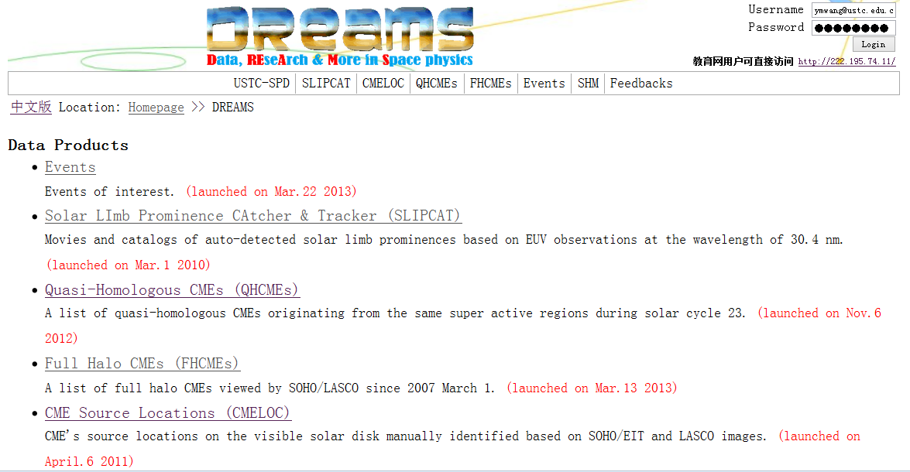
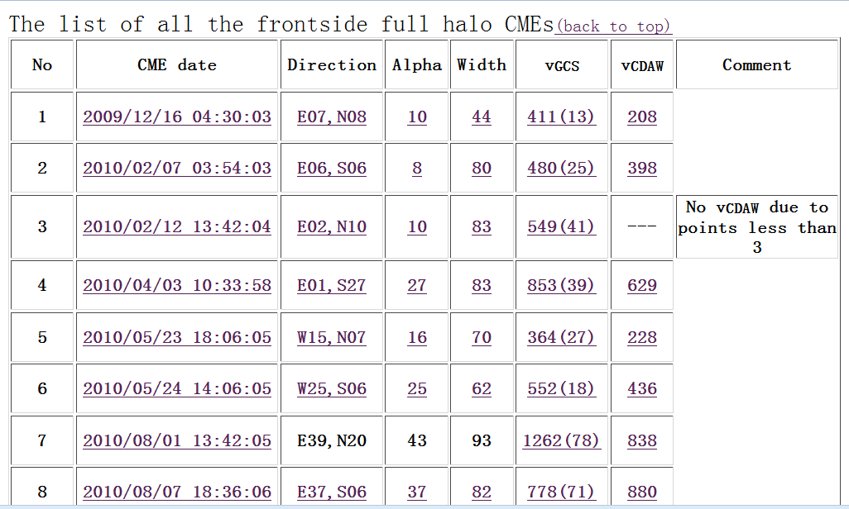
Data products
http://space.ustc.edu.cn/dreams

Slide 20
Thanks for attention

