Slide 1
NEW THEORITICAL WORK ON FLUX ROPE MODEL
AND PROPERTIES OF MAGNETIC FIELD
Valbona Kunkel
June 18 , 2013
Hvar, Croatia

Slide 2
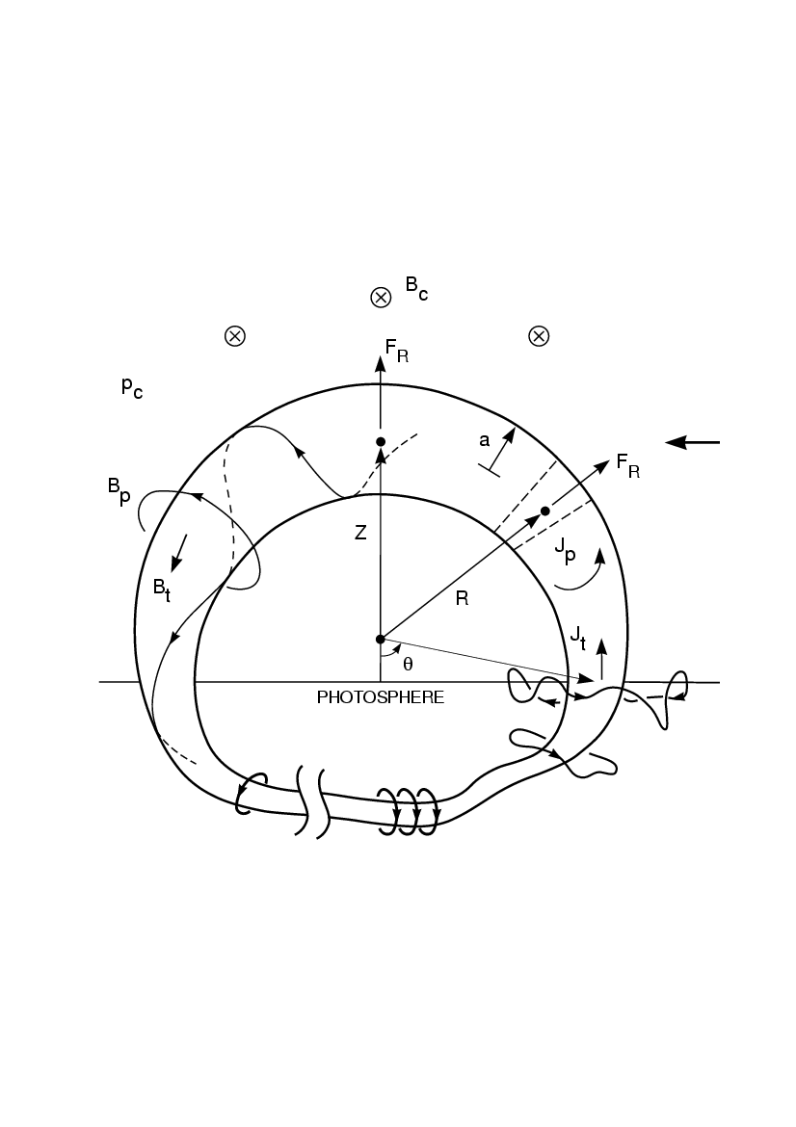
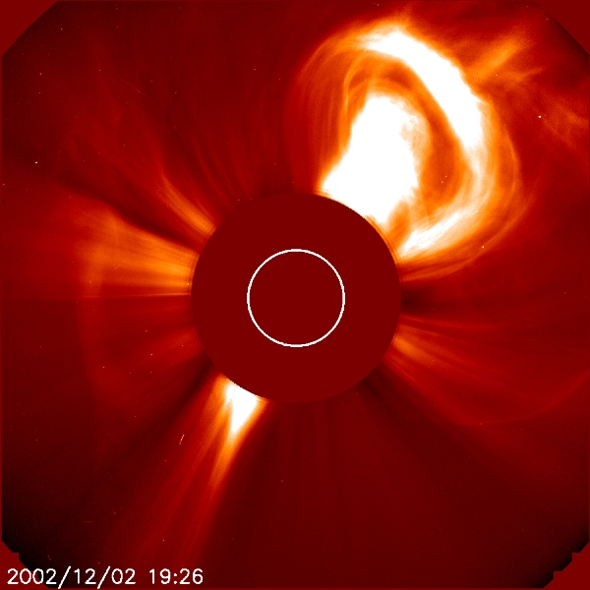
GEOMETRY OF FLUX ROPE MODEL
EFR model use a circular shape (Chen 1996) of the flux rope.
Non-axisymmetric
With fixed foot points by S_{f}
Minor radial is variable
Uniform major radius – expands as a segment of a circle with fixed S_{f}
a_{f}
S_{f}
So bright features represent high density of plasma along the line of sight.
Here is the classical three-part CME structure (Hundhausen 1993)
x
This structure is interpreted as a magnetic flux rope.
Notes:
Here is sun blocked by the occulting (ëcolt) disk of the telescope. What is actually observed is the light Thomson-scattered by the free electrons in the corona.
So bright features represent high density of plasma along the line of sight. Here a CME, containing a prominence. Here is the classical three-part CME structure (bright leading edge, a dark cavity, and a prominence inside). We interpret this image as a flux rope CME observed from the side.
Observation is in the plasma but physics is driving by magnetic field.

Slide 3
PARAMETERS
System Parameters
Model coronal and SW structure: n_{c}(Z), T_{c}(Z), B_{c}(Z), V_{sw}
V_{sw}, B_{c0} = B_{c}(Z₀) can be varied from event to event
Initial Flux Rope
Geometry: S_{f}, Z₀, a₀
B_{c0} = 0.5 – 5 G, according to Z₀
B_{p0}, B_{t0}, M_{T} = determined by the initial
force-balance conditions: d²Z/dt² = 0, d²a/dt² = 0
S_{f}
Best-fit Solutions
Adjust and minimize deviation from CME position-time data

Slide 4
PHYSICS OF CMEs: Forces
The force density is given by
Use physical quantities integrated over the minor radius (Shafranov 1966)
The apex motion is governed by:
[Shafranov 1966; Chen 1989; Garren and Chen 1994]
Initiation of eruption:
a_{f}
S_{f}
Notes:
Increasing current I_{t} increases the poloidal magnetic B_{p} this will increase pinch force I_{t}B_{p.} This will causes the minor radius to decrease or expend slowly relatively with to the upward expansion. As expansion speed increase , Induction will be increase as L ~ R and I_{t} will be decrease and when Flux is increased.
Shafranov calculated total energy apply variation on minor and major radius use principle virtual work and integrated forces. Chen make aproximated by apply to local curvature.
Surface current induce to cancel magnetic field Bc inside
J X B has two contributions ln( ) -1 xi/2 arising from Jt X Bp and the downward tension due Jp X Bt. During increasing poloidal dΦp/dt increase the toroidal current It. As It in- creases, the poloidal magnetic field Bp increases, increases (raises) a pinch force ItBp. This causes that minor radius to decrease or expand more slowly relative to the upward expansion. As the expansion speed increase the inductance L increases as L ∝ R.
It begins to decreases even while dΦp increases. Bpa ≡ Bp(a) = 2It/ca

Slide 5
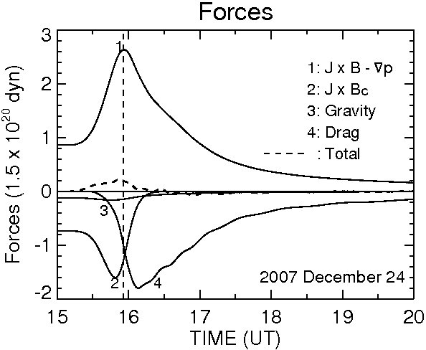
PHYSICS OF CMEs: Forces
The apex motion is governed by:
The momentum coupling between the flux rope and the ambient medium is modeled by the drag term F_{d}
The drag force in the radial direction:
Notes:
Increasing current will change all these component inside.
Shafranov calculated total energy apply variation on minor and major radius use principle virtual work and integrated forces. Chen make aproximated by apply to local curvature.
Surface current induce to cancel magnetic field Bc inside
J X B has two contributions ln( ) -1 xi/2 arising from Jt X Bp and the downward tension due Jp X Bt. During increasing poloidal dΦp/dt increase the toroidal current It. As It in- creases, the poloidal magnetic field Bp increases, increases (raises) a pinch force ItBp. This causes that minor radius to decrease or expand more slowly relative to the upward expansion. As the expansion speed increase the inductance L increases as L ∝ R.
It begins to decreases even while dΦp increases. Bpa ≡ Bp(a) = 2It/ca

Slide 6
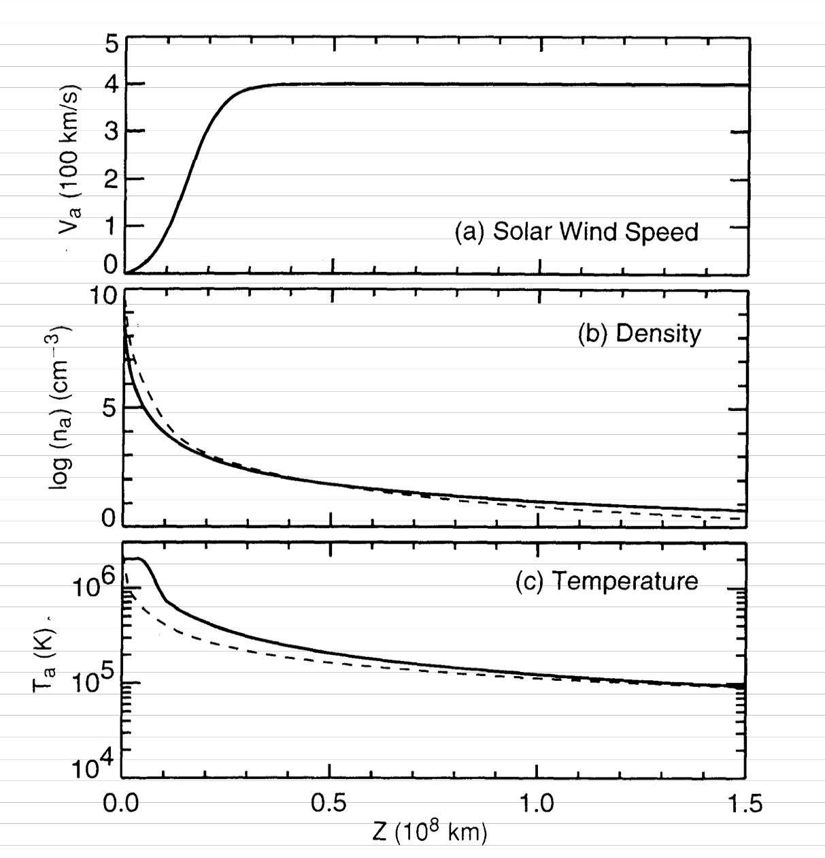
PHYSICS OF CMEs: Forces
Notes:
Temperature relation wit ambient value
Shafranov calculated total energy apply variation on minor and major radius use principle virtual work and integrated forces. Chen make aproximated by apply to local curvature.
Surface current induce to cancel magnetic field Bc inside
J X B has two contributions ln( ) -1 xi/2 arising from Jt X Bp and the downward tension due Jp X Bt. During increasing poloidal dΦp/dt increase the toroidal current It. As It in- creases, the poloidal magnetic field Bp increases, increases (raises) a pinch force ItBp. This causes that minor radius to decrease or expand more slowly relative to the upward expansion. As the expansion speed increase the inductance L increases as L ∝ R.
It begins to decreases even while dΦp increases. Bpa ≡ Bp(a) = 2It/ca

Slide 7
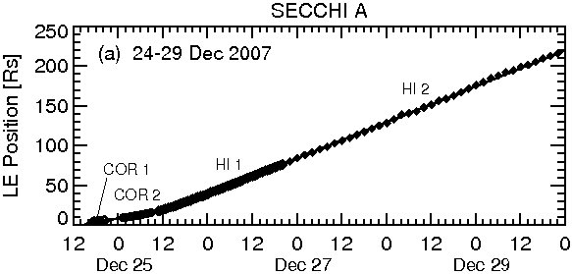
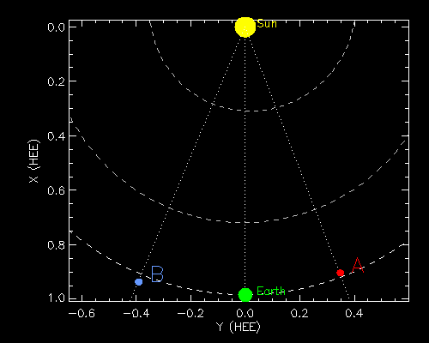
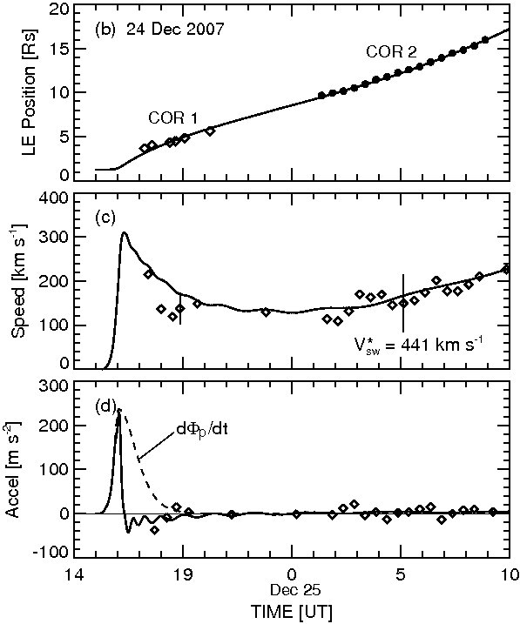
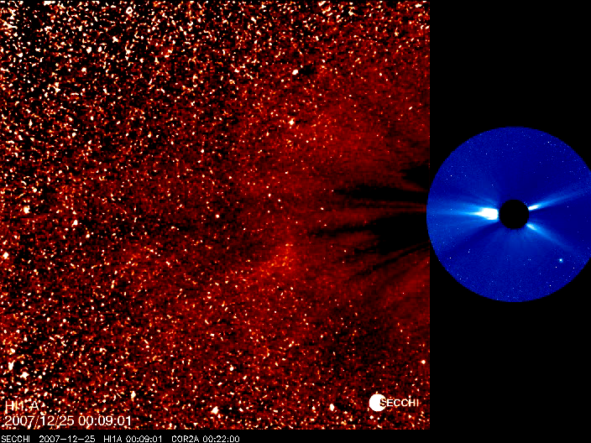
PROPAGATION OF CME and EVOLUTION OF B FIELD
STEREO Configuration
B
A
Best-fit solution is within 1% of the height-time data.
Calculated B field and plasma data are consistent with STEREO data at 1 AU

Slide 8
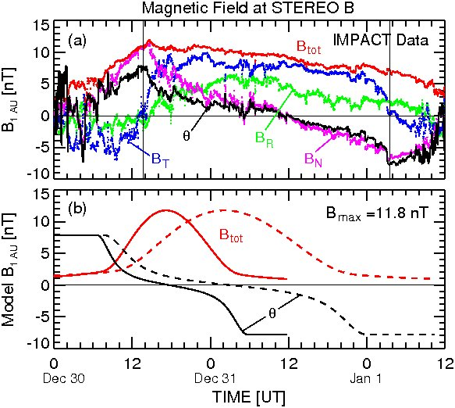
RESULT: PREDICTION OF B FIELD
Interplanetary “Magnetic Cloud”
a(t) is given by the equation of motion.
Kunkel and Chen (ApJ Lett, 2010)
Angle of intersection with flux-rope axis
90 deg 55 deg
Referring to Burlaga et al. (1981) MC is between two vertical line show extrema of theta, T_{p}=3-4x10⁴K between two vertical line, T_{p}=6x10⁴K outside, model calculate T =4.3x10⁴K. Calculated B and plasma data are consistent with STEREO data at 1 AU
Notes:
Extrema of theta indicating beginning and ending of MC theta =1/sin(Bn/B)

Slide 9
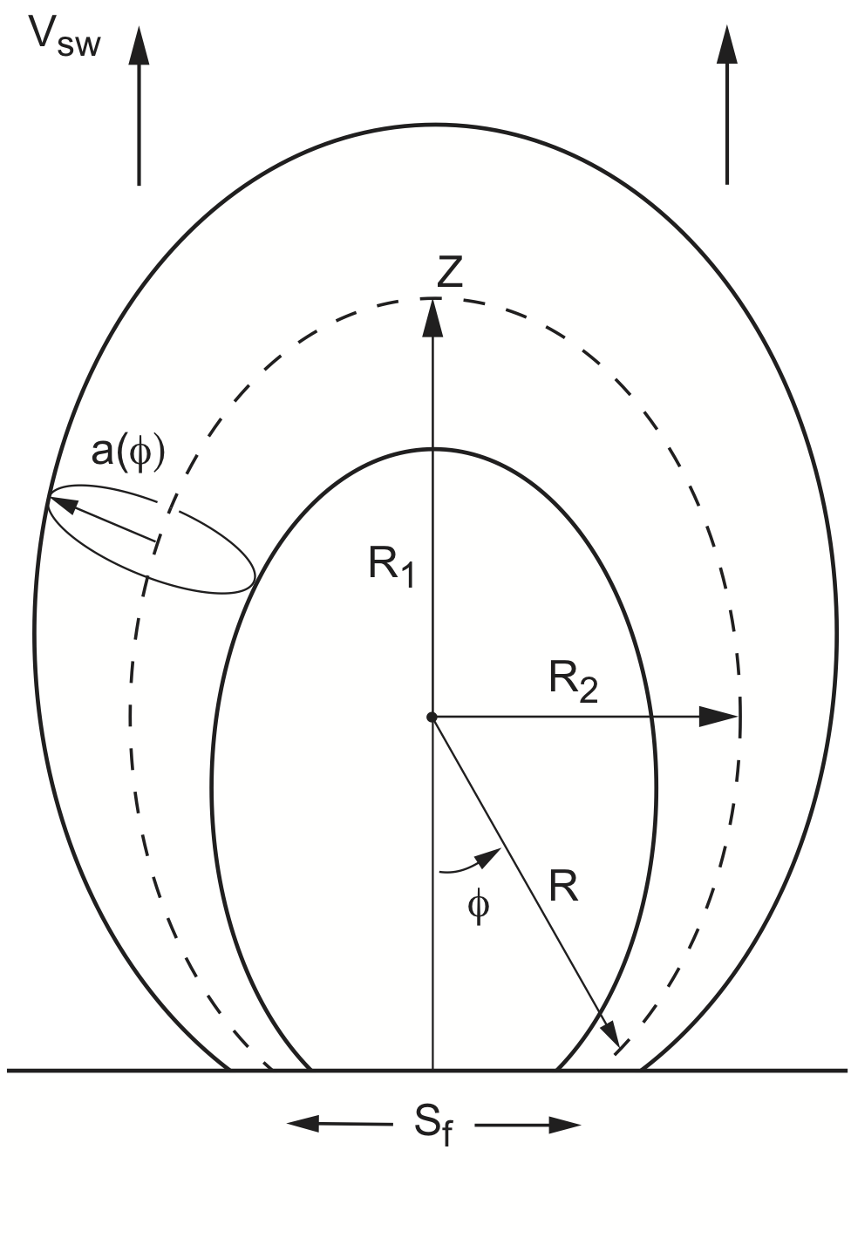
THE NEW MODEL
NON-CIRCULAR EXPANSION
At apex: CME expansion is parallel to the solar wind speed:
At flanks: solar wind speed along CME expansion direction is near zero:
CME flux rope geometry: two principle orthogonal directions of expansion
Simplest shape with two radii is an ellipse
Theoretical extension:
Additional coupled equations (2) of motion
Change semi-major radius: R1(Z, Sf, R2)
Inductance: calculated for an ellipse
Drag force for two orthogonal directions
Gravity is perpendicular to V at the flanks

Slide 10
THE FORCES
The force density is given by :
The net force per unit length acting in the semi-major radial direction R₁ is given by:
The net force per unit length acting semi-minor radial direction R₂ is:
Where is the curvature at the apex and is the curvature at the flanks
Notes:
Different of forces

Slide 11
THE MOMENTUM COUPLING
The momentum coupling between the flux rope and the ambient medium is modeled by the drag term F_{d}
The drag force in the radial direction:
The drag force in the transverse direction:
Notes:
Laminar flow (momentum transfer back to object so Cd = 0
Non-laminar flow some momentum transfer to the ambient Cd = 1, 2, 3. Momentum coupling constant
No mass transfer necessary
Snow plow--- In one unit time sweeps up a volum 2Va, mass swept is 2Va density. Momentum get by swept –up mass

Slide 12
THE BASIC EQUATIONS
Equation of motion for the semi-major radial direction R₁
Equation of motion for the semi-minor transvers direction R₂

Slide 13
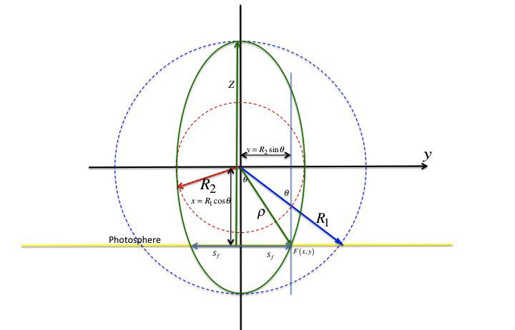
SELF-INDUCTANCE FOR AN ELLIPTICAL LOOP

Slide 14
THEORETICAL RESULTS
S_{f}= 1.8 x 10¹⁰ cm
Z₀= 9.2 x 10⁹ cm
B₀ = -1.0 G
B_{p0}= 45.47 G
B_{t0}= 44.47 G
C_{d}= 3.0
(dΦ/dt)_{max} = 5 x 10¹⁸ Mx/sec
Φ_{p0} = 3.5 x 10²¹ Mx
Notes:
Solid black curve is trajectory of the LE of the CME
trajectory the centroid of the apex

Slide 15
THEORETICAL RESULTS
Eccentricity is :

Slide 16
THEORETICAL RESULTS
Forces are increased in response to increasing the injected poloidal flux
Change of drag force has the effect of changing the dynamic on apex and flanks

Slide 17
SUMMARY
This work significantly improves our understanding of CME, evolution and prediction of magnetic field.
  Established the relationship between solar parameter (injected poloidal energy) and magnetic field at 1 AU
  New capability to self-consistently calculate the expansion speed at the flanks
  More accurate prediction of CME ejecta arrival time at the Earth
The future work is to further validate the model from observations.
These results have far-reaching implications for space weather modelling and forecasting. Furthermore, they provide key predictions for the Solar Orbiter and Solar Probe Plus missions when they launch later this decade.

Slide 18
End

