Slide 1
Influence of the Magnetic Decay Index Spatial Distribution on the Kinematics of the Solar Eruptive Prominence
Myshyakov I.¹, Tsvetkov Ts.², Petrov N.²
¹ Institute of Solar-Terrestrial Physics, SB RAS, Russia
² Institute of Astronomy and National Astronomical Observatory, BAS, Bulgaria
XVIth Hvar Astrophysical Colloquium
24 – 28 September 2018
Hvar, Croatia

Slide 2
Outline
Consider sequence of SDO/AIA images of an eruptive prominence prior and during its eruption in order to determine height of the prominence when it had lost the equilibrium
Perform extrapolation of the coronal magnetic field
Based on the obtained results investigate whether configuration of the coronal magnetic field could lead to the prominence eruption

Slide 3
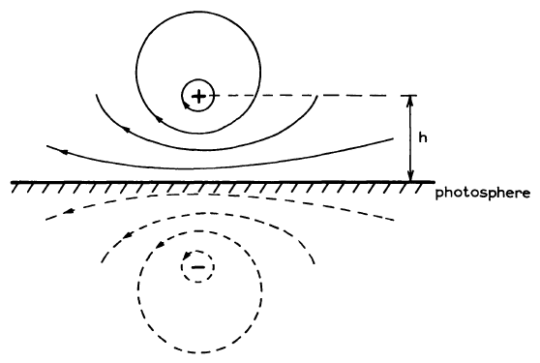
Prominence equilibrium model
Kuperus, M. and M.A. Raadu, 1974, Astron&Astrophys., 31: 1189-193
Van Tend W. and M. Kuperus, 1978, Solar Phys., 59: 115-127
F_{j}
j – current density
F_{j} – Lorentz force, produced by mirror current
F_{Bex} – Lorentz force, produced by external magnetic field
B_{ex} – external magnetic field
j
B_{ex}
F_{Bex}
Photosphere
-j

Slide 4
Torus instability
Kliem B. and T. Torok, 2006, Physical Review Letters, 96:255002-1 - 255002-4
F_{h}
j – current density
F_{h} – hoop force, self-induced by current
F_{L} – Lorentz force, produced by external magnetic field
B_{ex} – external magnetic field
B_{ex}
F_{L}
Photosphere
j

Slide 5
Magnetic decay index
Van Tend W. and M. Kuperus, 1978, Solar Phys., 59: 115-127
Kliem B. and T Torok, 2006, Physical Review Letters, 96:255002-1 - 255002-4
B_{ex} – external transverse magnetic field,
h – height above the photosphere
Critical values:
n = 1 for a straight, linear electric current
n = 1.5 for an electric current along curved axis (torus instability)

Slide 6
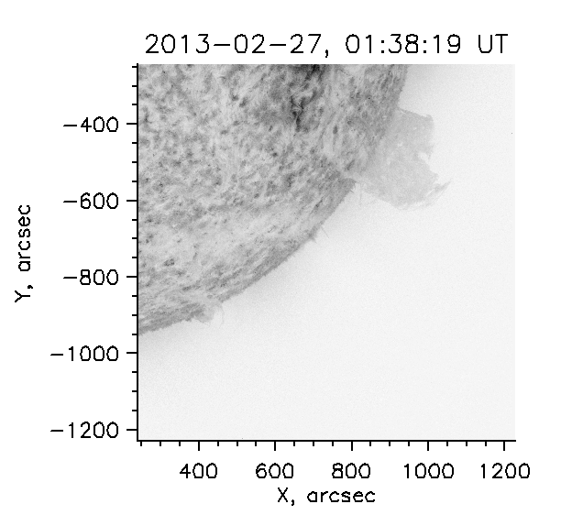
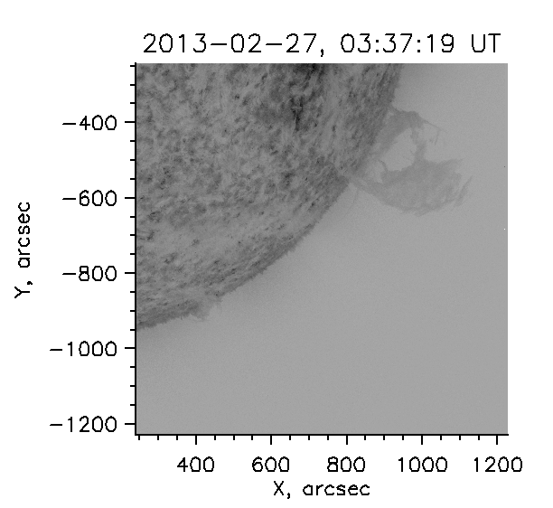
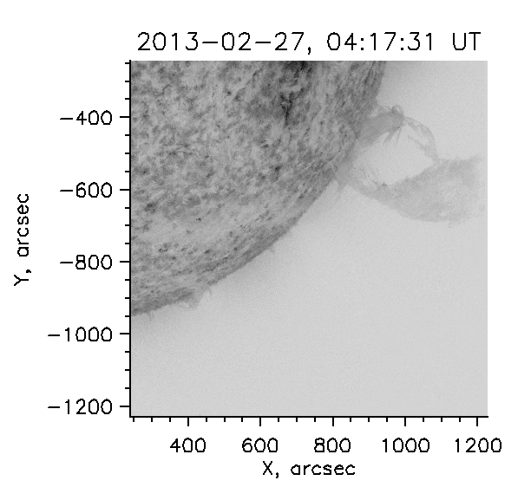
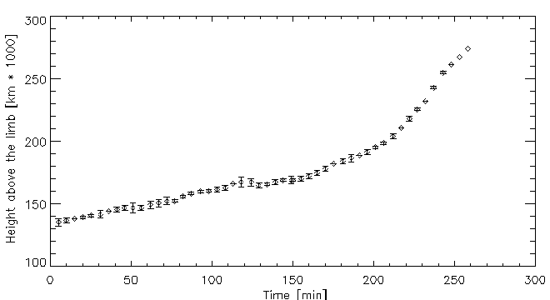
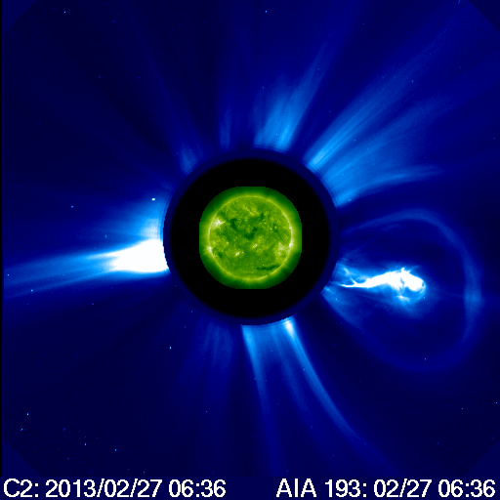
Eruptive prominence
SDO/AIA 304 Å
SDO/AIA 304 Å
SDO/AIA 304 Å
Time dependent
height profile

Slide 7
Magnetic field reconstruction
Green’s function based potential extrapolation in spherical geometry.
SDO/HMI vector magnetograms with resolved pi-ambiguity,
several days before the eruption.
Computational domain had sizes [720 x 540 x 300] Mm,
grid spatial resolution about 3 Mm.

Slide 8
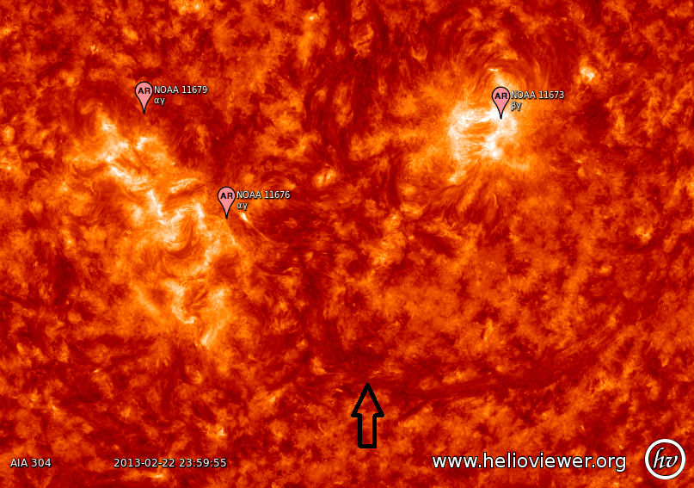
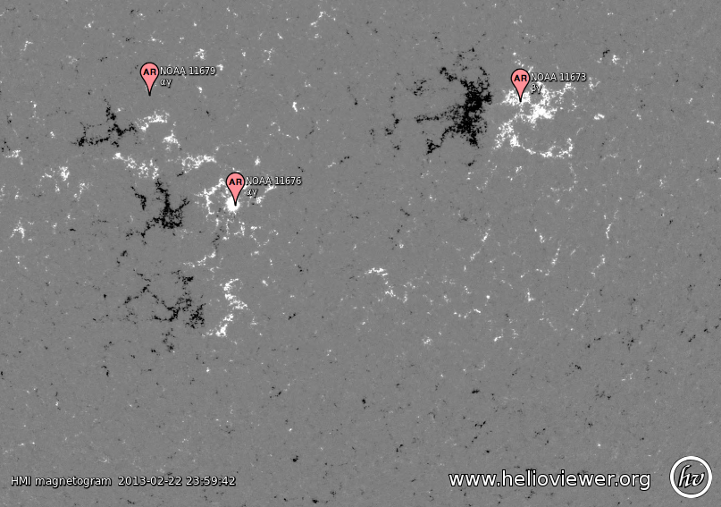
Images by SDO, 23 February 0:00 UT
SDO/AIA 304 Å
SDO/HMI line-of-sight magnetogram

Slide 9
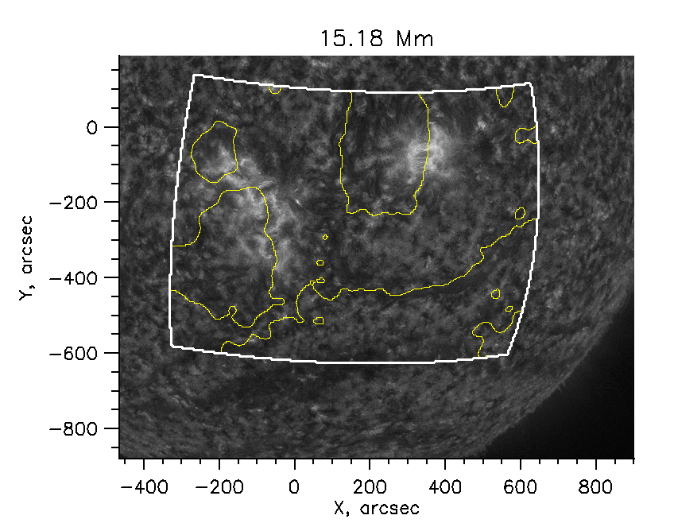
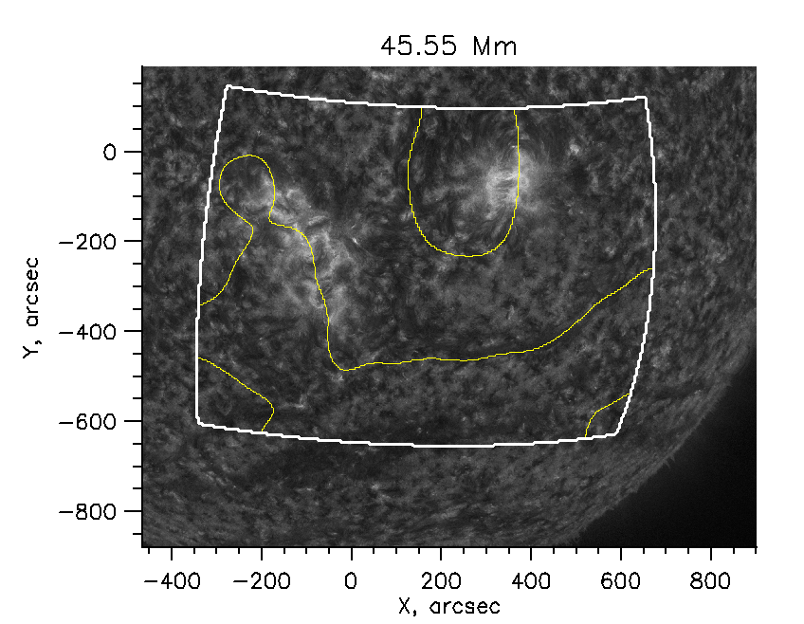
Neutral line over HMI/AIA 304 Å image, 23 February 0:00 UT
White contour – boundaries of the computational domain
Yellow contour – reconstructed neutral line

Slide 10
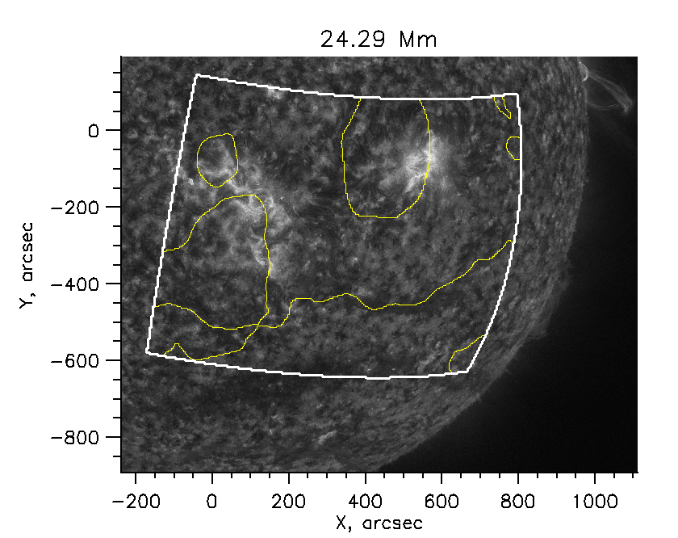
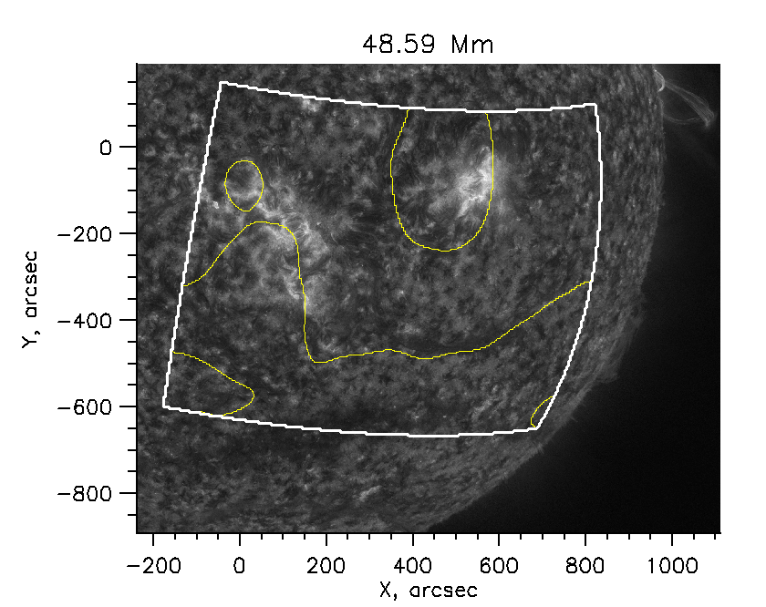
Neutral line over HMI/AIA 304 Å image, 24 February 0:00 UT
White contour – boundaries of the computational domain
Yellow contour – reconstructed neutral line

Slide 11
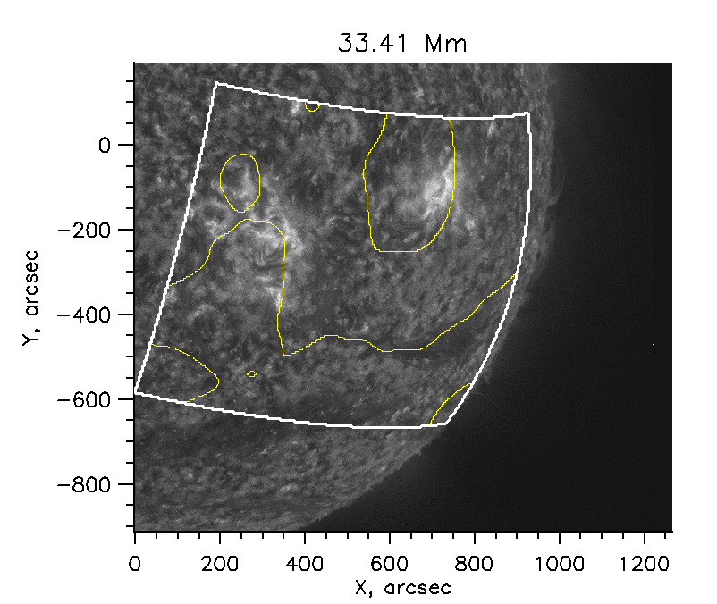
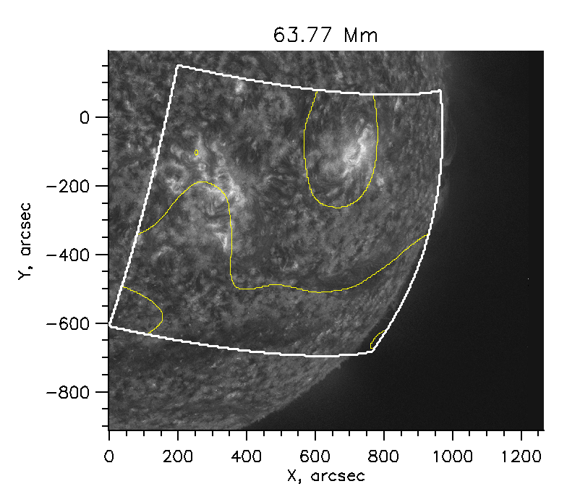
Neutral line over HMI/AIA 304 Å image, 25 February 0:00 UT
White contour – boundaries of the computational domain
Yellow contour – reconstructed neutral line

Slide 12
Magnetic decay index

Slide 13
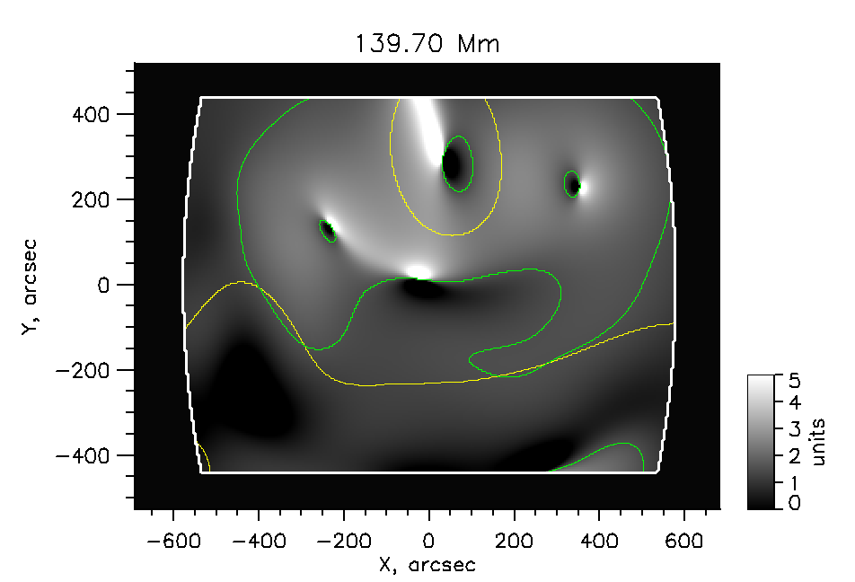
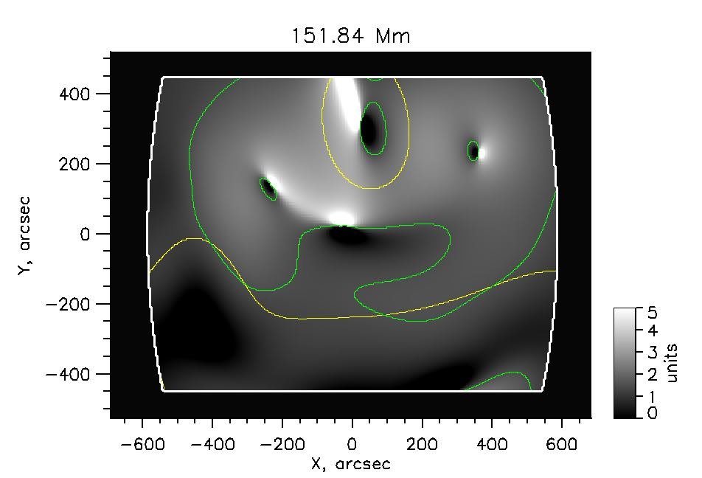
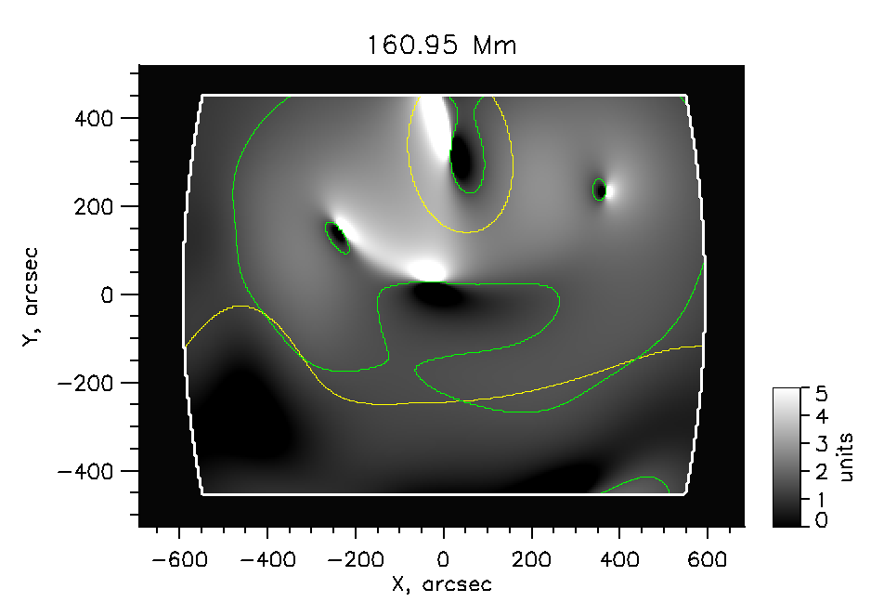
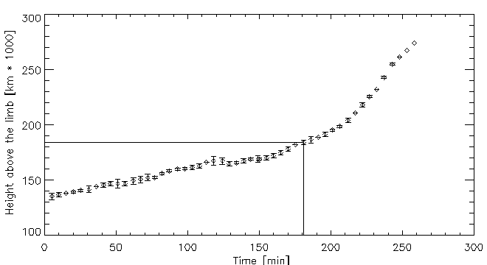
Magnetic decay index, 25 February 0:00 UT
Green contour marks decay index level n = 1.5
Acceleration started when apex of the prominence reached height of
180 – 190 Mm
Transverse size of the prominence, estimated from SDO/AIA 304 Å image was up to 100 Mm
Time dependent
height profile

Slide 14
Magnetic decay index, higher altitudes

Slide 15
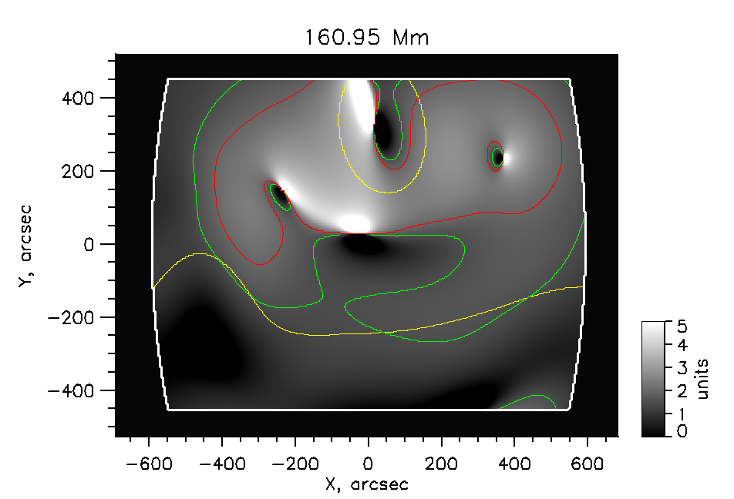
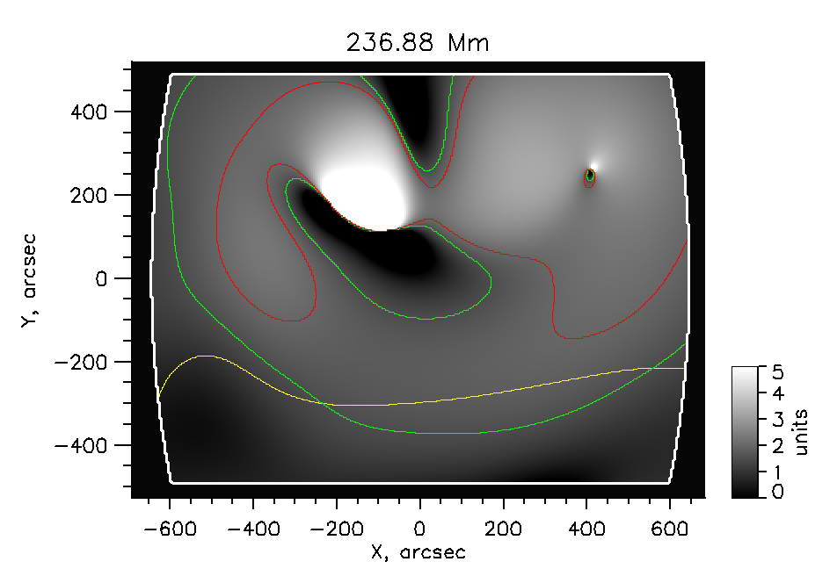
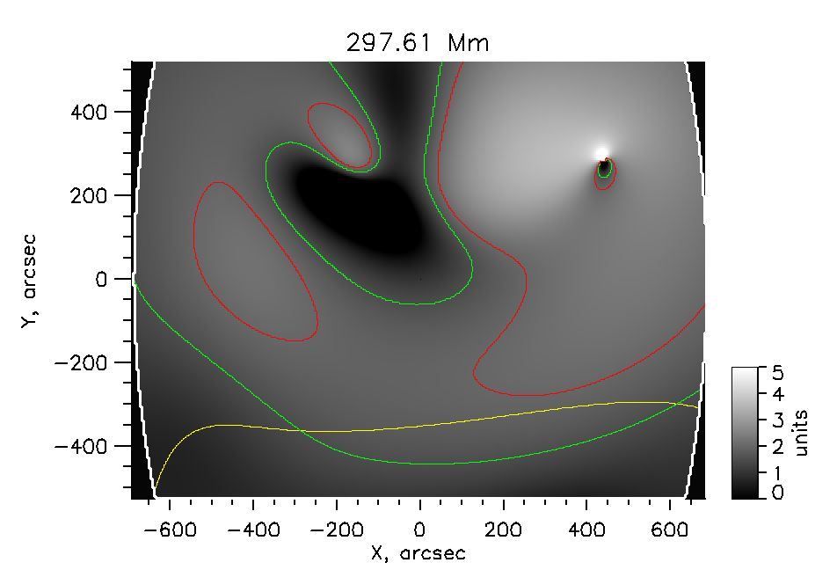
Magnetic decay index, 25 February 0:00 UT
Green contour marks decay index level n = 1.5
Red contour marks decay index level n = 2.0
Torok T. and B. Kliem, 2007, Astron. Nachr., 328, 8, 743-746
CME’s acceleration depends on steepness of the field decrease.
http://cdaw.gsfc.nasa.gov/CME_list CME speed = 622.4 km/s

Slide 16
Conclusion
Height of the prominence for several days before the eruption was estimated. It was found, that different parts of the prominence were located at different heights
The height at which magnetic decay index reached critical value are in agreement with the height where prominence lost its equilibrium
At higher altitudes magnetic field continues to decrease sufficiently rapidly, that is in agreement with average speed of the produced CME

