Slide 1
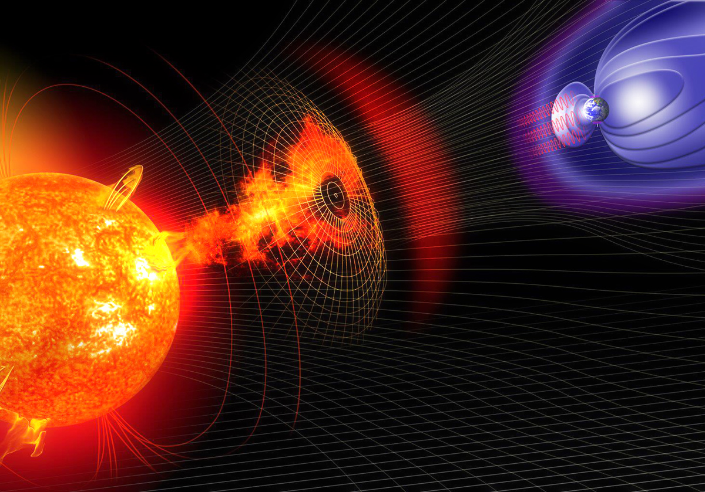


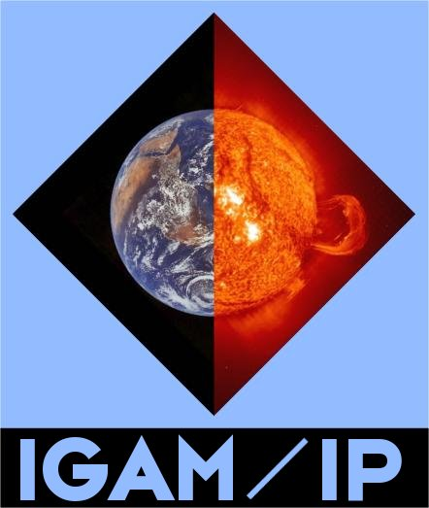




DBEM web application for heliospheric propagation of CMEs
J. Čalogović¹, M. Dumbović², B. Vršnak¹, D. Sudar¹, M. Temmer², L. M. Mays³, A. Veronig², I. Piantschitsch²
Hvar Observatory, Faculty of Geodesy, University of Zagreb, Croatia
Institute of Physics, University of Graz, Austria
NASA Goddard Space Flight Center, Greenbelt, MD 20771, USA

Slide 2
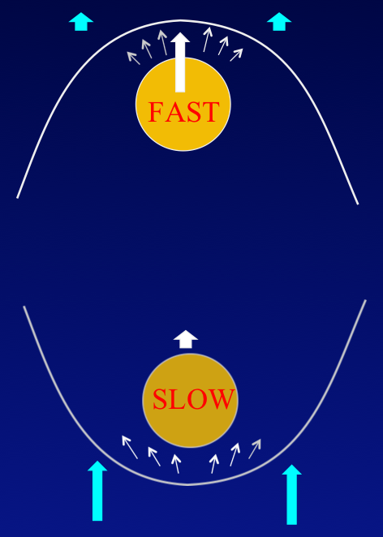
Drag-Based Model (DBM)
Beyond about 20 solar radii the MHD “aerodynamic” drag (a_{d}) caused by the interaction of CME with solar wind, becomes the dominant force
a = a_{L} – g + a_{d}
a_{d} = -γ(v-w)|v-w|
Equation of motion
CME dynamics is governed by interaction with (ambient) solar wind (w)
  fast CME (v > w) → deceleration
  slow CME (v < w) → acceleration
Drag parameter (γ) depends on characteristics of both CME and solar wind – the drag is larger for broader, low-mass CMEs in a high-density (slow) solar wind
If w and γ constant there is analytical solution
Cargill et al., 1996; Vršnak and Žic, 2007; Vršnak et al. 2013
Notes:
The Lorentz force ceases in upper corona and gravity is also neglectable
MHD drag:
Momentum and energy are transferred by magnetosonic waves
(collisionless environment: low viscosity, resistivity → dissipative processes are negligible)
The “drag parameter” Γ depends on the ICME mass, M , and
cross-sectional area, A , as well as the solar-wind density, ρ ,

Slide 3
Drag-Based Model (DBM)
Simple analytical model for heliospheric propagation of CMEs to predict the arrival time and speed of CME at any given target in the solar system
Advantages
  simple and robust
  very fast (one run << 1 sec) compared to numerical MHD models (e.g. ENLIL)
Disadvantages
  doesn’t give the best results in complex heliospheric environment (eg. CME-CME interactions, w and γ aren’t constant)

Slide 4
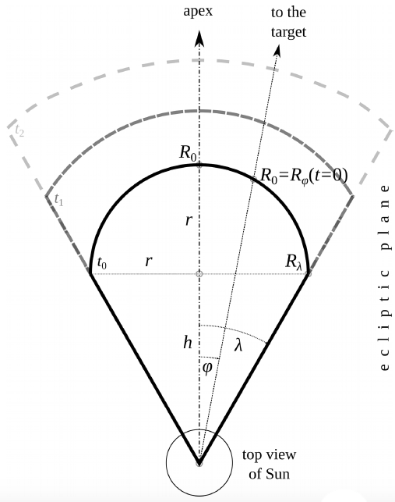
DBM CME geometry
Uses CME cone geometry with CME leading-edge flattening
each CME leading-edge segment propagates independently → the initial cone geometry flattens
Žic et al., 2015

Slide 5
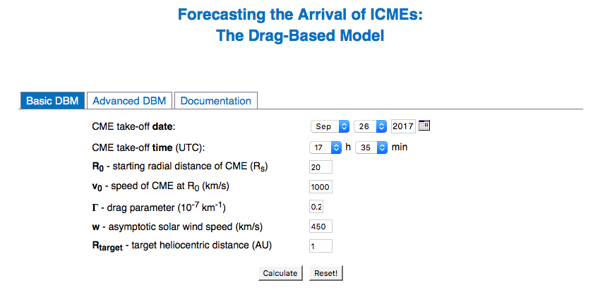
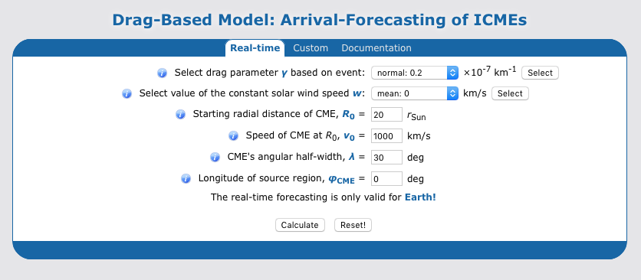
DBM and online space weather tools
Latest DBM version is integrated into ESA Space Situational Awareness (SSA) portal (CME leading-edge flattening):
Hvar Observatory - Forecasting the Arrival of ICMEs:
http://oh.geof.unizg.hr/DBM/dbm.php
http://swe.ssa.esa.int/heliospheric-weather
CME Arrival Time Scoreboard – NASA Space Weather Research Center:
ESA Expert Service Center for Solar & Heliospheric Weather:
http://swrc.gsfc.nasa.gov/main/cmemodels
http://swe.uni-graz.at
The COMESEP alert system (DBM input from CACTus):
http://www.comesep.eu/alert

Slide 6
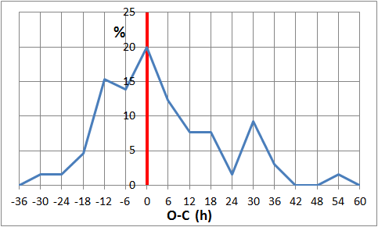
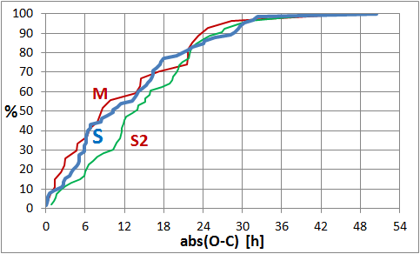
Reliable observations are needed for better accuracy of heliospheric propagation models
In about 55% of events DBM has error (observed – calculated) less than 12h and more than 85% of events has error less than 1 day
DBM errors (Observed – Calculated)
Comparison od DBM and WSA-ENLIL-CONE model (Vršnak et al., 2014)
Relative difference is most often less than 10%
ENLIL preforms better during the solar maximum due to complex solar wind structure (differences 10-11h) and DBM can provide better results during the solar minimum (differences 6-9h)
However, the main problem of all models is the lack of reliable observations (input) eg. CME launch speed

Slide 7
Ensemble modelling
Input
Set of
results
Parameter 1 (eg. 𝛾)
value 1
Multiple model
runs
(DBEM)
value 2
value x
allows to calculate the confidence intervals of arrival times and impact speed (parameter uncertainties are quantified)
Parameter x
Value 1
value x

Slide 8
Drag-based Ensemble Model (DBEM)
Recently, the DBM code was rewritten to python (modular design)
Optimizations and improvements in the code → new version of DBM runs up to 200 times faster
Parallelization of code that supports multi thread (CPU) calculations (up to 1000x faster)
Example for input parameters for CME on 6 Feb 2013
Member ID | date & time | Latitude | Longitude | Half-Width | Speed
1 | 2013-02-06 03:15 | 30 | -25 | 38 | 1226
2 | 2013-02-06 03:07 | 30 | -35 | 38 | 1300
3 | 2013-02-06 02:42 | 33 | -28 | 28 | 1389
4 | 2013-02-06 02:37 | 30 | -20 | 27 | 1436
5 | 2013-02-06 02:40 | 30 | -26 | 43 | 1460
6 | 2013-02-06 02:39 | 30 | -24 | 36 | 1474
7 | 2013-02-06 02:37 | 33 | -19 | 28 | 1536
8 | 2013-02-06 03:01 | 39 | -33 | 43 | 1387
9 | 2013-02-06 02:40 | 30 | -26 | 22 | 1460
10 | 2013-02-06 02:52 | 35 | -30 | 27 | 1430
11 | 2013-02-06 02:44 | 34 | -25 | 30 | 1470
12 | 2013-02-06 02:54 | 40 | -28 | 30 | 1441
* | 2013-02-06 02:41 | 30 | -26 | 30 | 1460
Each DBEM input parameter can be defined as list of parameters (eg. multiple observations of the same event)

Slide 9
DBEM with ensemble and synthetic measurements
Dumbović et al., ApJ, 2018
INPUT
Ensemble modeling applied to Drag-based Model (DBM, Vršnak et al., 2013, SolPhys)
Ensemble of CME measurements:
T₁, v₁, φ₁, λ₁
T₂, v₂, φ₂, λ₂
…
T_{n}, v_{n}, φ_{n}, λ_{n}
SW speed, w
DBEM OUTPUT
Synthetic values for:
w₁, ɣ₂ / w₂, ɣ₂
...
w_{m}, ɣ_{m}
n inputs
m x m inputs
Fig .4 Dumbovic et al. 2018
RUNS
nm² combinations (ensemble members)
nm² DBM runs
2D DBM (Žic et al., 2015, ApJ)
hit or no hit
transit time
arrival time
arrival speed
Notes:
- 1 -
Drag-based ensemble model was recently developed and described by Dumbovic et al., 2018.
It was developed based on the drag based model (DBM) by Vrsnak et al., 2013.
- 2 -
For one CME, the input is given in a form of CME ensemble with n members (similar as in paper by Mays et al., 2015).
Each ensemble member is a set of measurements of CME start time, initial speed, longitude and half width.
- 3 -
The input values for solar wind speed and drag-parameter gamma are also given in a probabilistic manner.
For each of them, m “synthetic values” are calculated under the assumption that they follow normal distribution.
- 4 -
CME ensemble and synthetic values are combined to give a total of nm² ensemble members as input.
For each ensemble member DBM is run (2D DBM with assumed cone geometry, described by Zic et al., 2015).
- 5 -
As an output DBEM provides probability of arrival, and most likely transit time (TT) and arrival speed.
Probability of arrival is calculated as a number of ensemble members that hit the target divided with the total number of ensemble members. Transit time and arrival speed are given as distributions (only for ensemble members that hit!) with mean, median and 95% confidence intervals. Median value is taken as most likely transit time and arrival speed.

Slide 10
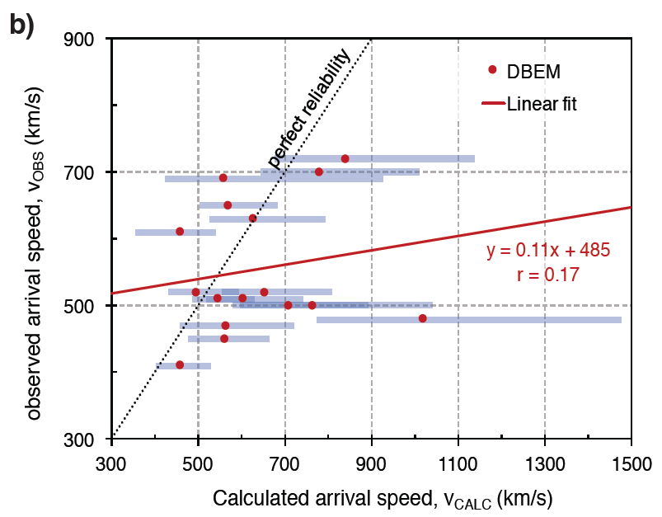
Performance and comparison with ENLIL
TRANSIT TIME
Fig. 7 from Dumbović et al., 2018
Based on sample: Mays et al., 2015, SolPhys
RELIABILITY DIAGRAM
ARRIVAL SPEED
Both ENLIL and DBEM are not far away from the line of perfect reliability
Fig. 5 from Dumbovic et al. , 2018
Fig. 8 from Dumbovic et al., 2018
Notes:
- 1 -
Basic evaluation and comparison with ENLIL was done using a sample from Mays et al,, 2015.
We present some selected results, a detailed evaluation/comparison can be found in Dumbovic et al., 2018.
- 2 -
The reliability diagram describes how well the model predicts the probability of arrival.
It shows that both ENLIL and DBEM are in general not too far away from the line of perfect reliability.
Both ENLIL and DBEM have tendency to underforecast intermediate bins, and overforecast high probability of CME arrival.
- 3 -
Regression line between ENLIL and DBEM transit times is close to identity line.
Both ENLIL and DBEM show same deviation from the identity line in comparison of observed vs. calculated transit time.
- 4 -
There is a substantial deviation from identity line in comparison of observed and calculated arrival speed.
General trend is observed – fast CMEs are predicted to arrive too early.

Slide 11
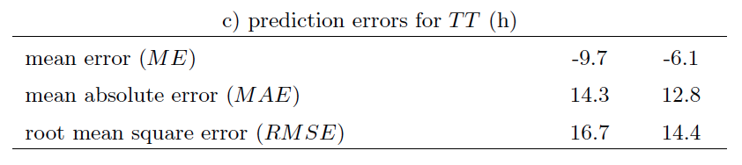
Main points - DBEM
Dumbović et al., ApJ, 2018
Offers probabilistic forecasting of CME hit chance, transit time and arrival speed for different targets in solar system
Reliable and simple model
Runs very fast (more than 1000 DBM runs per sec on a single CPU)
ENLIL and DBEM perform similarly
Fast CMEs predicted to arrive too early for both DBEM and ENLIL
Suitable for implementation as on-line (web) forecasting tool: DBEMv1 and DBEMv2 - ESA Expert Service Group for Solar & Heliospheric Weather (swe.uni-graz.at)
DBEM
ENLIL
Notes:
- 1 -
Main points regarding the DBEM presented in Dumbovic+, 2018 are that:
DBEM offers probabilistic forecasting of CME arrival with the main advantage that it runs very quickly.
The evaluation and comparison with ENLIL reveal that both perform similarly.
Both models fast CMEs are predicted to arrive earlier than observed, most probably owing to the physical limitations of models, but possibly also related to an overestimation of the CME initial speed for fast CMEs.
- 2 -
Finally, this approach is useful when a CME ensemble is provided as an input (e.g. when several observers or methods are employed).
When only one observer provides CME input based on only 1 method, it is more convenient to use different approach more similar to error propagation (DBEMv2).

Slide 12
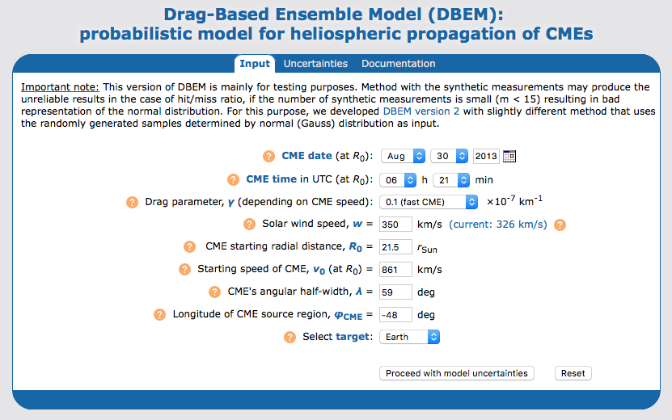
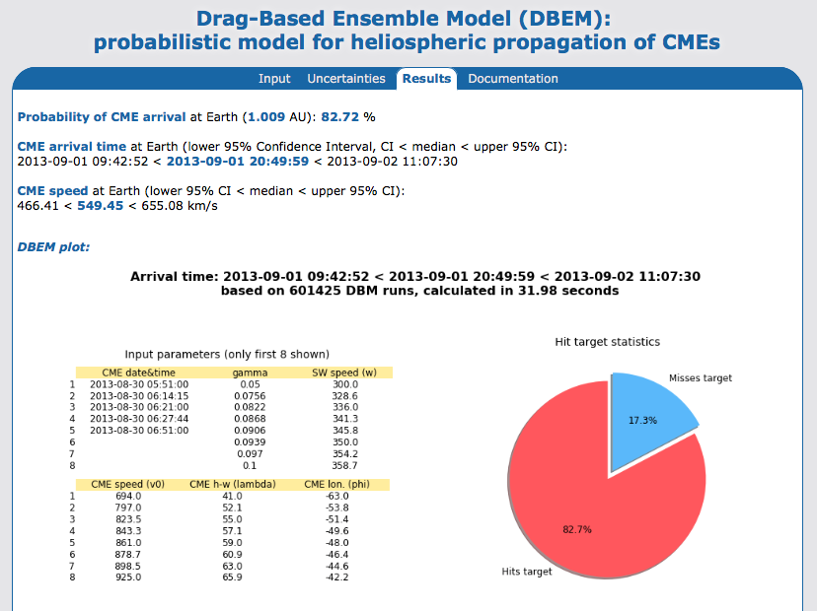
On-line DBEMv1 tool with synthetic measurements
Needs as input only one CME measurement with estimated uncertainties
Uses synthetic measurements for all 6 input parameters (T, v, φ, λ, w, ɣ)
Needs certain number of synthetic measurements (m > 9) to perform reliably - large number of DBM calculations (slow)
DBEMv2 is faster and more reliable than DBEMv1
oh.geof.unizg.hr/DBEM
phyk039240.uni-graz.at:8080/DBEM
Notes:
1 -
Representation of normal (Gauss) distribution is bad with lower number of synthetic measurements (m<7), where especially calculated CME hit/miss ratio (but also TT and v_tar) can be significantly altered only by changing m (e.g. from 3 to 7).
Due to certain limitations in DBEMv1 and large amount of DBM calculations to obtain reliable results (slower speed) it is better to use DBEMv2 as operational forecasting tool

Slide 13
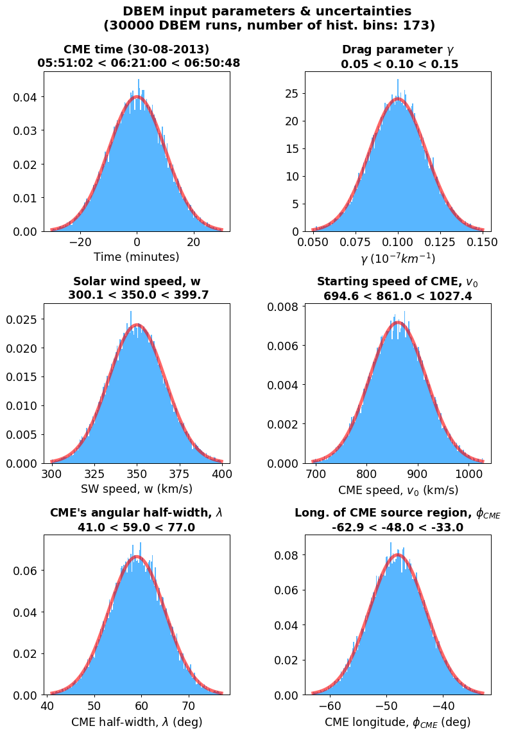
DBEMv2 (version 2) input parameters
Same engine (software) as DBEMv1 with synthetic measurements, however different method is used for input uncertainties
For all 6 input parameters (T, v, φ, λ, w, ɣ) random values are generated in a range input ± uncertainty (3 σ) following a normal (Gaussian) distribution
Advantages:
  input distributions are better represented than with DBEMv1
  converges to stable results much faster than method with syn. measurements
  allows lower number of DBM runs - faster
  user can choose the exact number of DBEM runs
Disadvantages:
  due to random input, it produces every time slightly different results - differences converge with increasing nr. of runs (differences are negligible at >10 000 runs)
Notes:
- 1 -
Disadvantages of DBEMv1 with synthetic measurements (where synthetic measurements are generated for all 6 parameters uncertainties):
- number of synthetic measurements (m) influences significantly the results - especially hit/miss ratio (sometimes by factor 2-3x)
- with small number of synthetic measurements (m<=7) normal distribution is not properly represented and results are very much biased toward the uncertainty end values
- needs a large number of calculations to obtain the stable results (> 100 000) -> long calculation time
Advantages:
- produces always exactly the same results with the same input parameters
- 2 -
DBEMv2 uses exactly the came code as DBEMv1 with synthetic measurements except the part that prepares the input parameters for DBEM. Much faster, simpler and with less code than in the case of DBEMv1.
DBEMv2 assumes that all input parameters ± uncertainties are following the normal (Gussian) distribution. Uncertainty is defined as 3 standard deviations (σ) – range where 99.7% of measurements are found
Note: the same event (30 Aug 2013) is selected for comparison with DBEM with synthetic measurements

Slide 14
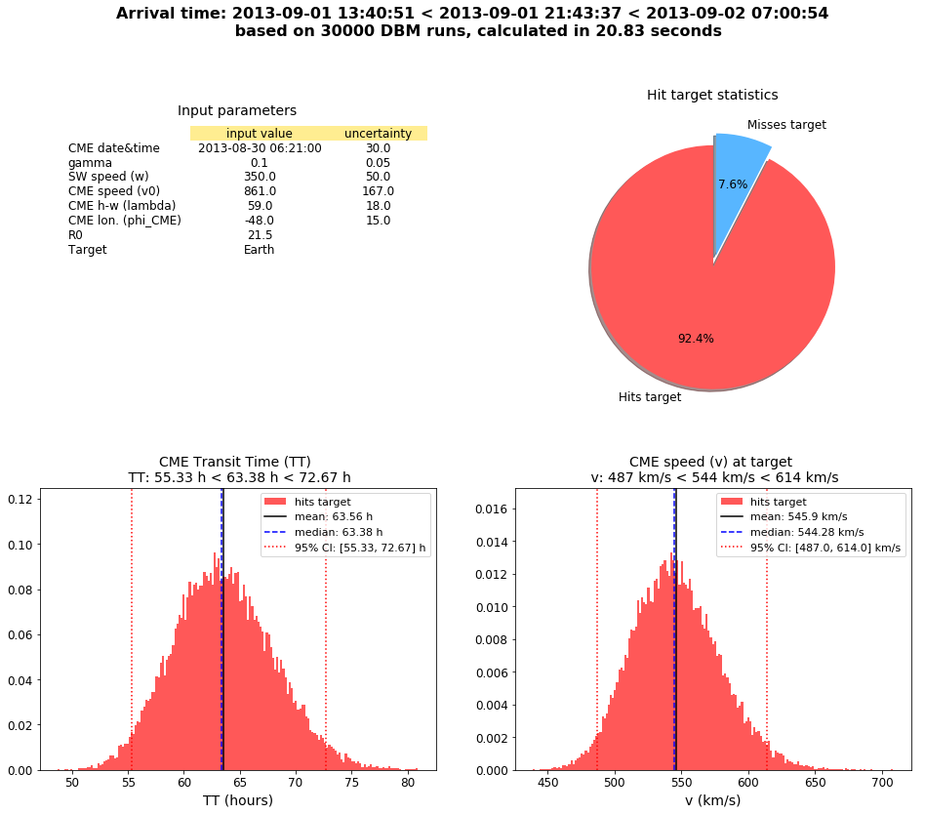
DBEMv2 results
More accurate hit/miss ratio due to better representation of normal distribution in uncertainty range
Provides statistics (mean, min, max, StDev, CI) for all calculated parameters
User can download all results in a zip file
Integrated in ESA SSA portal as operational forecasting tool in the frame of the ESA Expert Service Group for Solar & Heliospheric Weather
swe.ssa.esa.int/heliospheric-weather
Notes:
- 1 -
Due to the random input, DBEMv2 will produce every time slightly different results with the same set of input parameters. This is more pronounced by lower number of DBM runs. However, DBEMv2 converges very well already with n=1000 DBM runs and calculation time less than 1 sec. Comparison (DBEMv2) of n=1000 and n=100 000 for the same set of input parameters showed that hit/miss ratio difference is <2%, median values <0.2%, confidence intervals <0.4% and standard deviation <2%.
- 2 -
Tests with the exactly same input parameters and number of runs, n showed that the variation in DBEM results is small or neglible if n>1000 runs. Hit/miss is absolutely stable already at n=1000, median TT values are up to 10min, impact speed few km/s, and CI are slightly higher than median but also in range of 30min and 10 km/s.

Slide 15
Conclusions
Very fast (up to 1000 runs per sec), reliable and simple model
Suited for a fast real-time space-weather forecasting
Comparisons with numerical MHD models (ENLIL) show good accuracy of DBM at very low computational cost
DBM performs better during the solar minimum than in the solar maximum, due to the complex heliospheric environment (eg. CME-CME interaction)
DBEM can provide important information such as confidence intervals of CME arrival time and impact speed related to the input errors (observations)

Slide 16
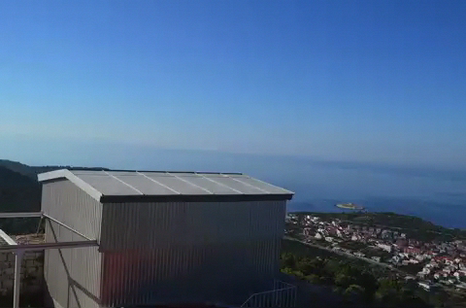
Thank you for your attention
We acknowledge the ESA Space Situational Awareness Programme's network of space weather service development activities, supported under ESA contract number 4000113183/15/D/MRP.

Slide 17
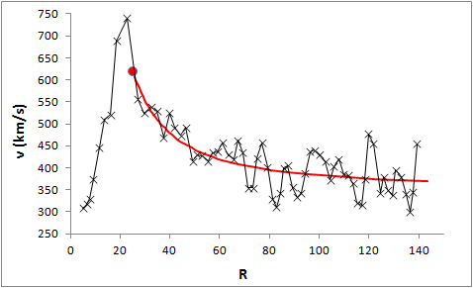
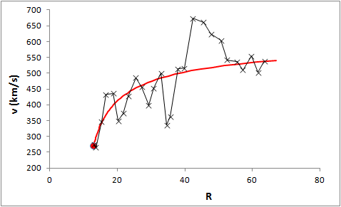
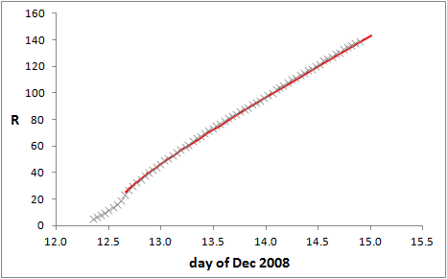
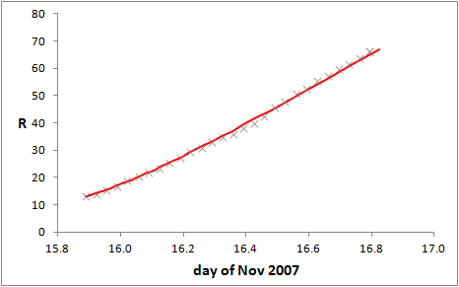
DBM and observations
Examples of ICME kinematics
Fast ICME
12 December 2008
γ = 2.0×10⁻⁷ km⁻¹
w = 350 km/s
Slow ICME
15 November 2007
γ = 1.6×10⁻⁷ km⁻¹
w = 600 km/s
measurements
DBM
Vršnak et al., 2013

Slide 18
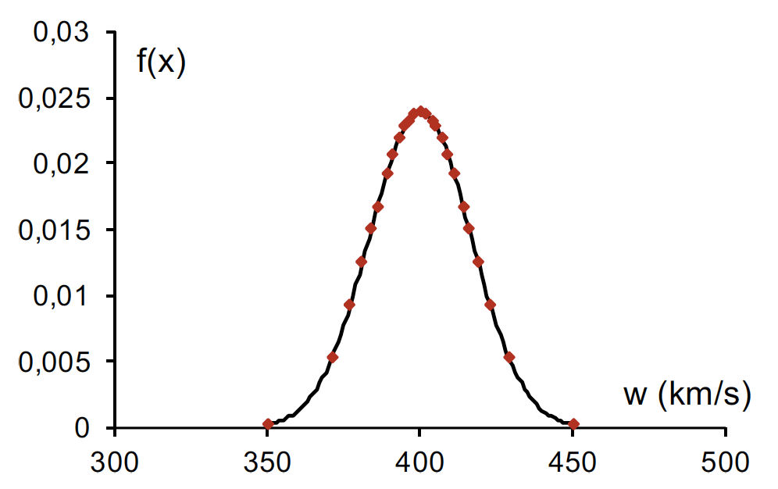
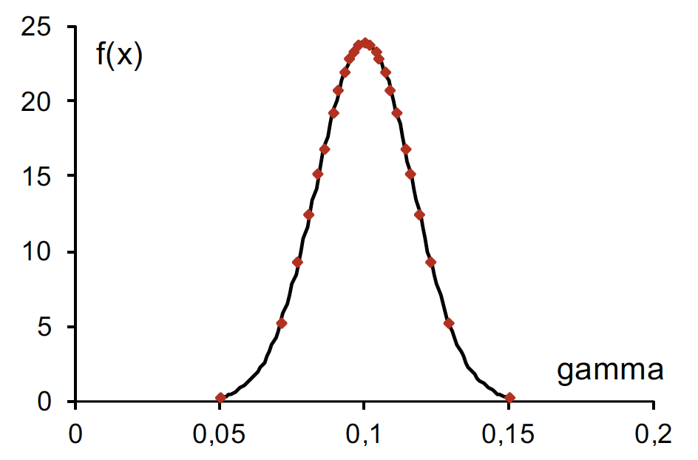
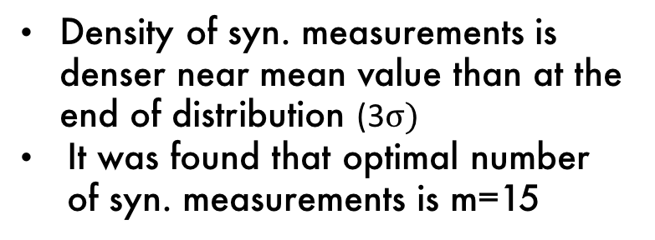
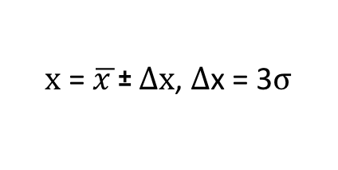
Create m synthetic measurements based on the known error (CI) for each parameter
For each input parameter can be generated m synthetic measurements in a range determined by standard deviation
Assumption: parameters follow a normal distribution
w = (400 ± 50) kms⁻¹
$$\text{x}\text{ = }\overline{x }\text{±} ∆x\text{, }∆\text{x}\text{ = 3}σ$$
γ = (0.1 ± 0.05) 10⁻⁷ km⁻¹
Density of syn. measurements is denser near mean value than at the end of distribution ($\text{3}σ)$
It was found that optimal number of syn. measurements is m=15

Slide 19
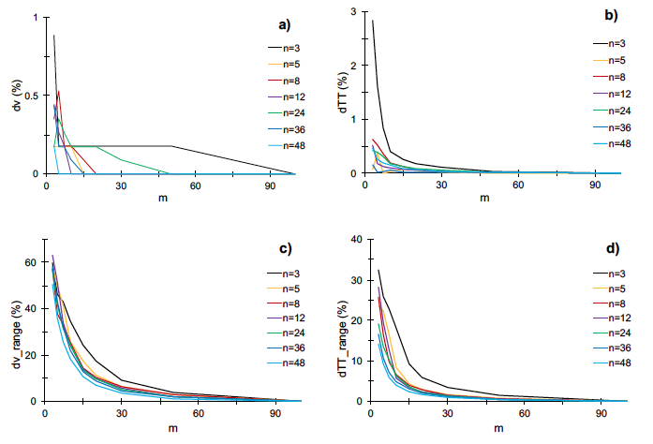
Optimal number of synthetic measurements (m)
For m synthetic measurements of solar wind speed (w) and γ parameter
Optimal for m = 15
n - number of ensemble members (different measurements)

Slide 20
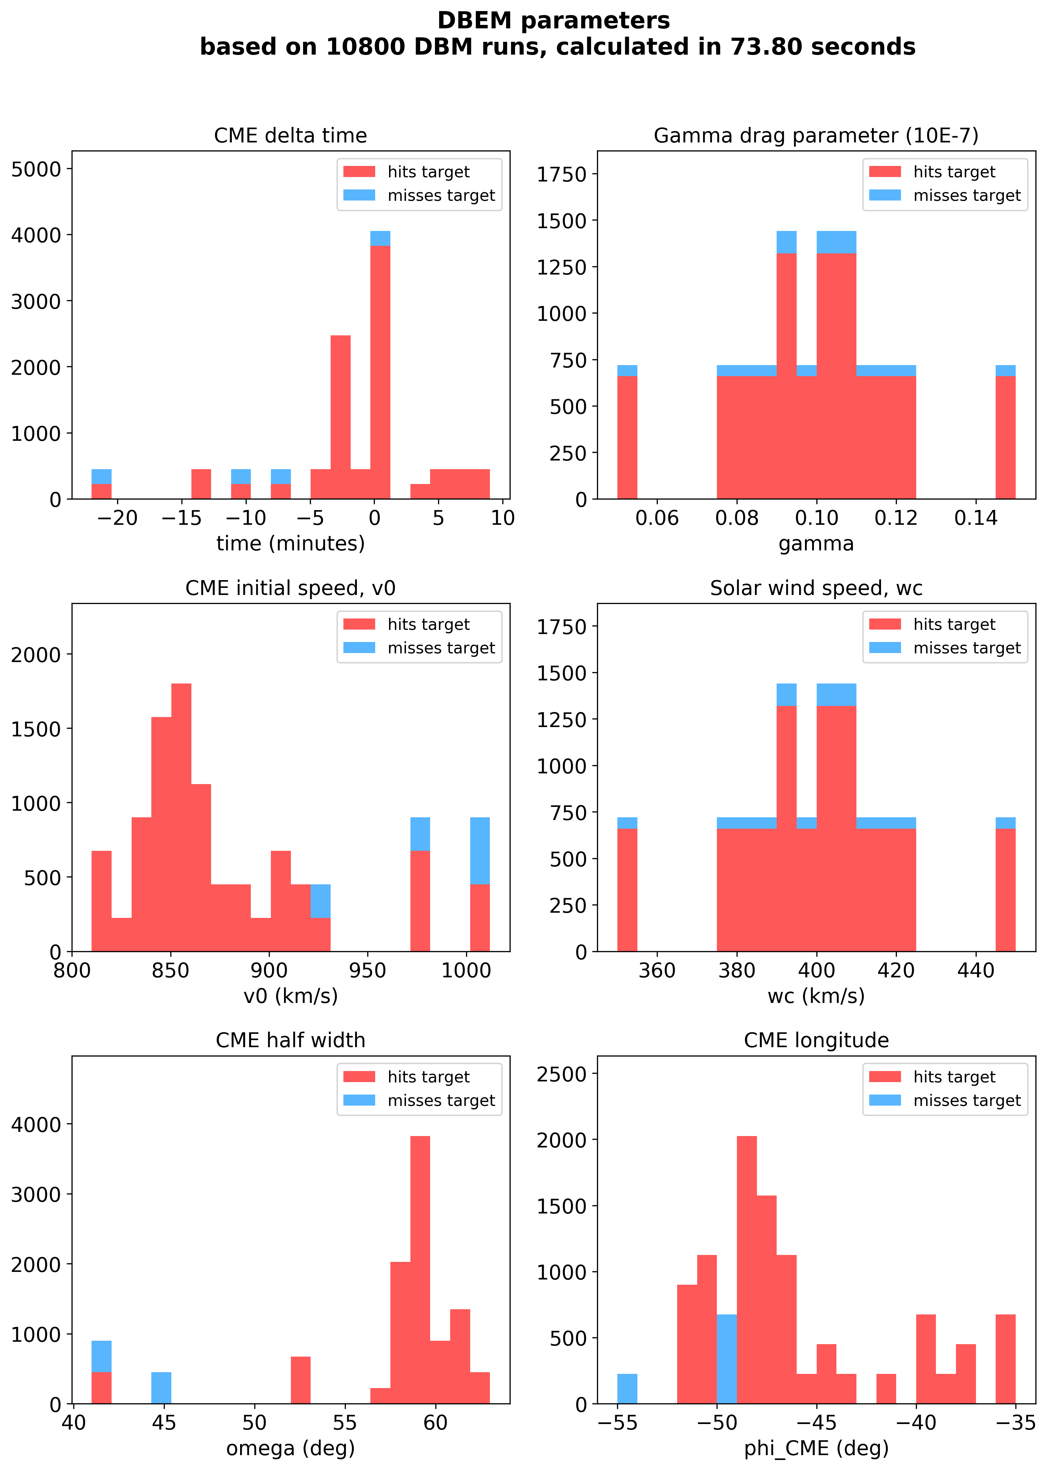
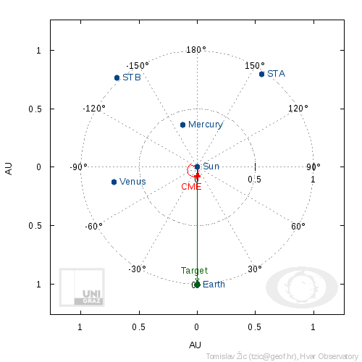
Example of DBEM results
ICME on 30 August 2013
Results of DBEM can be used to investigate which input parameters are responsible for certain results (eg. criteria: hits/misses target)
DBM CME geometry

Slide 21
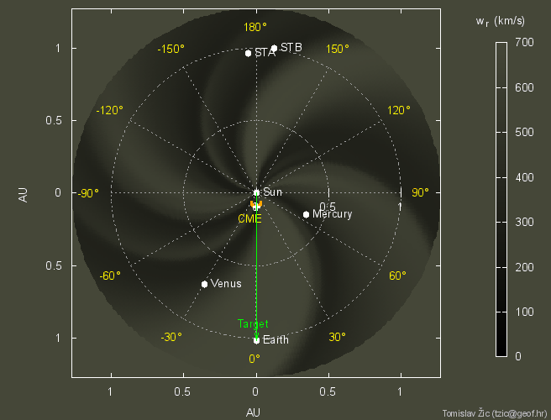
Further DBEM developments

