Slide 1
The catalogue of solar failed eruptions
Mrozek, T.^{1,2}, Gronkiewicz, D.³, Kołomański¹, S., Stęślicki, M.²
¹Astronomical Institute, University of Wrocław
²Solar Physics Division, Space Research Centre PAS
³Nicolaus Copernicus Astronomical Center PAS

Slide 2
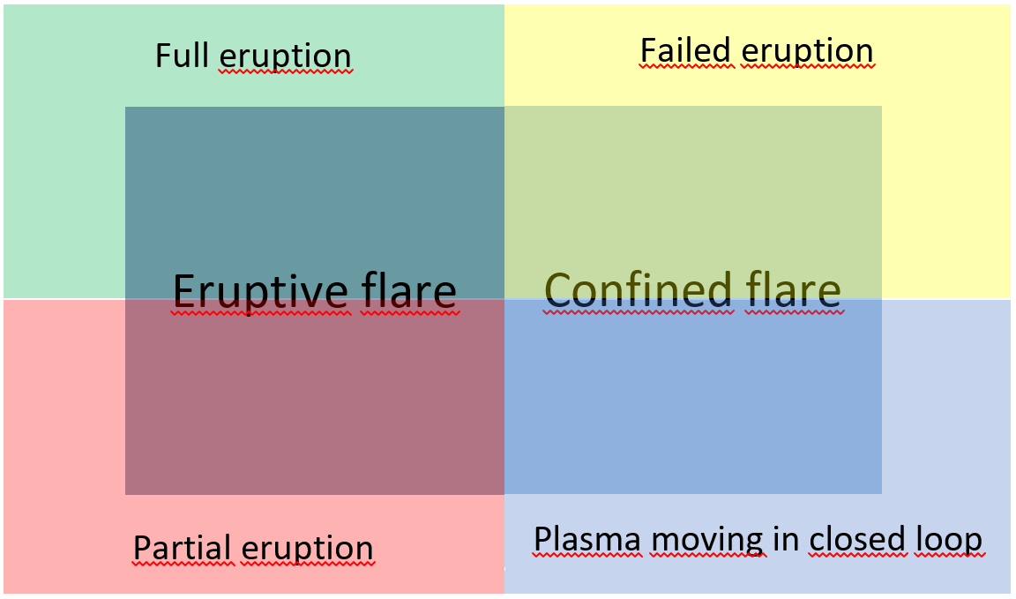
What is a failed eruption?
Gilbert, H. R., Alexander, D., & Liu, R. 2007, Sol. Phys., 245, 287:
Full - most (≥ 90%) of filament mass and magnetic structure is erupted.
Partial: - class A – the eruption of the entire magnetic structure with small amount
or even no mass. - class B – the partial eruption of magnetic structure with some or none mass.
3. Failed - neither of mass nor magnetic structure escapes from the Sun. (No CME) – eruption stops after initial acceleration.

Slide 3
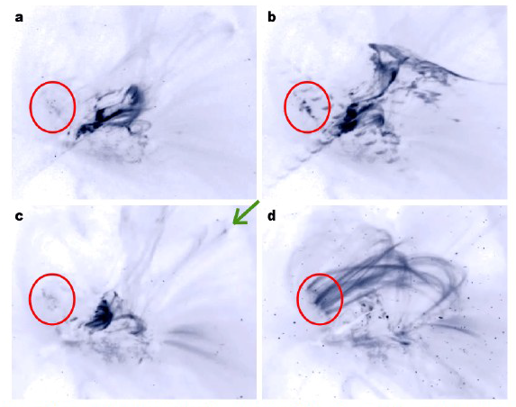
Why failed eruptions?
Failed eruptions are not Earth-affecting, but they might help us to define boundary conditions for CME occurence.
Which mechanism(s) is(are) responsible for stopping eruptions?
Interaction between magnetic structures
Particle acceleration in interaction region
AR12192, flare-rich and CME-poor
Sun, X., et al. 2015, ApJ 804, L28
Thalmann, J.K., et al. 2015, ApJ 801, L23
Mrozek, T. 2011, SolPhys 270, 191

Slide 4
The aim
The aim is to analyse hundreds of failed eruptions. We do not focus on strong events only, but we want to have a broad overview of phenomena.
SDO/AIA:
4 telescopes
4096 by 4096 full-disk images (0.6 arcsec/pixel)
12 s cadence
1.5 TB of data/day – basic problem for downloading and analysing data
Our choice:
Synoptic – Lev.1.5 compressed to 1024x1024, 2 min. cadence,
1 MB/image
Two steps have been taken:
To construct method for automatic search for eruptive/moving features on the basis of SDO/AIA observations.
To classify found events and to built a catalogue.

Slide 5
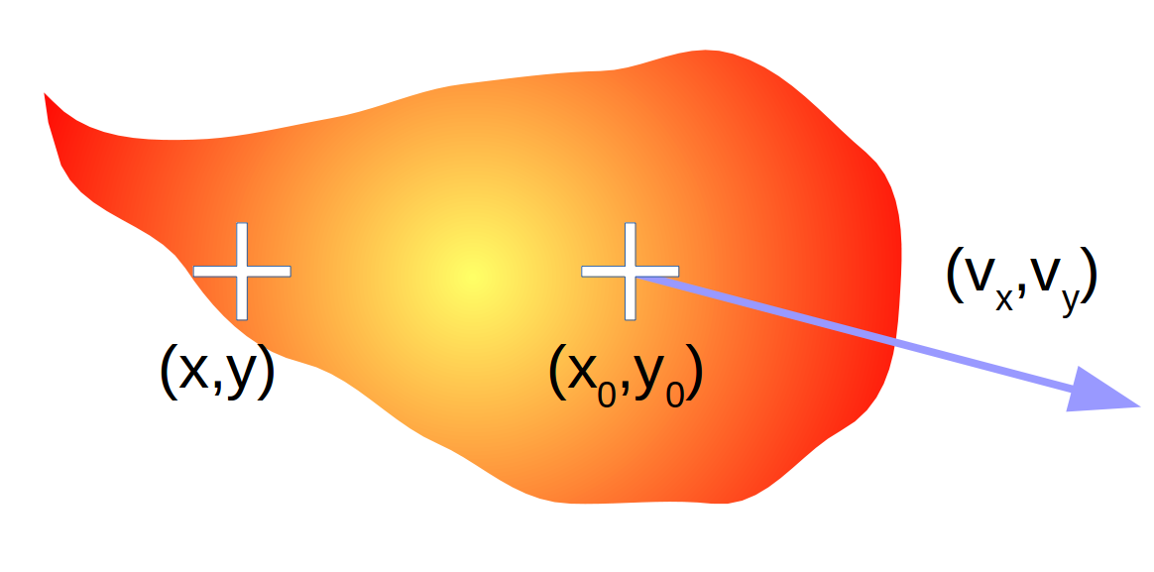
Searching for moving structures
Moving feature with initial brightness distribution R(x,y).
Its brightness is modulated with time by ϕ(t).
Starting position (x₀,y₀) is moving with velocity (v_{x},v_{y}). Then brightness may be represented with:
$$I\left(x,y,t\right)=R\left(x−x_{0,}y−y_{0}\right)φ\left(t\right)=I_{0}\left(x,y\right)φ\left(t\right)$$
Differential image:
$$I_{t}=\frac{dI\left(x,y,t\right)}{dt}=−φ\left(t\right)⋅\left(\vec{v}∘∇I_{0}\right)+I_{0}\frac{dφ\left(t\right)}{dt}$$
change of position
change of brightness

Slide 6
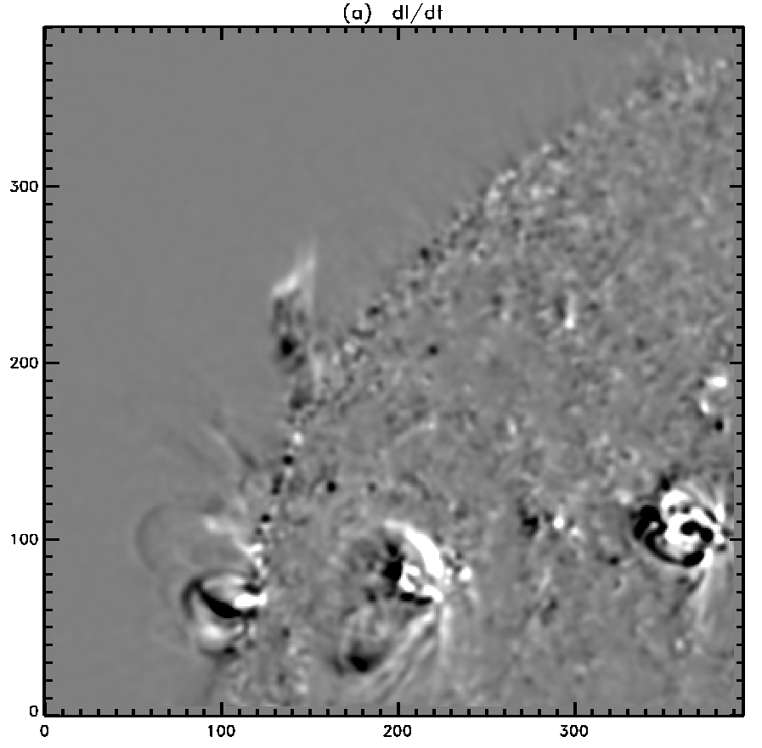
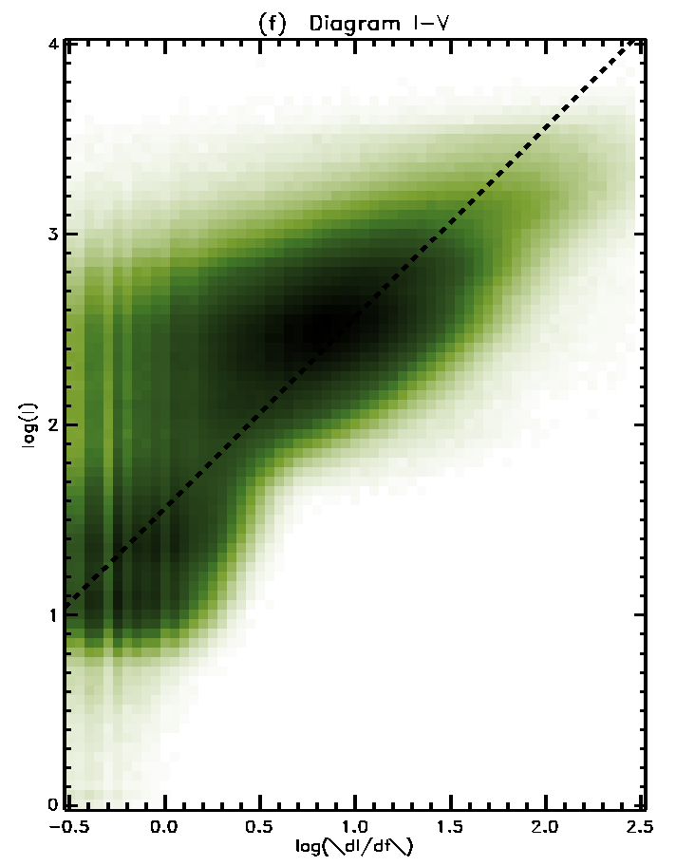
Searching for moving structures
$$\frac{dI}{dt}$$
Intensity-Variability diagram
Most variable are brightest features – using derivative only will lead to detection of all bright features (loops, active regions, flares) which is not our aim.

Slide 7
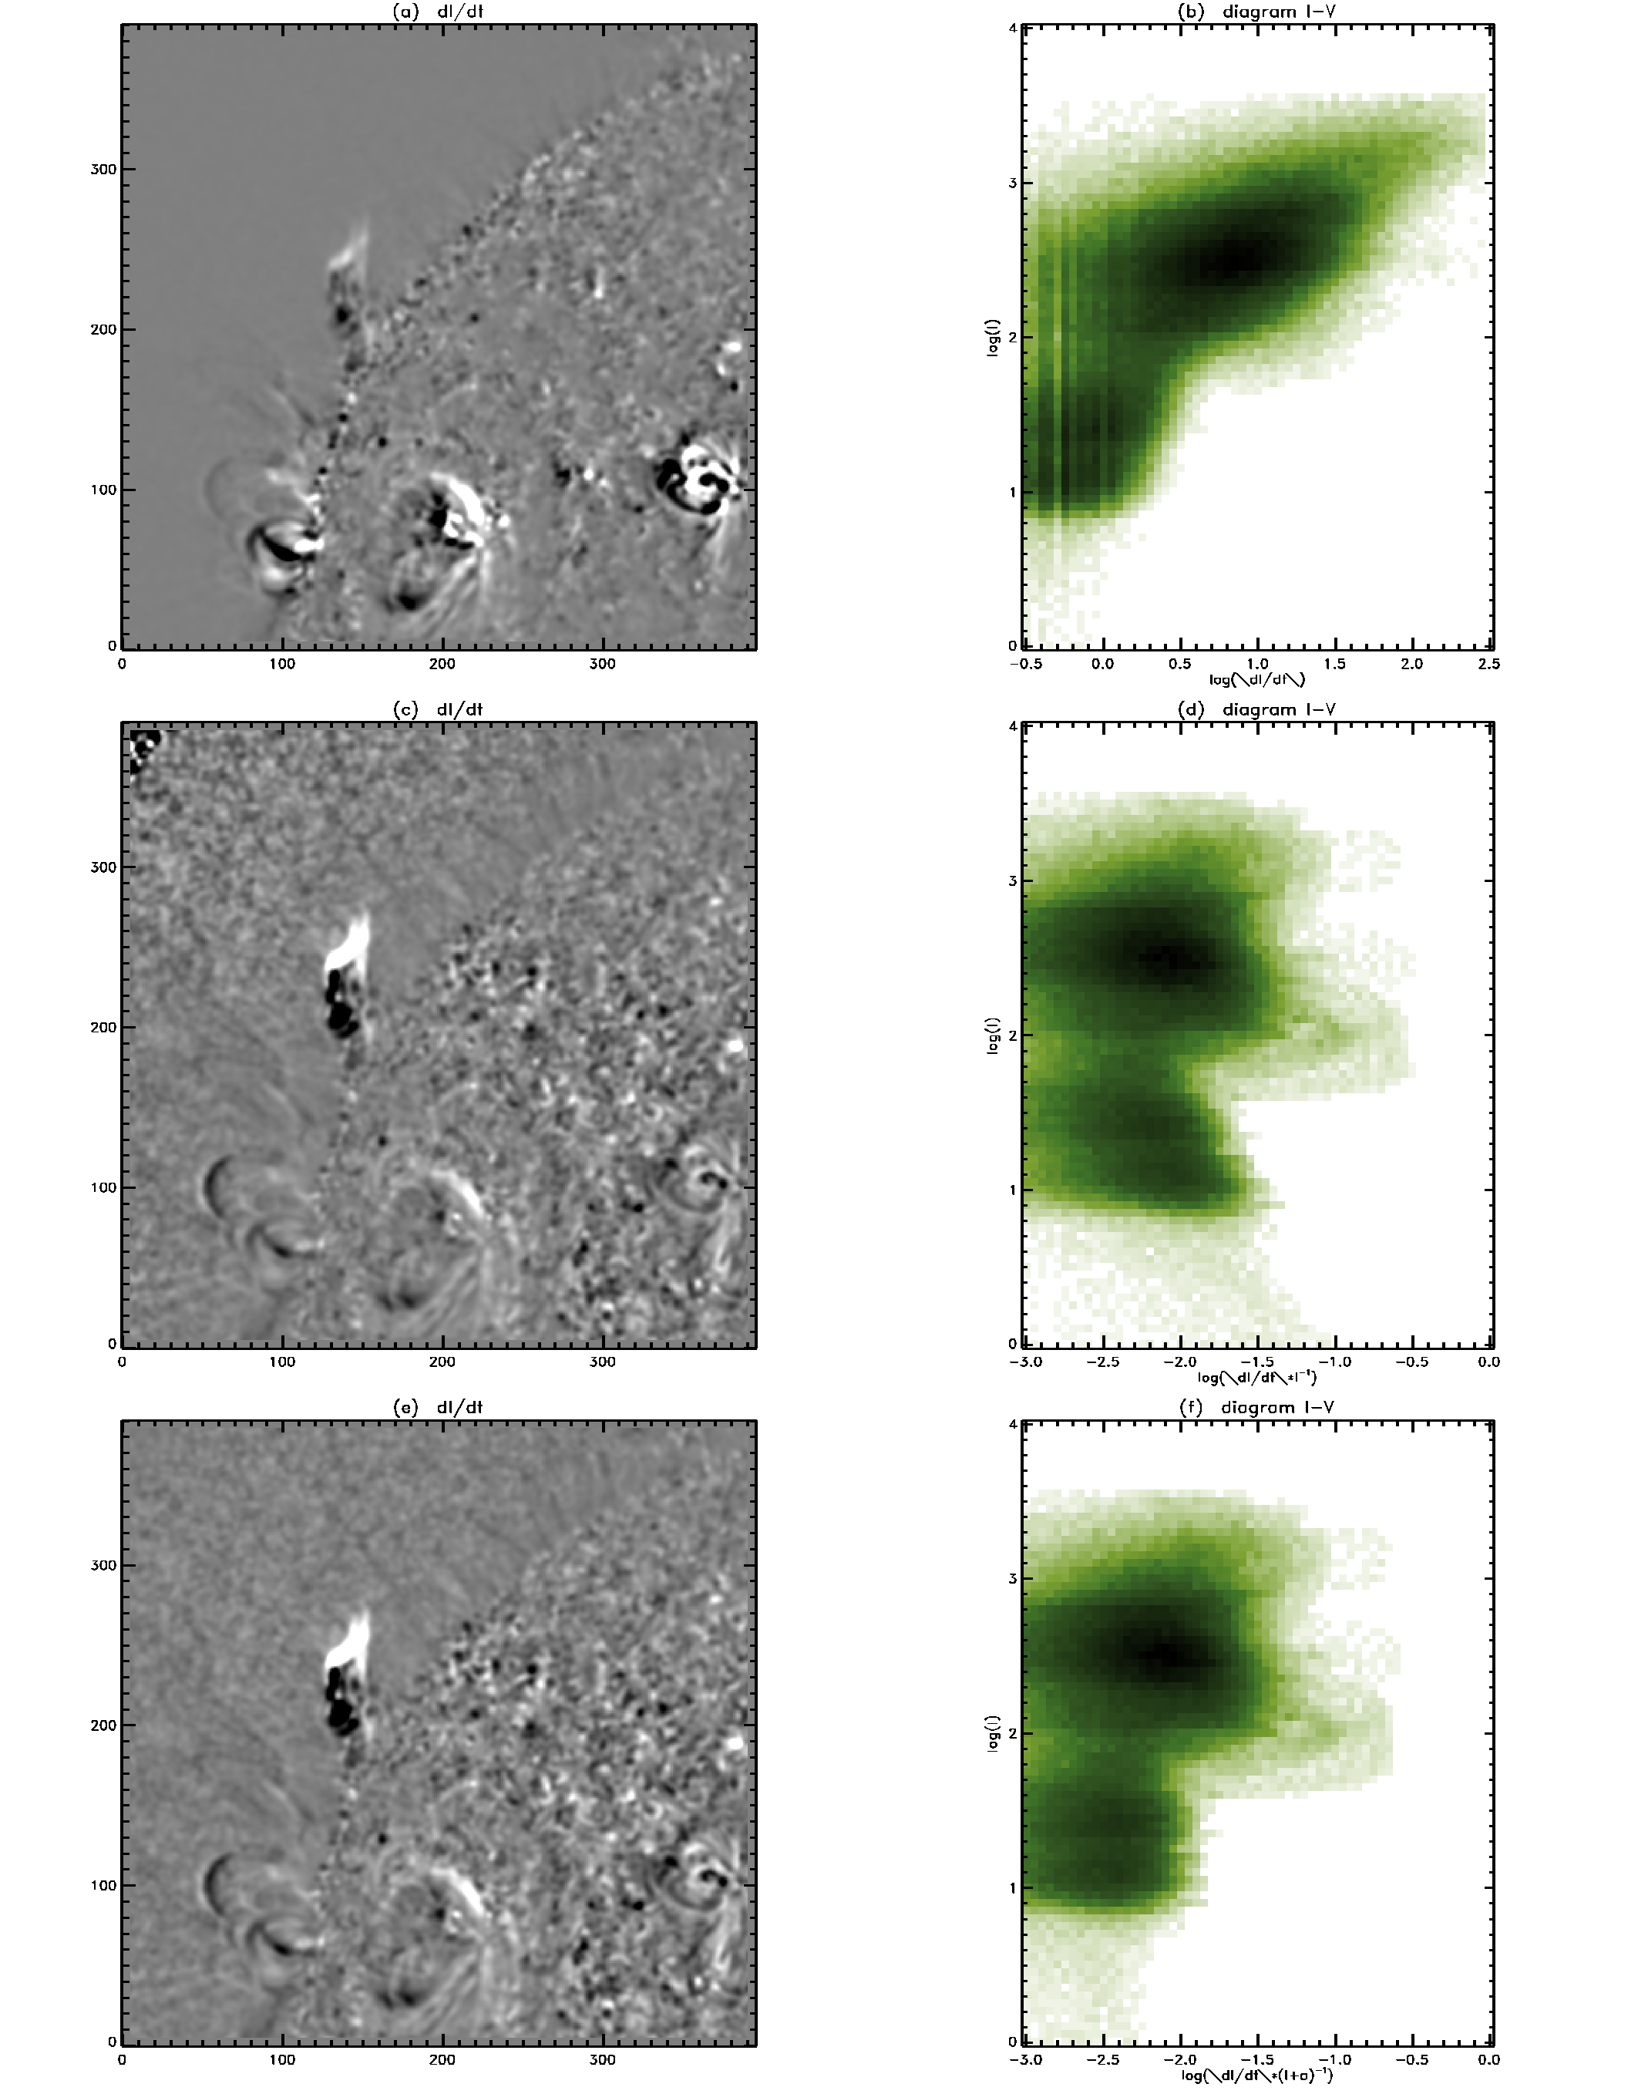
Searching for moving structures
$$I_{t}$$
$$I_{t}^{norm}=\frac{I_{t}}{I+α}=J_{t}$$
$$I_{tt}^{norm}=\frac{I_{tt}}{I+α}=J_{tt}+J_{t}^{2}$$
$$\frac{I_{t}}{I}$$
For next step we constructed (arbitrarily) a variablility index which was used to separate slow- and fast-changing structures:
$$\frac{I_{t}}{I+α}$$
$$V=\sqrt{{J_{t}}^{2}+\frac{1}{4}{J_{tt}}^{2}}$$

Slide 8
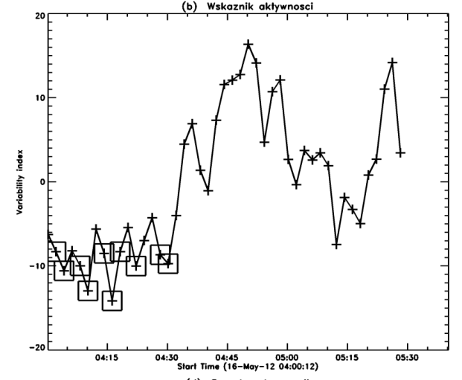
Searching for moving structures
On the basis of measured state of each pixel $\hat{x}=(I,V)$ we want to classify it to one of classes E (eruptive) or Q (quiet).
Let’s assume that $P(Q)≈1$, and classify pixels as Q or E. Having number of E-pixels we calculate $P\left(Q\right)=1−P\left(E\right)=1−\frac{n_{erupt}}{n_{total}}$ , and run algorithm again with new value of $P(Q)$. Usually, after 3 steps $P(Q)$ had stabilized.
$$V_{mean}\left(t_{k}\right)=\frac{1}{n_{x}n_{y}}\sum_{i=1}^{n_{x}}{\sum_{j=1}^{n_{y}}{V(x_{i},y_{j},t_{k})}}$$
$$I_{mean}\left(t_{k}\right)=\frac{1}{n_{x}n_{y}}\sum_{i=1}^{n_{x}}{\sum_{j=1}^{n_{y}}{I(x_{i},y_{j},t_{k})}}$$
activity index:
$$A\left(t_{i}\right)=\frac{I_{mean}\left(t_{k}\right)−\overline{I_{mean}}}{σ_{I_{mean}}}+w\frac{V_{mean}\left(t_{k}\right)−\overline{V_{mean}}}{σ_{V_{mean}}}$$
activity index
we can estimate $P\left(\hat{x} | Q\right)$ assuming that several images in sequence do not contain eruptions
$$P\left(E | \hat{x}\right)=1−\frac{P(Q)P(\hat{x}|Q)}{P(\hat{x})}$$
probability that pixel of state $\hat{x}=\left(I,V\right)$ belongs to class E
normalized distribution of $\hat{x}=(I,V)$ for entire sequence of images

Slide 9
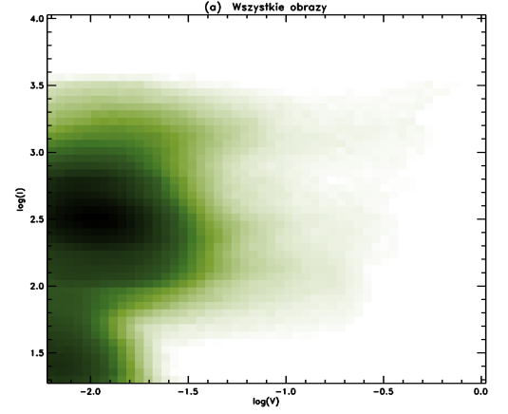
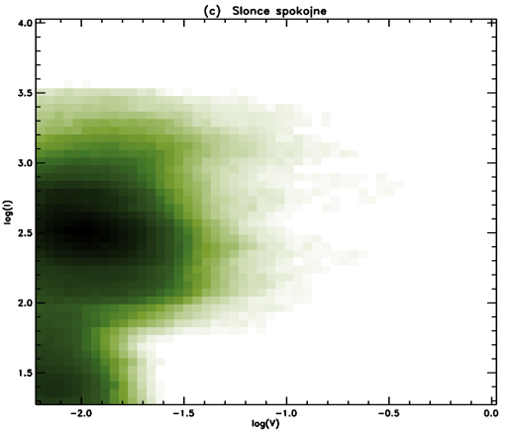
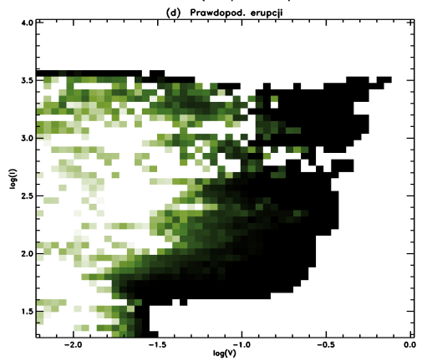
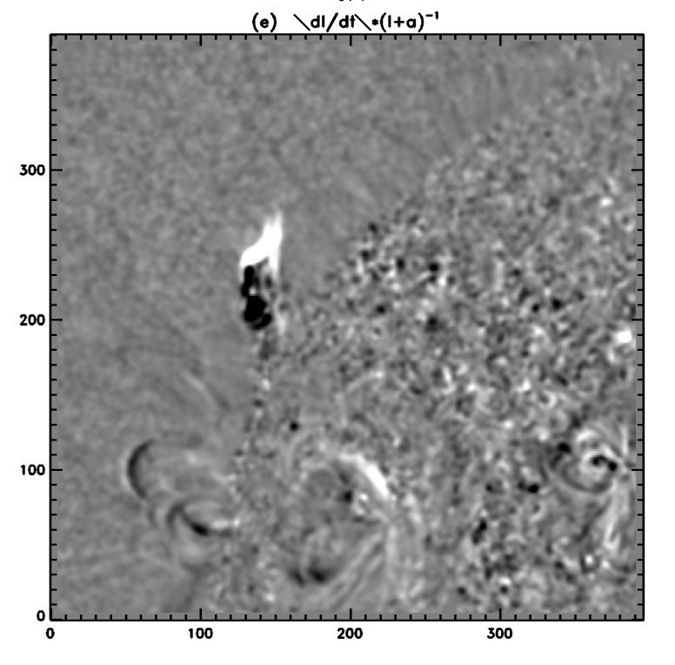
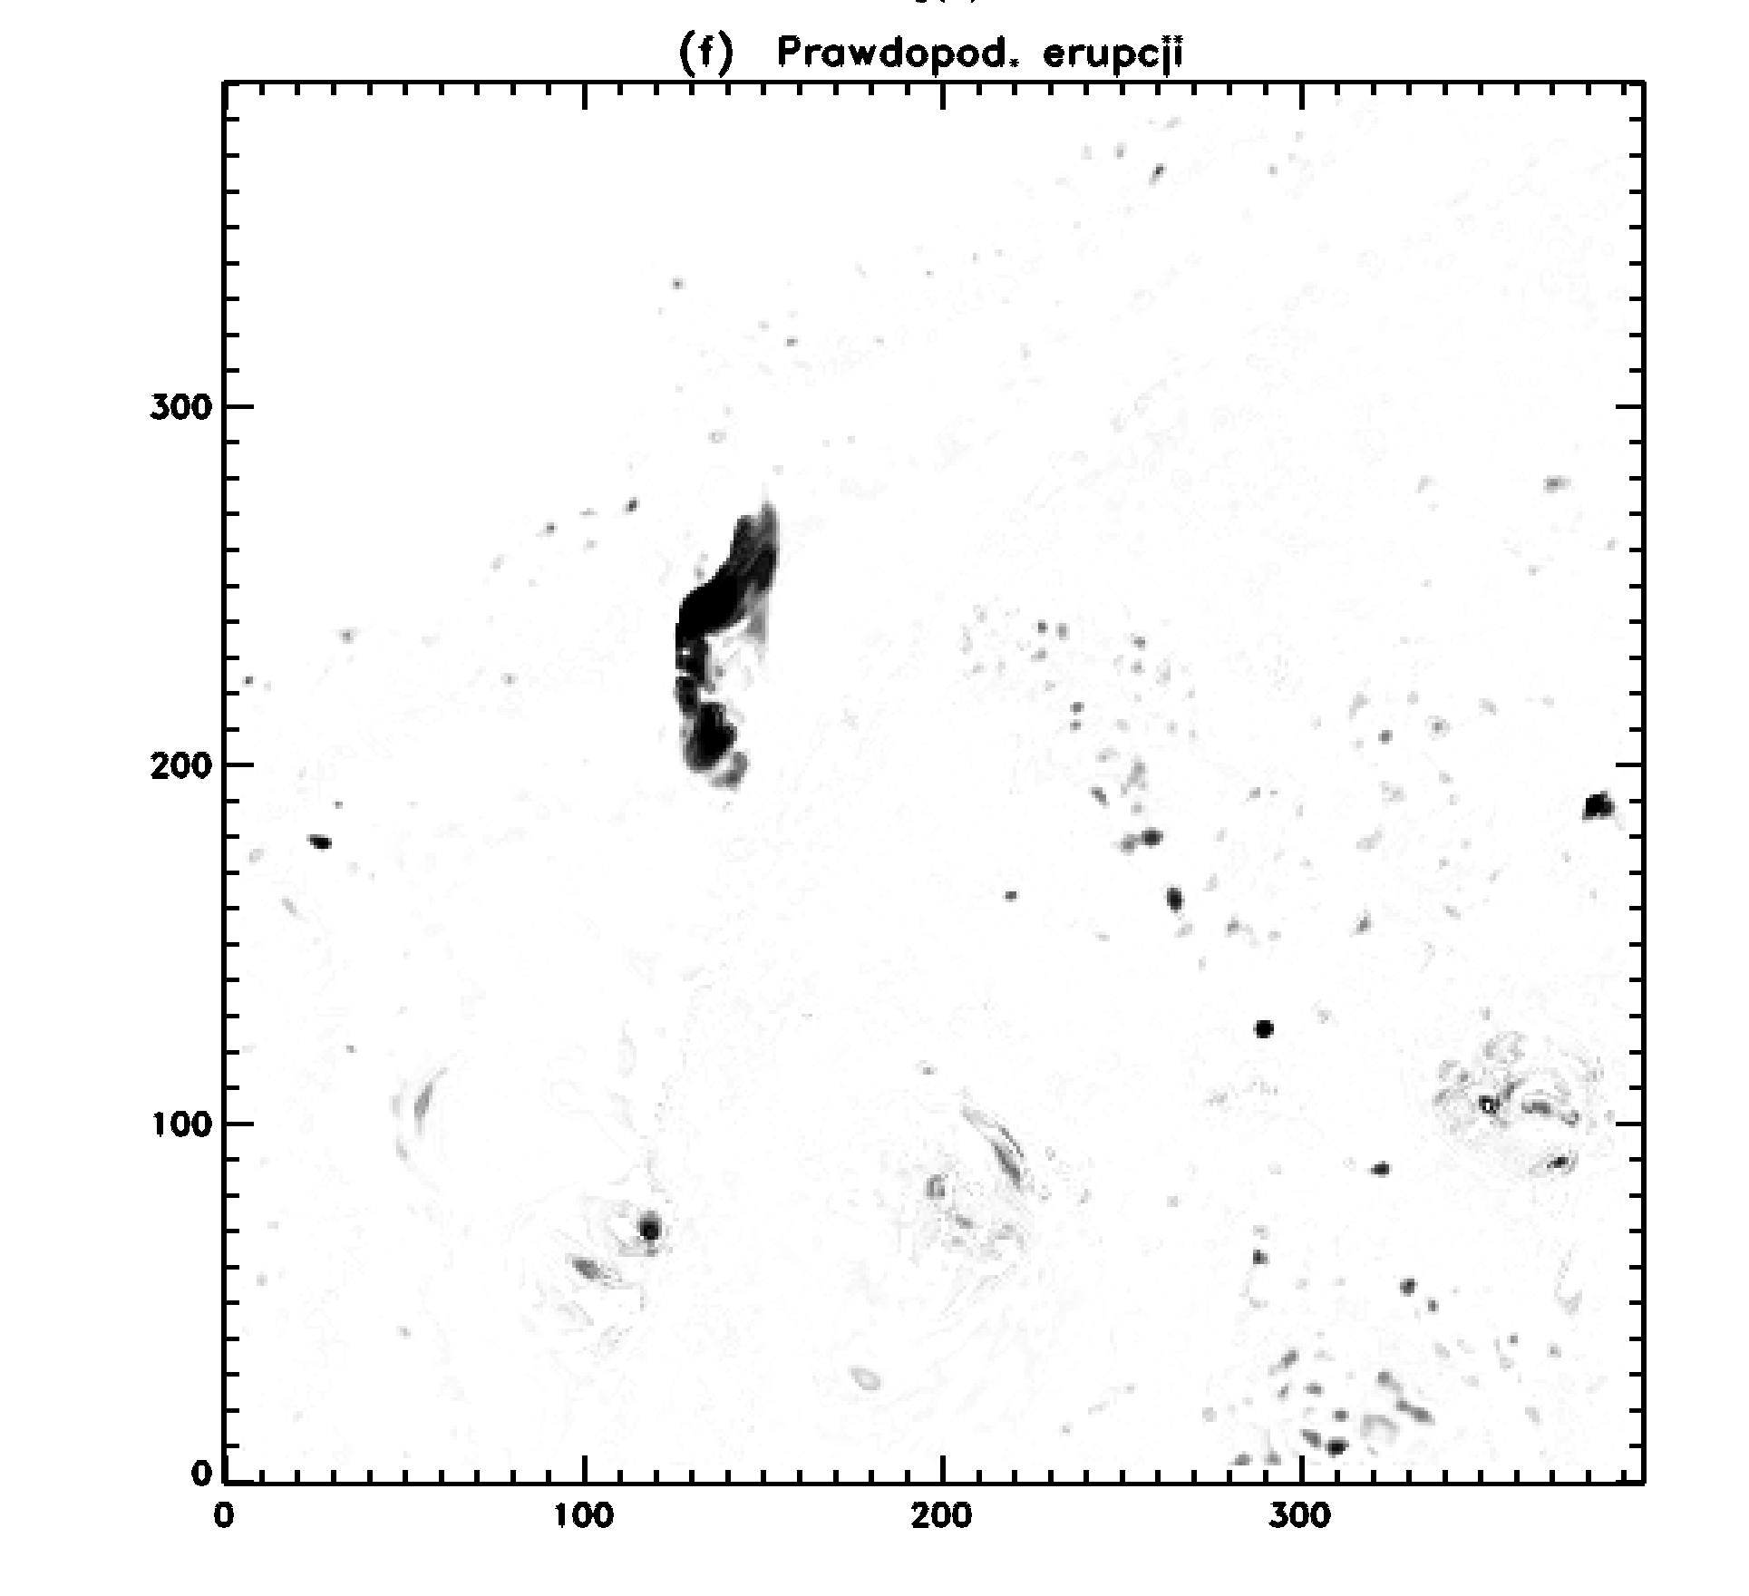
Searching for moving structures
All frames
Activity index
Quiet Sun
$$P\left(E | \hat{x}\right)$$
A
B
C
D
$$\frac{I_{t}}{I+α}$$
probability of eruption
$$A \frac{B}{ } C=D$$

Slide 10
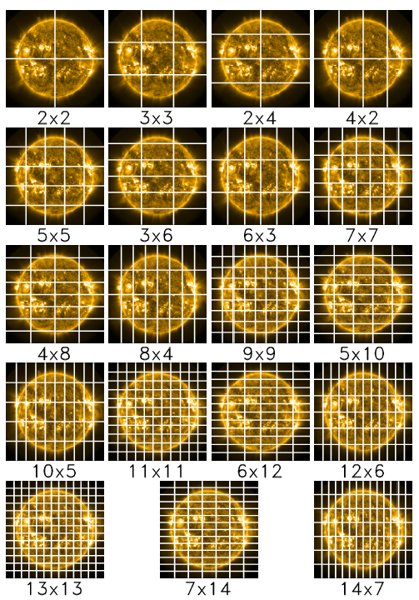
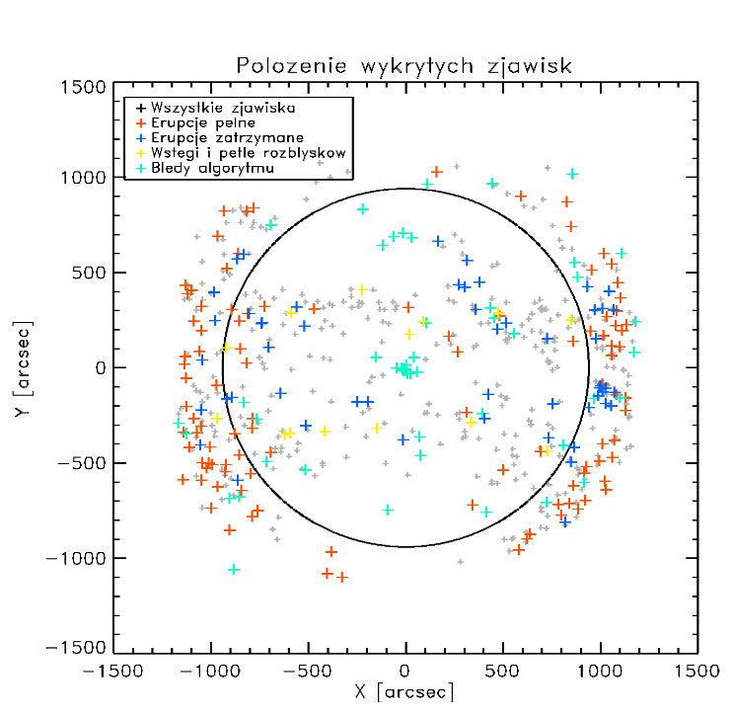
Searching for moving structures
E-pixels were searched (in 3h-long data packs) within frames of various size to avoid edge effects.
Area of eruption was calculated with simplest growth algorithm (slow).
Possible eruption was recognized when selected area:
for each pixel: $P\left(E | \hat{x}\right)>0.35$
was visible on 8 or more consecutive frames
was greater than 600 arcsec² on at least one frame
mean value of brightness was above 30 DN on at least one frame
showed change of centroid position greater than 25 arcsec.
We have foud that our algorithm is slower but more effective than algorithm described by Hurlburt, N. 2015 (arXiv:1504.03395) and Hurlburt, N. & Jaffey, S. 2015 (arXiv:1504.04660)
1 APR 2012 – 1 APR 2013: 1906 moving features have been recognized and classified
Classification of found events was made by user. We did not use authomatic feature recognition (but we tried).
Locations of found events
All events
Full eruptions
Failed eruptions
Flaring loops
Errors

Slide 11
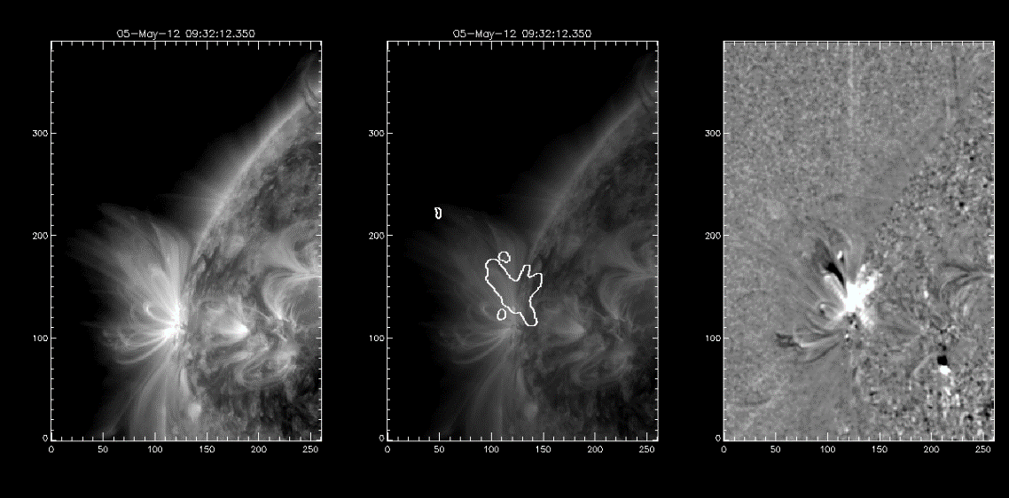
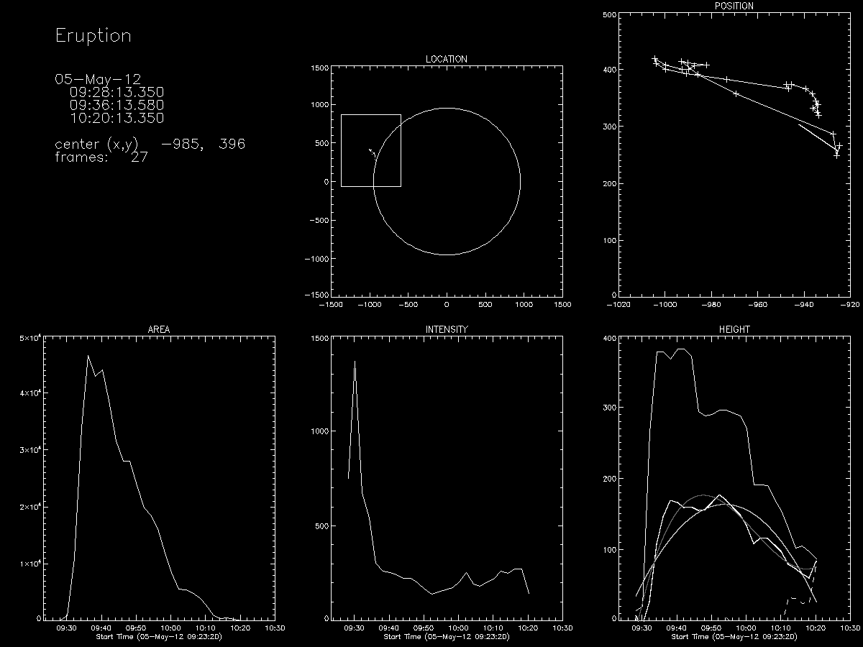
Classification and catalogue structure
found events (1906)
Lev0 (1341)
Lev1 (375)
Lev2 (190)
Found events were divided into three groups:
Level 0: small mass movements, waves, small changes of loops brightness, small scale jets etc.
Level 1: succesful eruptions, interesting events (e.g. oscillating structures)
Level 2: failed eruptions
Basic
Basic+ Extended
Basic data products are
triple plots presenting image, image with overlayed eruptive pixels area, differentia image
eruption start, maximum of the area, and end times, heliocentric coordinates
positions of centroid of moving structure, area and intensity
authomaticaly determined height of eruption front, centroid, and back with second order polynomial fit – the intention was to select authomaticaly structures that were failed eruptions – partial succes
IDL save files with even more parameters will be available

Slide 12
Small/unclassified events (Level 0)

Slide 13
Full/partial eruptions (Level 1)

Slide 14
Failed eruptions (Level 2)

Slide 15
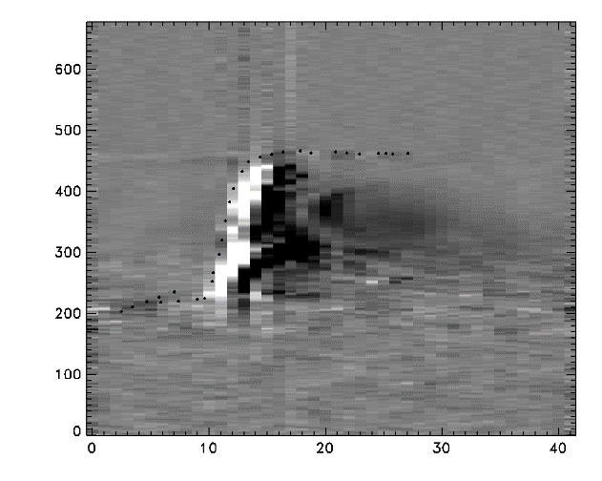
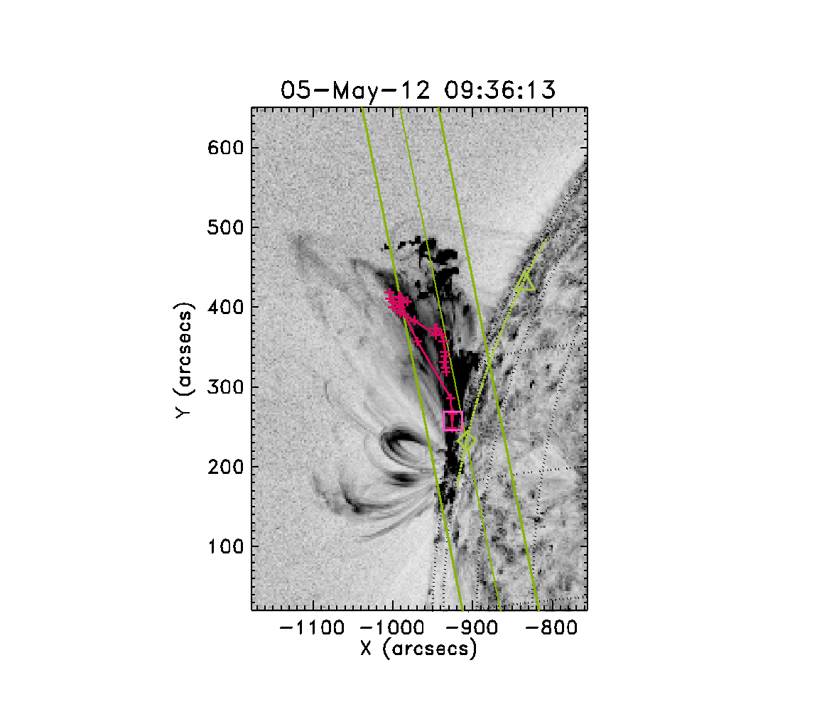
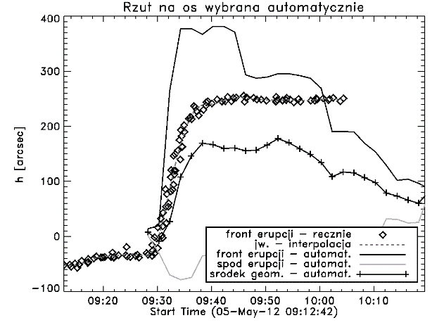
Extended data products (failed eruptions only)
Start 2012/05/05 09:10
Max 2012/05/05 09:36
End 2012/05/05 11:00
Centroid [heliocentric] -925, 257
Inclination[deg] 120
Kinematics h(t), V(t), a(t)
Accompanying flare yes
Accompanying flare class C8.0
RHESSI light curve
AIA movies
FE class 110110001
References No
Remarks
FE classification scheme:
morphology (jet-like, buble-like, other)
flare related (yes/no)
visible interaction with overlying field (yes/no)
sequence of events (yes/no)
inclination
max speed
max height
eruption front (manually)
eruption front (interpolation)
eruption front (automatic)
eruption back (automatic)
eruption centroid (automatic)

Slide 16
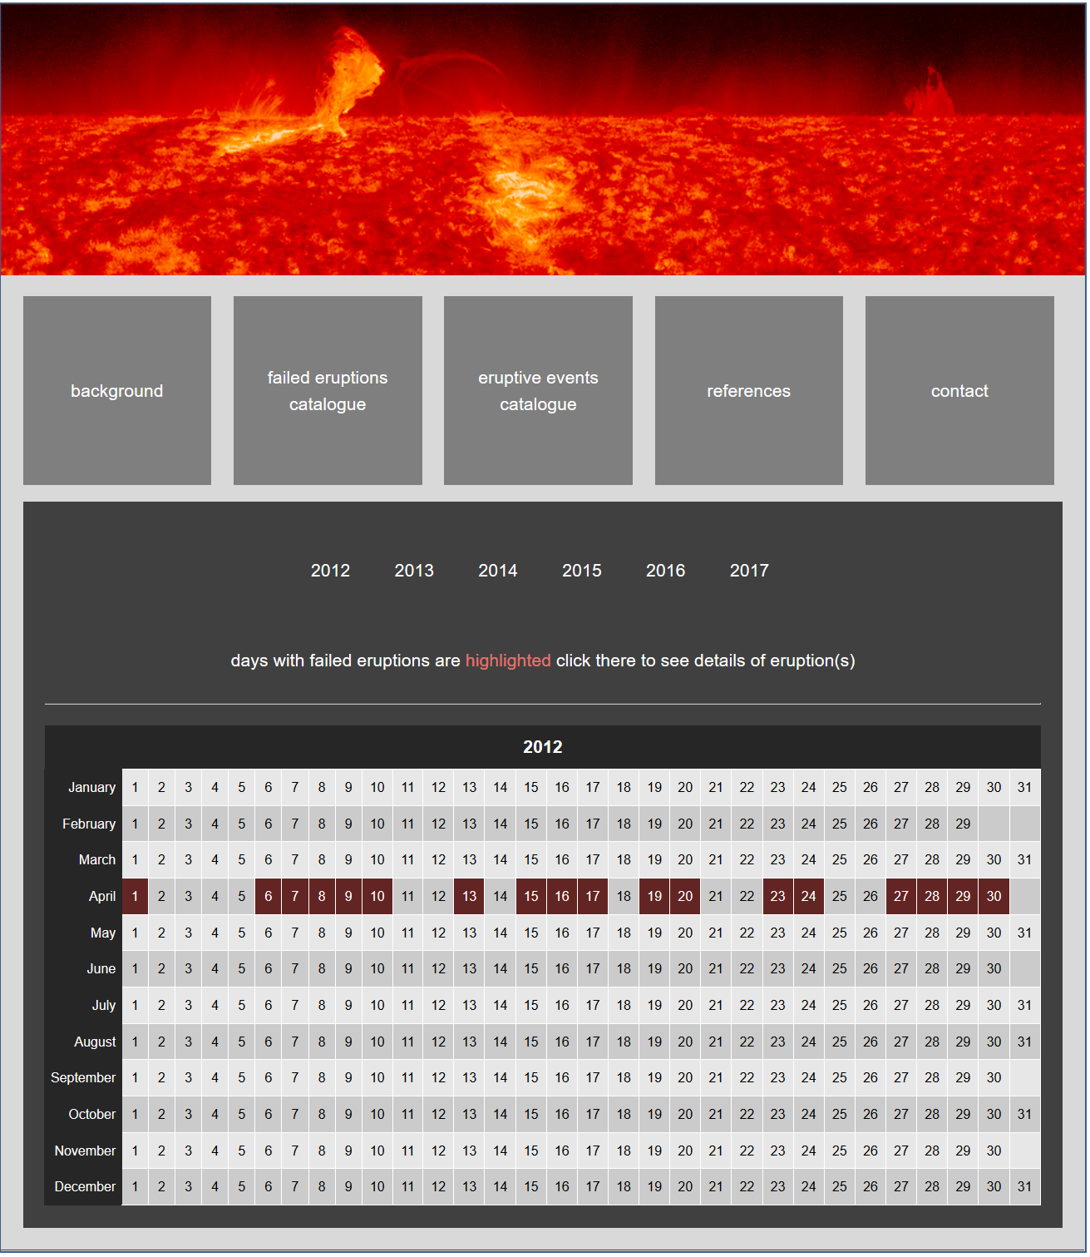
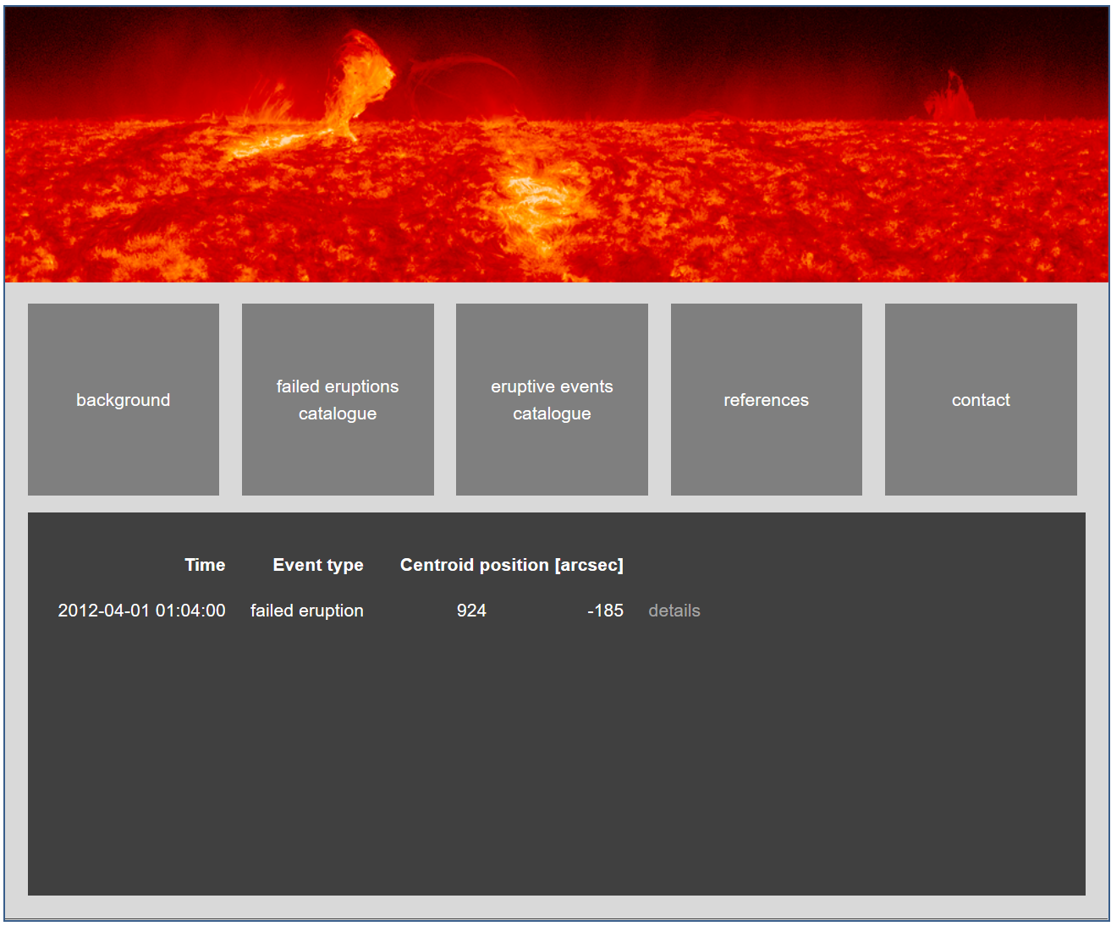
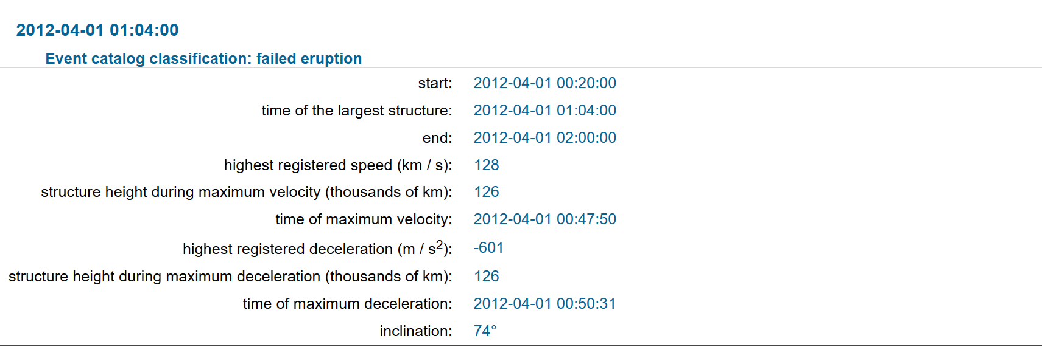
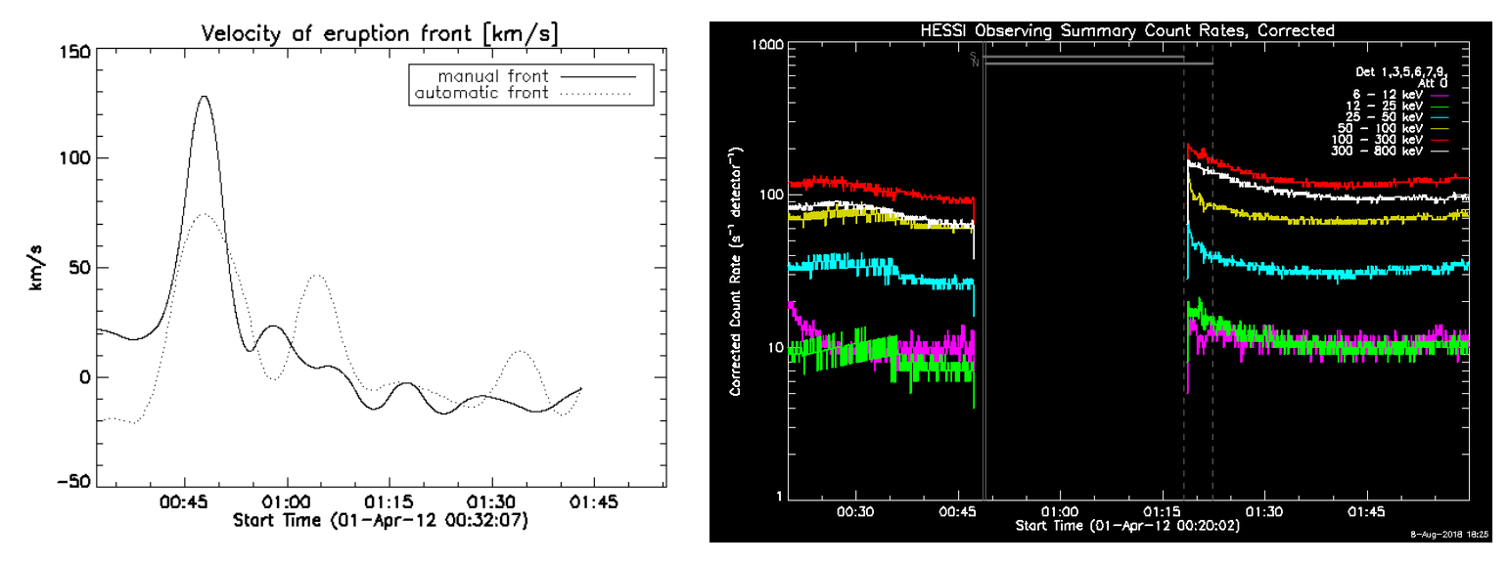
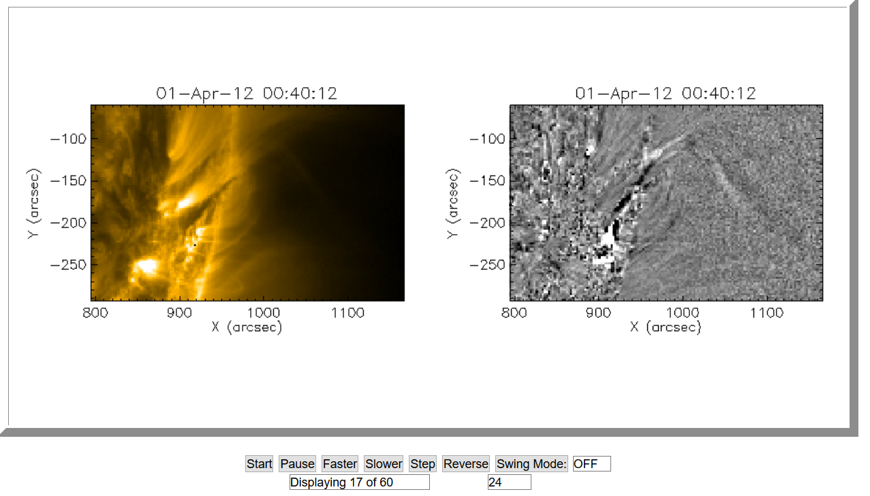
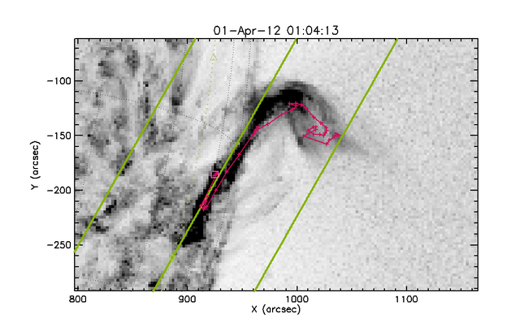
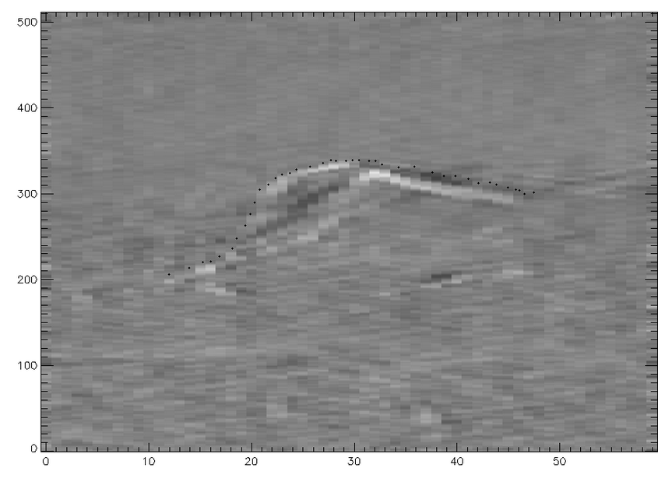
The catalogue (www.eruptivesun.com)

Slide 17
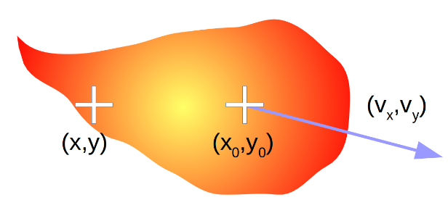
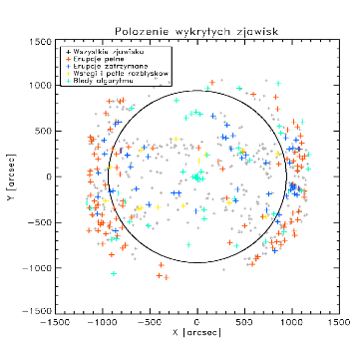
Final remarks
SDO/AIA data base for time period 2012 – 2016 have been searched for eruptive events with an automatic algorithm (~10000 events, ~1000 full eruptions, ~800 failed eruptions). Until the end of 2018 we will look over the entire data base.
Found events (1 APR 2012 – 1 APR 2013 ) have been classified and collected in the catalogue. The failed eruption class is investigated with more details.
Problems:
we have to abandon (restrict?) working with full resolution data (problems with server connection, huge amount of data to download)
a lot of events that need to be classified by hand (all found: 2000+/year, failed eruptions: 200+/year)
The first version of catalogue will be available on September/October 2018 (www.eruptivesun.com)

