Slide 1
Evolution of Coronal Cavities leading to CMEs
Ranadeep Sarkar and Nandita Srivastava
¹ Udaipur Solar Observatory, Physical Research Laboratory, Udaipur, India
In collaboration with
Marilena Mierla², Matt West² and Elke D’Huys²
²Royal Observatory of Belgium, Brussels, Belgium

Slide 2
Outline
Introduction
Motivation of study
Observations of the morphological evolution of a coronal cavity during eruptive phase (SWAP/Proba2 observations)
Pre-eruptive stability condition of the cavity in the context of torus instability
Results

Slide 3
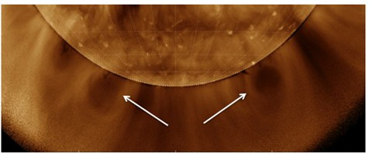
Coronal Cavity
Cavities appear as dark features over the solar limb and are believed to be the density depleted cross-sections of the magnetic flux ropes, where the magnetic field strength attains a much higher value compared to the background corona. Cavities may last for days or even weeks and evolve as the dark core part of the CME during the eruptive phase.
(Low and Hundhausen, 1995; Gibson and Fan, 2006)
PCF observed in Hα by BBSO on July 2002 (right):
White light cavity observed by MLSO/MK4
[Gibson 2017]
EUV Cavity observed from AIA 193 channel
on 29 May 2013
[Karna et al. 2017]

Slide 4
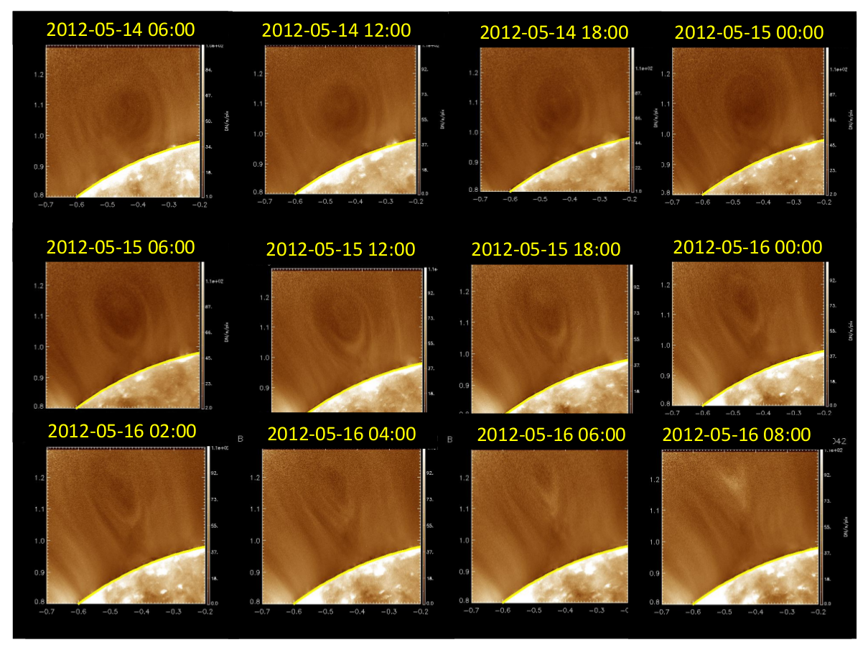
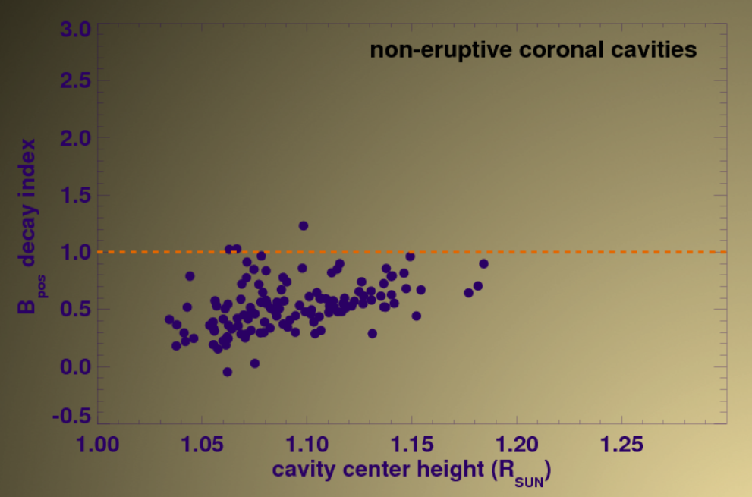
Morphological pre-cursors for cavity eruption:
Cavity morphology can be observed as semi-circular, elliptical or tear-drop shape.
Forland et al. 2013, identified 129 cavities during June 2010 to December 2019 from the data obtained from AIA 193 channel
Of these 129 cavities, 28 % were eruptive.
61% of all the eruptive cavities have been found to be in tear-drop shape before the eruption.
Stability study of coronal cavities:
Decay index values for the non-eruptive cavities at the height of its centroid mostly lie below the 1.0 value. (de Toma & Gibson 2018)

Slide 5
Motivation
Continuous tracking of an eruptive coronal cavity starting from its EUV counterpart in lower corona up to the white-light cavity morphology seen in LASCO C2/C3 field-of-view has not been
studied earlier due to the observational gap between 1.3 to 2 solar radii. The extended field-of-view of SWAP/PROBA2 EUV Imager fills the observational gap between 1 to 2 R_{S.} Therefore, it enables us to track the complete morphological evolution of the coronal cavity in order to address the following key problems regarding the initiation mechanism of CMEs at lower corona
The initiation height of the CME
Morphological pre-cursor of CME initiation
Correspondence between the EUV cavities seen in lower corona and the white light cavities seen during the CME eruption
Self-similar expansion of CMEs: Starting from the initiation height whether the CMEs exhibit self-similar expansion or not. If not, then what is the critical height above which it shows the self-similar expansion.
Role of ideal MHD instabilities to trigger the CME eruption

Slide 6
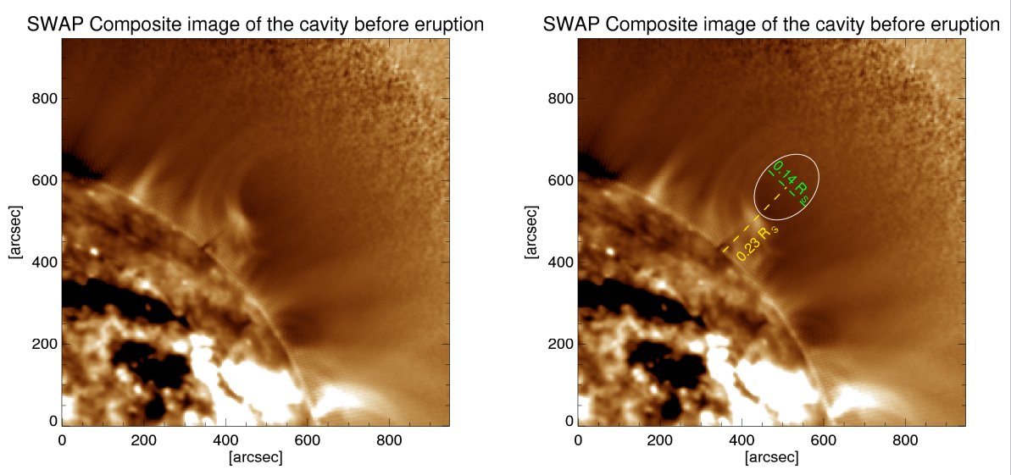
13 June 2010: Cavity morphology as seen in SWAP before eruption
Eruption time – around 06:30 UT on 13 June, 2010
Location - North-West solar-limb
Axis height of the cavity is near about 1.23 solar radii prior to eruption

Slide 7
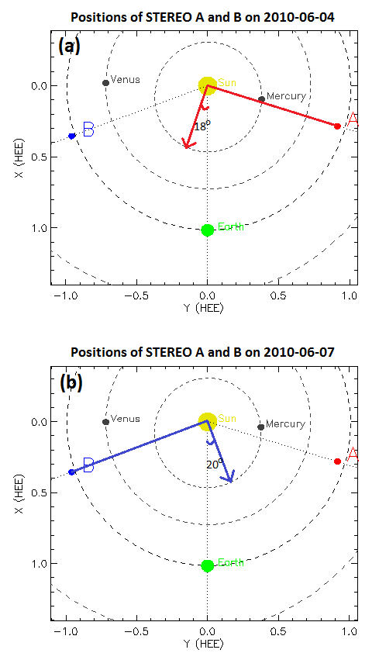
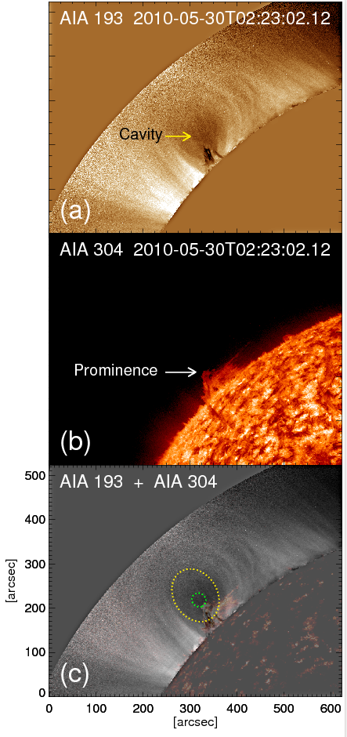
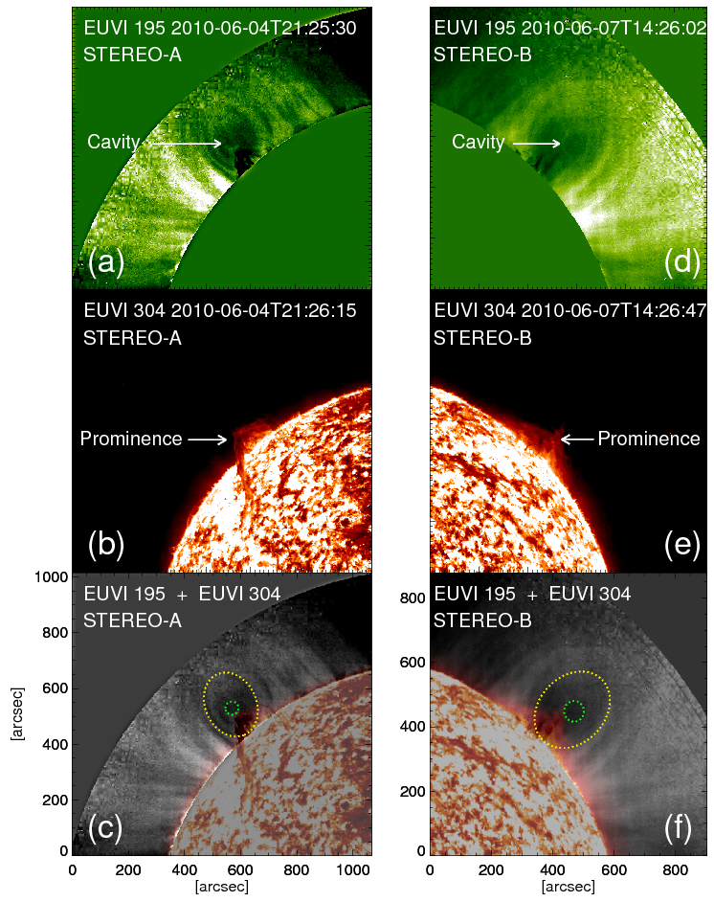
Evolution of the cavity during quiescent phase
East limb
POS along 18° east from central meridian
POS along 20° west from central meridian
Longitude w.r.t CM | Cavity centroid height (R_{S})
90° | 1.10
18° | 1.13
-20° | 1.17
Shape is ~ circular

Slide 8
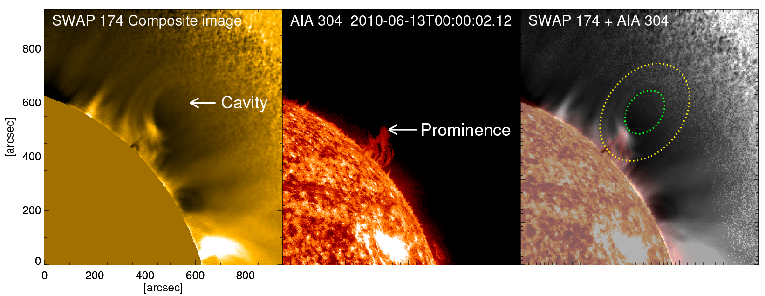
Overlap of coronal cavities seen in SWAP and the prominence material seen in AIA 304
The top of the prominence material and the lower-most part of the cavity coincide well.
Do they maintain this trend during the eruption also ?

Slide 9
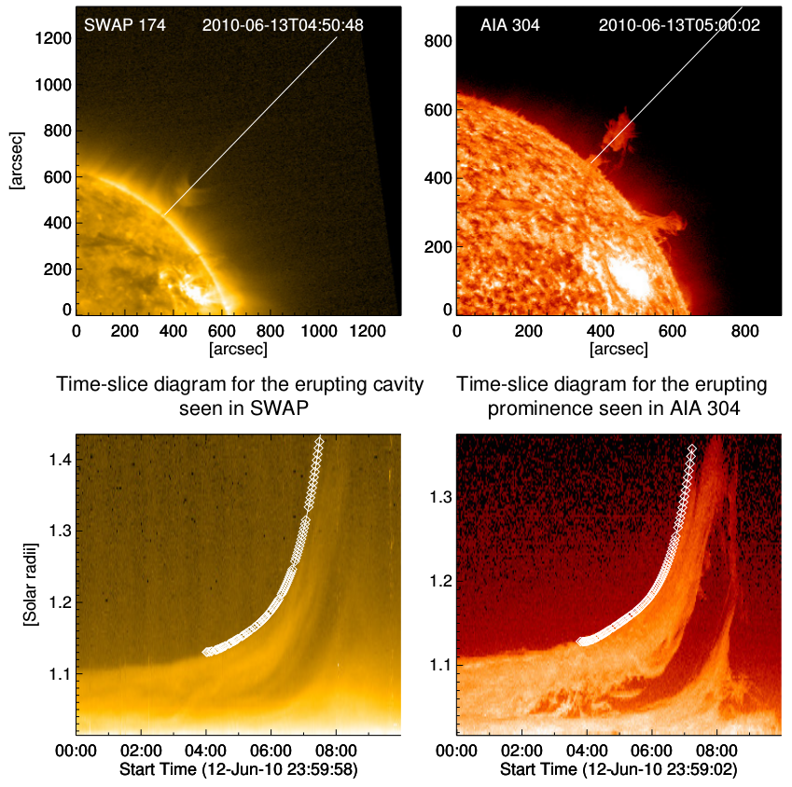
Spatial relationship between prominence and cavity during eruptive phase
Positions of the slits on SWAP and AIA images along which the height-time profile for the lower-most boundary of the cavity and the top-most part of the prominence have been evaluated
Both the slits are taken along the same position angle
Height-time plot for the lower-most boundary of the cavity and the top-most part of the prominence
Do these two height-time profiles match with each other?

Slide 10
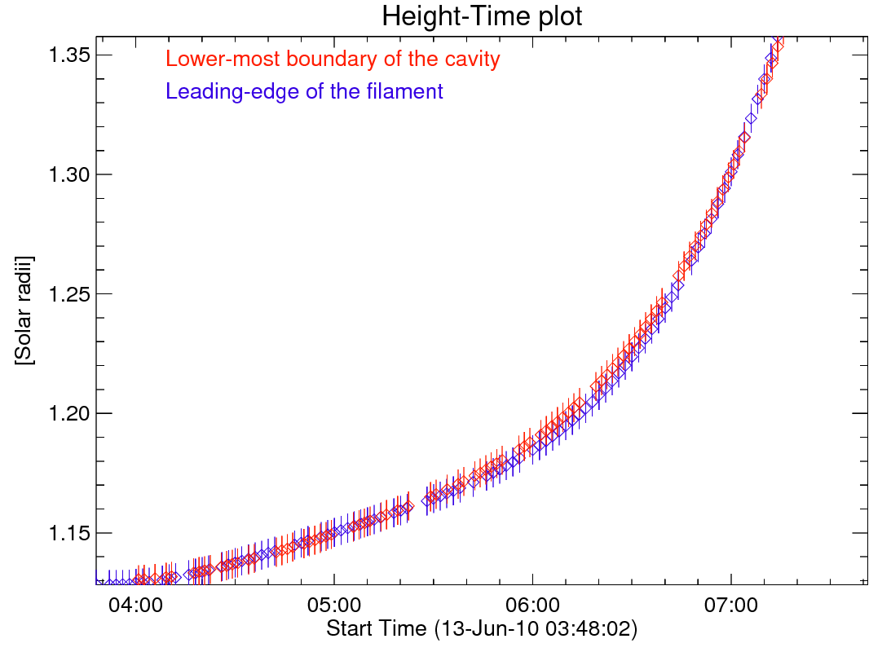
UT
The two height-time profiles almost coincide. The bottom boundary of the cavity and the top most part of the prominence lie in a same boundary.

Slide 11
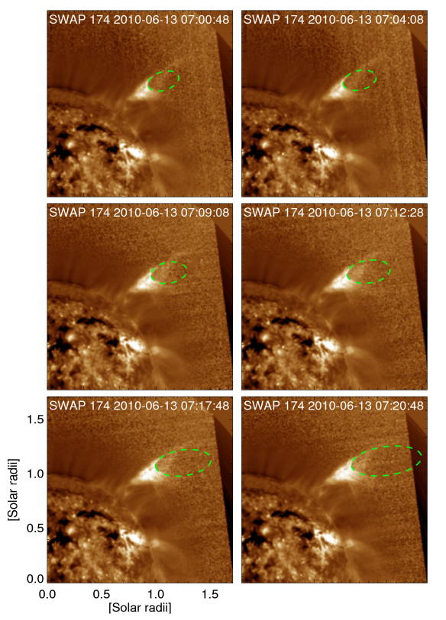
Geometrical fitting to the cavity morphology in different time-steps during its eruptive phase within SWAP field-of-view
In the AIA (17.1 nm ) field-of-view we could track the evolution of the cavity only up to 1.35 solar radii
The extended field-of-view of SWAP(17.4 nm) gave an unique opportunity to track the cavity up to 1.7 solar radii

Slide 12
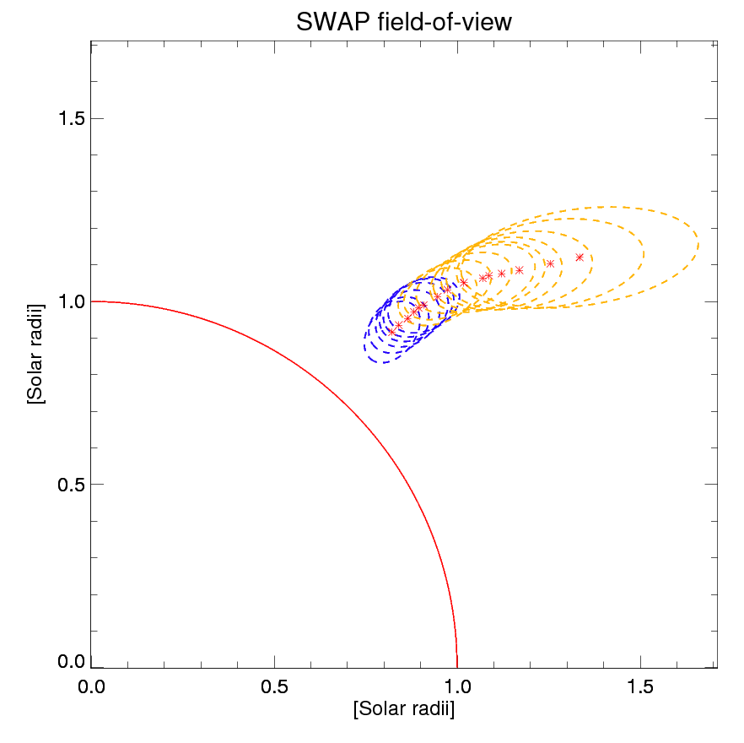
Evolution of the cavity in SWAP field-of-view
Non-radial motion at about 1.3 solar radii
Position angle changes from 310 to 270 degrees

Slide 13
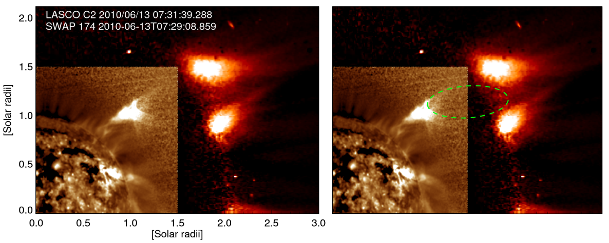
Fitting the cavity morphology in SWAP + LASCO C2 field-of-view (2-6 Rsun)
07:30 UT

Slide 14
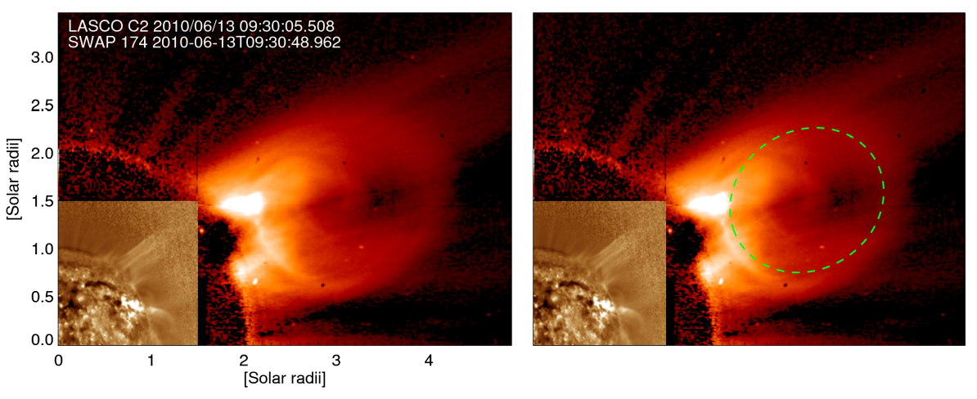
Fitting the cavity morphology in SWAP + LASCO C2 field-of-view
09:30 UT

Slide 15
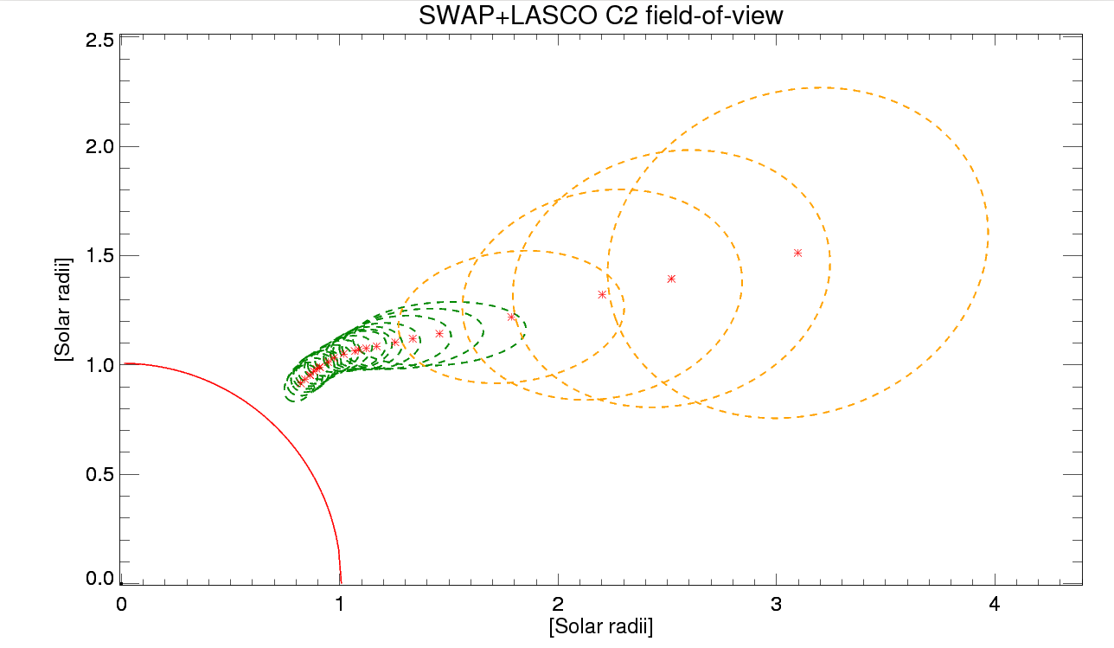
Evolution of the cavity in SWAP + LASCO C2 field-of-view

Slide 16
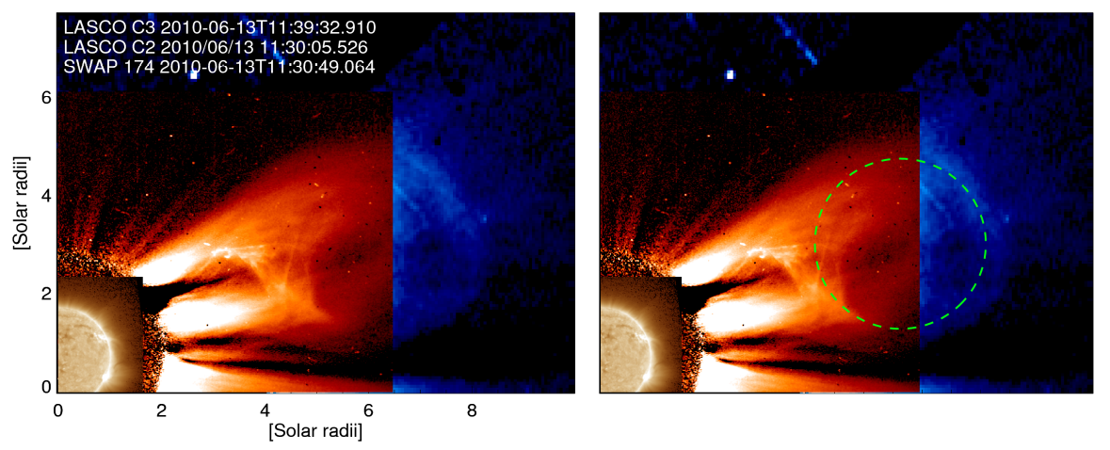
Fitting the cavity morphology in SWAP + LASCO C2 + C3 field-of-view (3-30 Rsun)

Slide 17
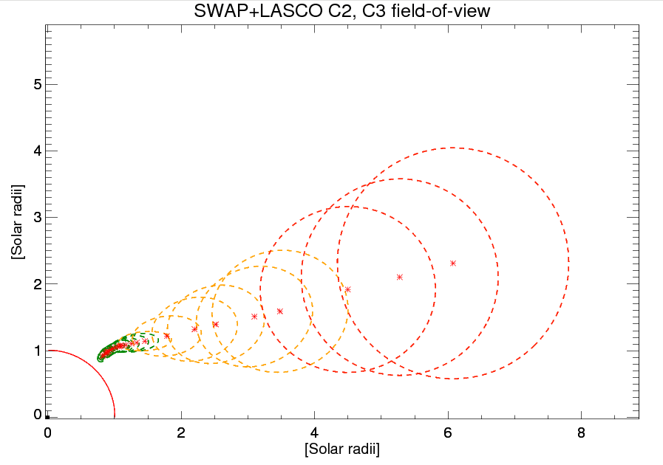
Evolution of the cavity in SWAP + LASCO C2 + C3 field-of-view

Slide 18
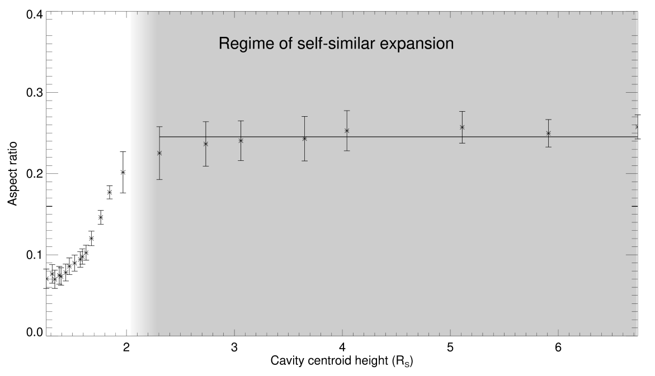
Aspect ratio vs height of the cavity-centroid plot
Aspect ratio: Ratio of Radius of cross section and the centroid height

Slide 19
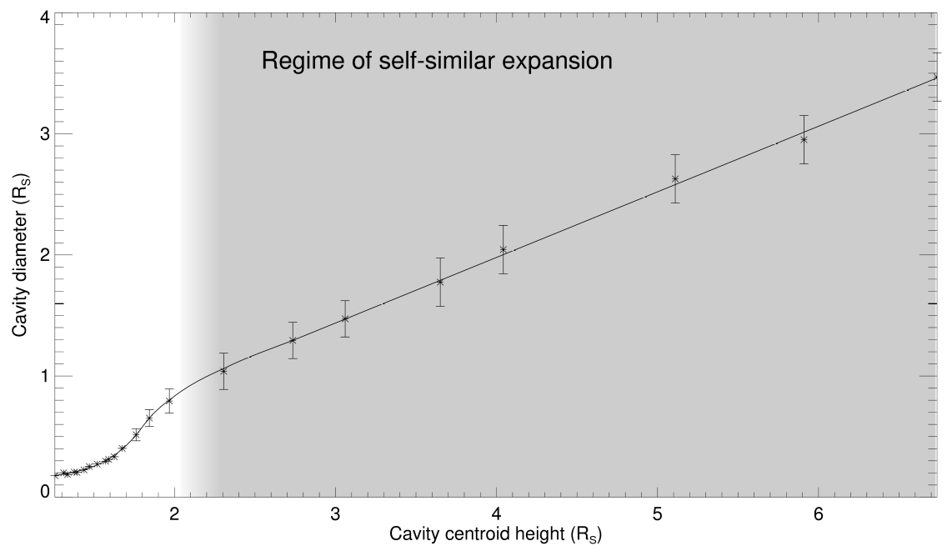
Cavity diameter vs height of the cavity-centroid plot

Slide 20
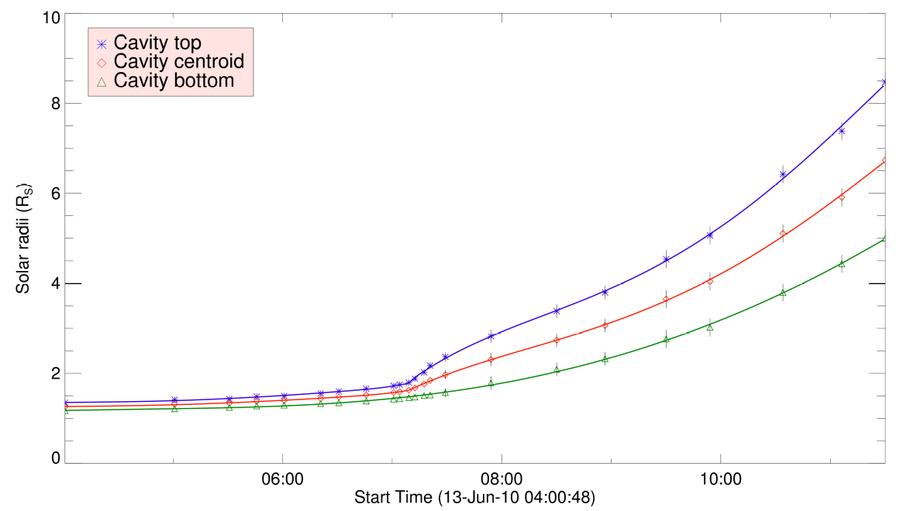
Height-time plot for individual cavity top, bottom and centroid

Slide 21
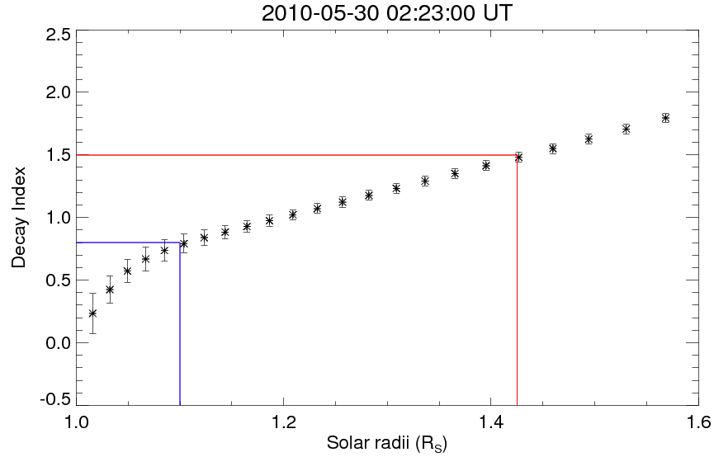
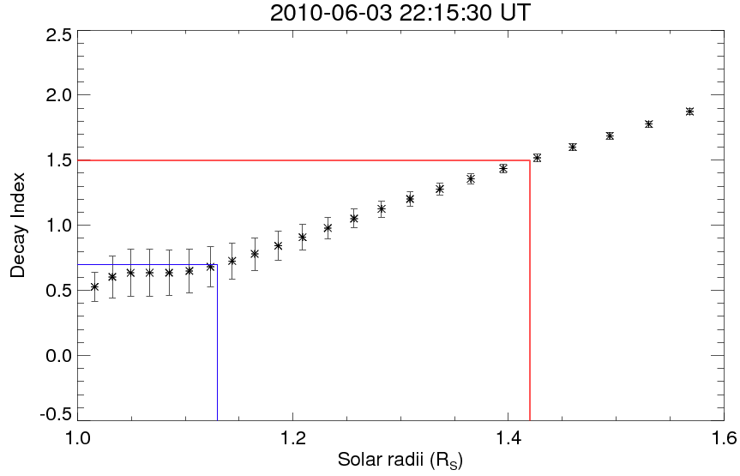
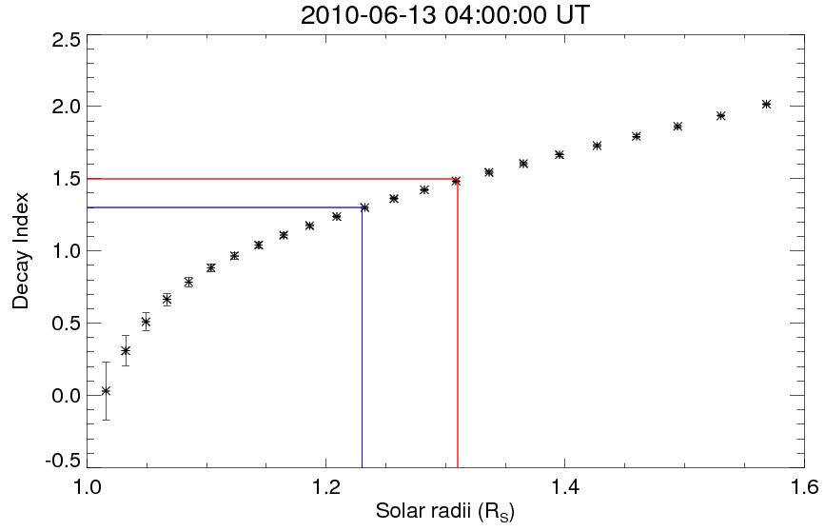
Decay Index profiles for four different dates during the quiescent phase
Cavity seen in the east-limb
Cavity seen in the STEREO-A
Cavity seen in the STEREO-B
Cavity seen in the west-limb

Slide 22
Results
We have studied the morphological evolution of an erupting coronal cavity starting from its initiation in the lower corona up to the LASCO C2/C3 field-of-view.
The height-time profiles for the top of the prominence material and the lower-most part of the cavity almost coincide.
Up to almost 1.3 solar radii in SWAP field-of-view, the cavity exhibits non-radial motion. After approx. 1.3 solar radii, it maintains same position angle (270⁰).
Up to almost 4 Rsun (LASCO-C2), the cavity morphology is best fitted with an ellipse. In LASCO C3 field-of-view the cavity morphology attains almost circular shape.
After near about 2 solar radii, the cavity maintains a constant value of aspect ratio (approx. 0.25) and thus exhibits self-similar expansion.
In the quiescent phase, the cavity centroid height slowly rises from 1.10 to 1.23 R_{S} during its passage on the visible solar disc from May 30 to June 13, 2010 and its initial circular shaped morphology gradually expanded and evolved into elliptical shape prior to the eruption from the western solar limb.
The cavity centroid undergoes acceleration after crossing the critical decay index value.
THANKS!!

