Slide 1
Study of Earth-affecting Solar CMEs: Report from ISEST/MiniMax24 WG 4 on Campaign Events
David F. Webb
Institute for Scientific Research/Boston College
Chestnut Hill, MA, USA
STP-13 - ISEST-MiniMax24 Workshop
Xian, China
18 October 2014

Slide 2
ISEST (International Study of
Earth-affecting Solar Transients)
ISEST Goals and Research Approach
• To improve the scientific understanding of the origin, propagation and evolution of solar transients through the space between the Sun and the Earth.
- Enabled by continuous observations of Sun and heliosphere from an array of spacecraft and ground-based instruments, global numerical simulations of the system, and theoretical analysis.
• To develop/improve the prediction capability for these transients' arrival and potential impacts at Earth.
- Issues include the transit times of CMEs and shocks from the Sun to their arrival at Earth and their impacts. Effects of impact → arrival speed, magnetic field orientation (B_{z}) and its complexity.
To study all the factors and place results in a global picture, ISEST has several working groups (WGs), as discussed.
- Here I review WG4 on Campaign Events
ISEST Wiki created for data repository, discussion forum & education:
http://solar.gmu.edu/heliophysics/index.php/Main_Page

Slide 3
Progress and future plans of the ISEST/Minimax24 WG4 → Campaign Events
Participants try to integrate observations, theory and simulations to understand chain of cause-effect dynamics from Sun to Earth/1 AU for a few carefully selected events.
Sun-to-Earth events expected to be geoeffective are analyzed and made available to the other ISEST WGs, all of VarSITI, and the community. We identify 3 types of events:
- Textbook (“classic”) cases: Complete chain of a well-observed event from solar source, through IP propagation, to geoeffects. Illustrates the scientific and prediction questions related to space weather.
- Not Textbook but Understood cases: Something missing in the chain of a well-observed event, but we understand why. These are generally not geoeffective.
- Problem cases: The chain is not complete and we do not understand why.
ICME and storm but source is faint or missing (a “stealth” CME) or multiple sources OR
Source is expected to be geoeffective but is not.
A focus of WG4 is to examine these problem or controversial events to better understand how they are produced and propagate.
- Analyze the complications that arise when linking CMEs to ICMEs.
- Focus on controversial Earth-Affecting CME/ICME pairs during the STEREO and SDO eras
(STEREO from 2007; SDO from 2010)
WG4 interacts with the four VarSITI-wide campaign projects. WG4 has a wiki site that will be updated: http://solar.gmu.edu/heliophysics/index.php/Working_Group_4

Slide 4
ISEST / MiniMax Event List
Dates Source Geo-response Dst Type
Possible VarSITI-wide Campaign Study Events
*2012 July 12-14 X1 flare, fast CME Shk, MC, strong storm -127 TB
2012 Oct. 4-8 Strong CME, but multiple weak surface signatures, slow propagation to Earth Smaller storm -105 P
2013 March 15-17 M1 fl, EP, IV, fast halo Shk, MC?, SEP, strong stm -132 TB
2013 June 1 Slow CME on 27 May? CH influence? Cause of big storm
unclear -119 P
Other ISEST/MiniMax Study Events
2008 Sep. 12-19 Stealth CME; deflected prop. to 1 AU. No U/P?
2009 August 25 Source unclear; deflected prop.; flank hits Earth? No U/P?
2012 Jan. 19-23 M3 fl, II, Skh, ICME -69 TB
2012 Jan. 23-25 M9 fl, II, Skh, ICME missed L1? -73 P?
2012 March 7-9 X5 fl, wave, fast CME Shock, MC, strong storm -131 TB
2012 July 23-24 2 fls, EPs Extreme ST-A event; strong storm Carr.-typeTB?
2012 Sep 28-Oct 1 2 CMEs Shk, complex ejecta -119 U/P?
*2014 Jan. 7-9 A “problem” event being studied for an AGU session. No P
*2014 Sep. 10-13 X2 fl, wave, sym halo. Evolution of source AR also of interest. Shk, MC, small storm -73 U
___________________________________
See: http://solar.gmu.edu/heliophysics/index.php/The_ISEST_Event_List
Type: TB = textbook; U = understand chain; P = problem

Slide 5
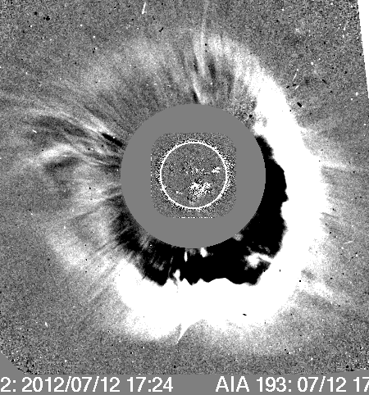
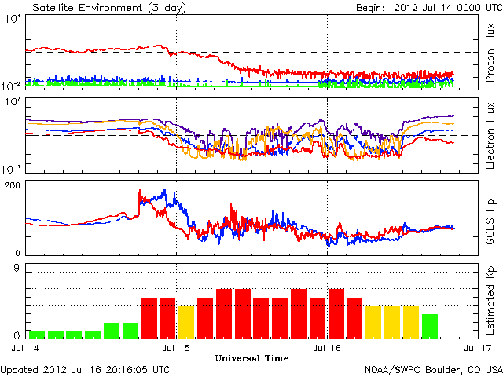
1) A “Textbook” Event: 12-14 July 2012
Complete chain of a well-observed Sun-to-Earth event → from solar source, through
IP propagation, to its geoeffects. Illustrates the scientific and prediction questions
related to space weather.
On 12 July 2012: X1.4 flare at ~S17°W08° in NOAA AR 11520 (arrow). LASCO full halo
CME with initial speed ~1300 km/s.
On 14 July ICME arrived at L1/Earth with a shock, sheath, and 2-day long MC.
Strong southward IMF in the MC produced a strong geostorm (peak Dst = -127 nT),
with beautiful aurora over the Earth, extending into the 15th.
Papers: Moestl et al. (ApJ, 2014) – Propagation kinematics; Hess & Zhang (ApJ, 2014) – Propagation, drag; Cheng et al. (ApJ, 2014) – FR eruption; Shen et al. (JGR, 2014 – 3D MHD; and several posters this meteing.

Slide 6
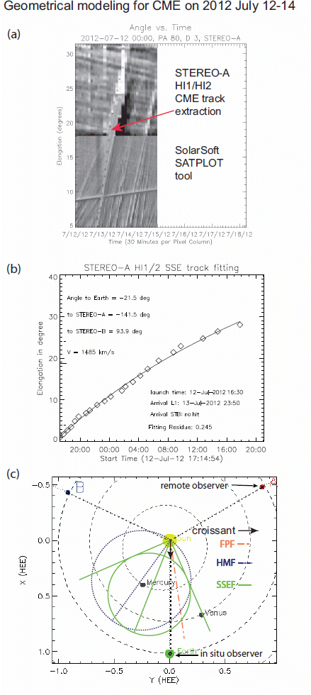
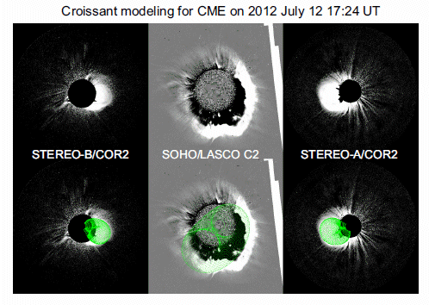
Modeling Comparison – 12-14 July 2012
Event
Above: Thernisien et al. (2009) croissant Flux-Rope model fitted to SOHO LASCO C3 and STEREO COR2 observations (courtesy Robin Colaninno; NRL).
Right: Results of different modeling techniques for fitting the tracks of CME in STEREO heliospheric imaging data. CME had non-radial deflection due to coronal holes, which needs to be accounted for in models (see Gopalswamy et al., SW, 2013).
From Moestl et al. (ApJ, 2014)

Slide 7
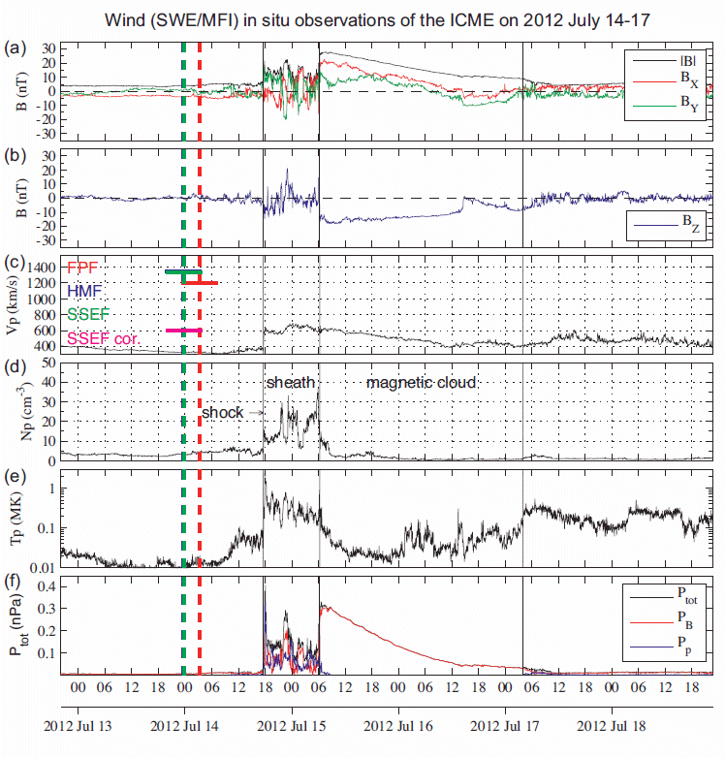
In-situ data at Wind spacecraft at L1.
Note strong, prolonged southward IMF (arrow) that drove storm.
MC of WSE type; Right-handed; highly inclined to the ecliptic plane.
Bulk speed = 549 km/s
FR radius = 0.227 AU
Bo = 50.4 nT
P = 0.985
(C. Moestl; K. Marubashi)
Predicted arrival times (vertical bars) and speeds (horizontal bars) shown in colors.

Slide 8
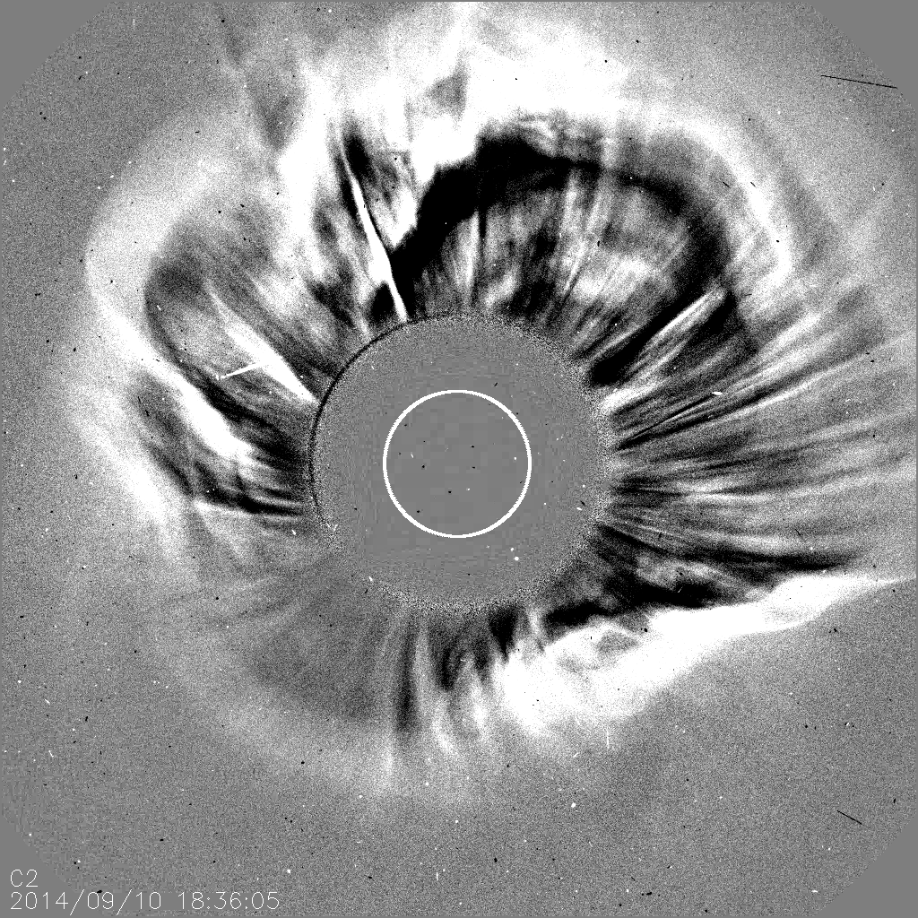
2) 10-12 Sept. 2014 – Not “Textbook” but “Understood”
AIA 193A RD. Courtesy N. Nitta SOHO LASCO C2 RD
X1.6 LDE flare, location N14°E05°, AR 12158, onset 17:21 UT.

Slide 9
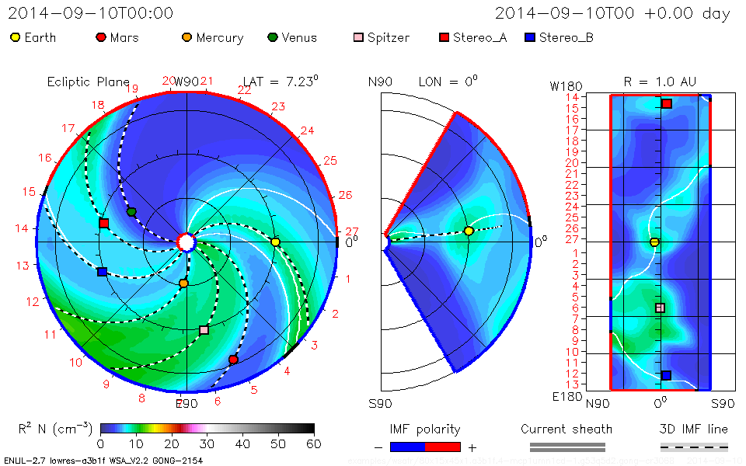
ENLIL MHD model run from NASA SWRC

Slide 10
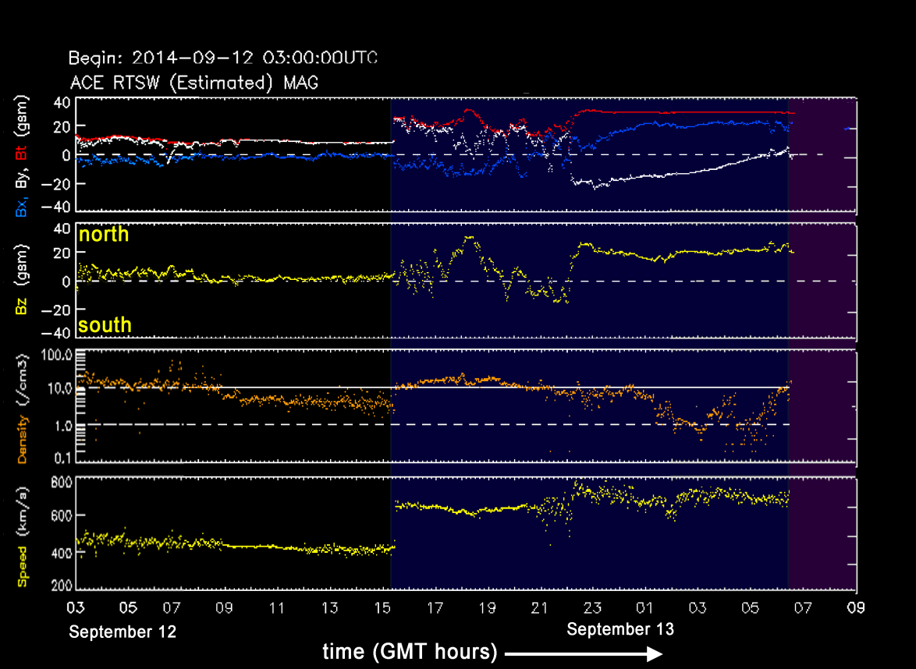

Slide 11
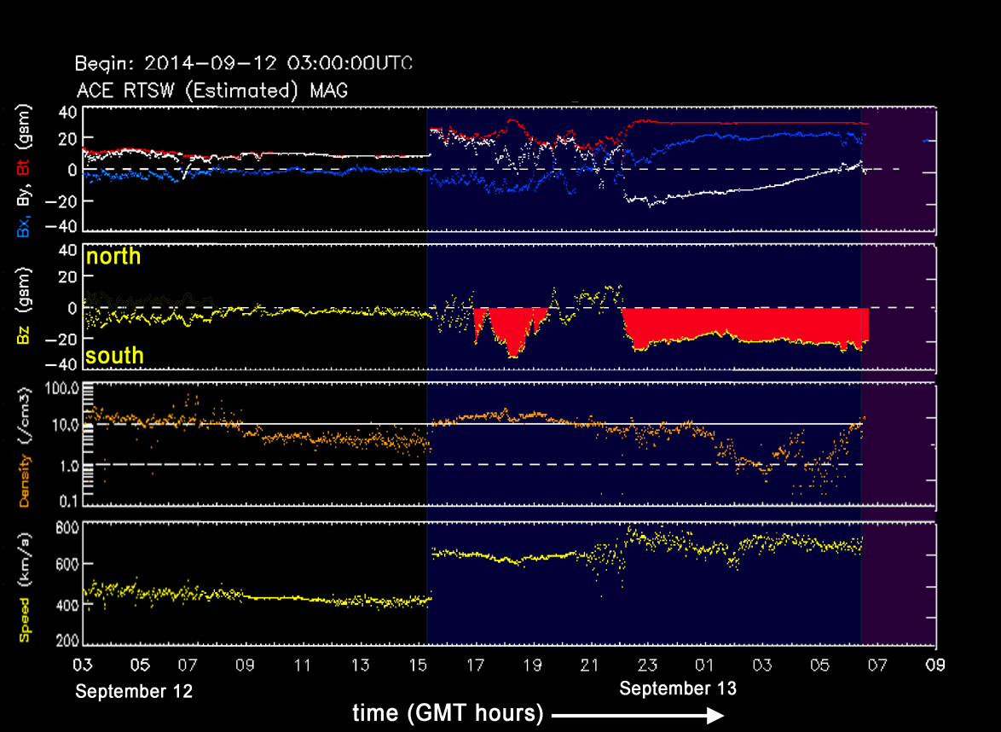

Slide 12
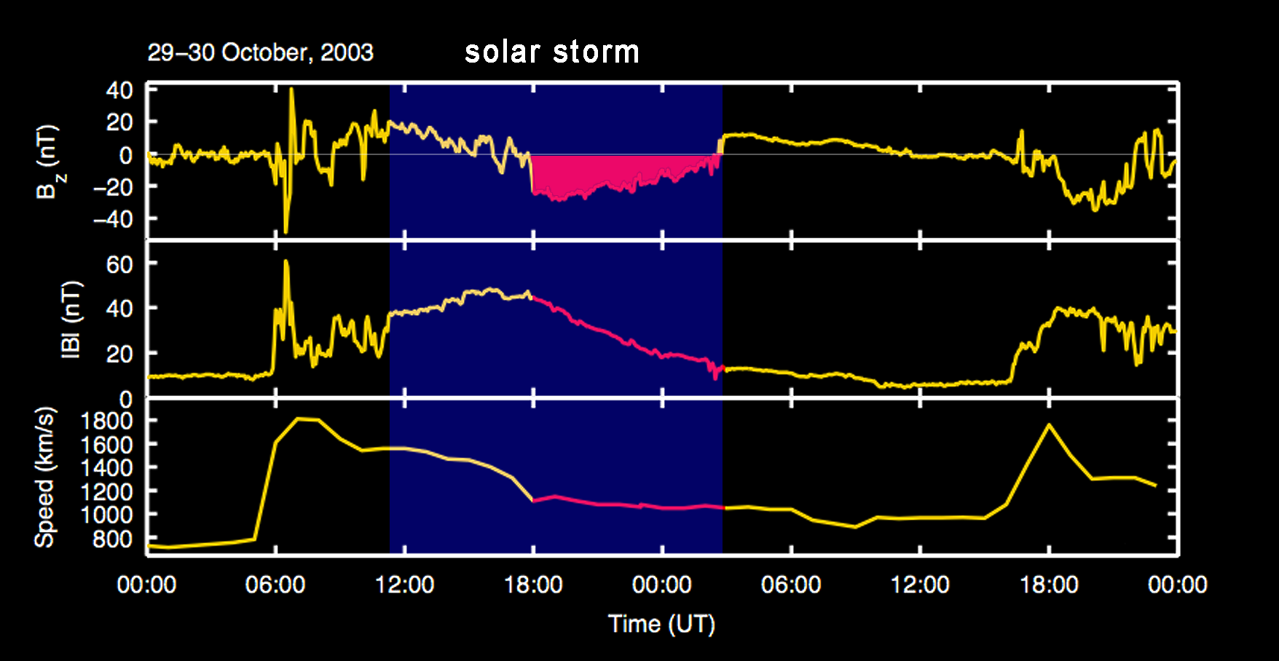
From a YouTube video in a series being produced by Tamitha Skov (Mulligan).
See: https://www.youtube.com/user/SpWxfx Follow Tamitha’s daily updates on twitter: http://twitter.com/TamithaSkov

Slide 13
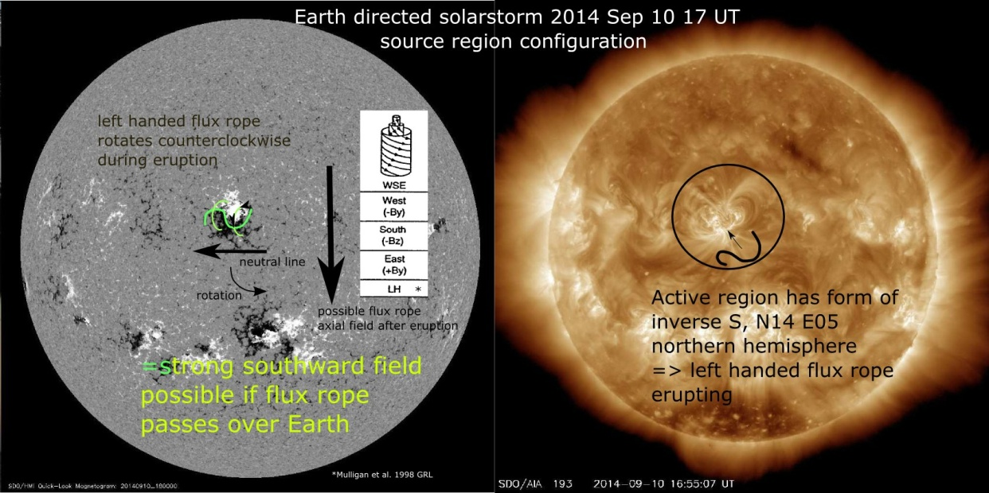
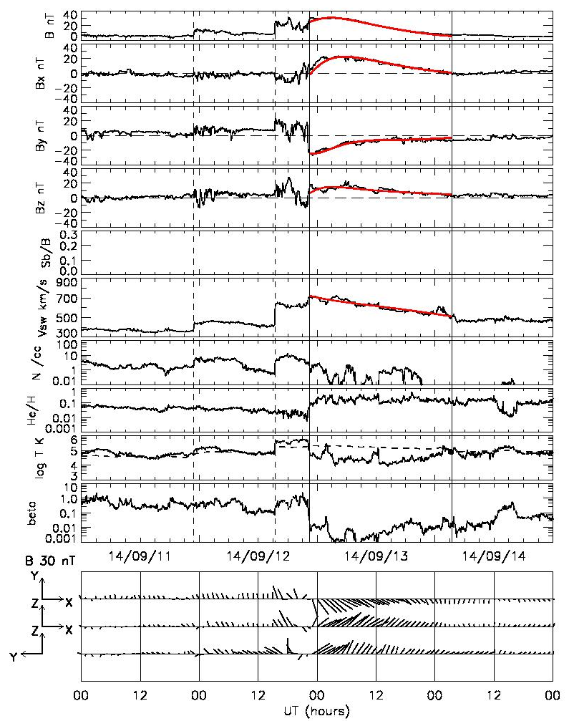
Flux Rope Fits for 10 Sept. 2014 Event
C. Moestl: “the erupting flux rope is Left-Handed and, if it rotated, it should do so anticlockwise on the order of 100° so that the axial field points toward south if the cloud hits Earth.”
V. Bothmer: the expected rope should be horizontal, not vertical, with possible kinks. There is no flux rope rotation, resulting in a LH, SEN FR according to Bothmer & Schwenn.
K. Marubashi fits the MC as a torus
with these parameters

Slide 14
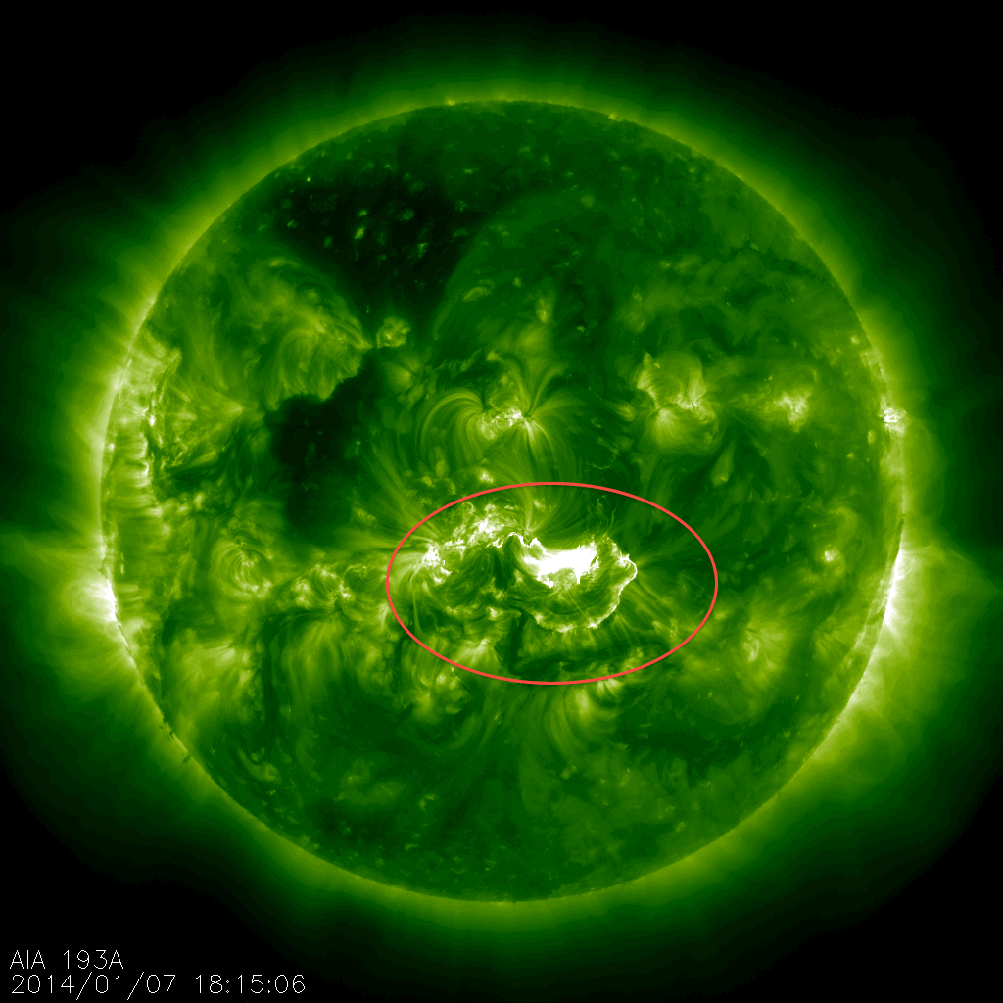
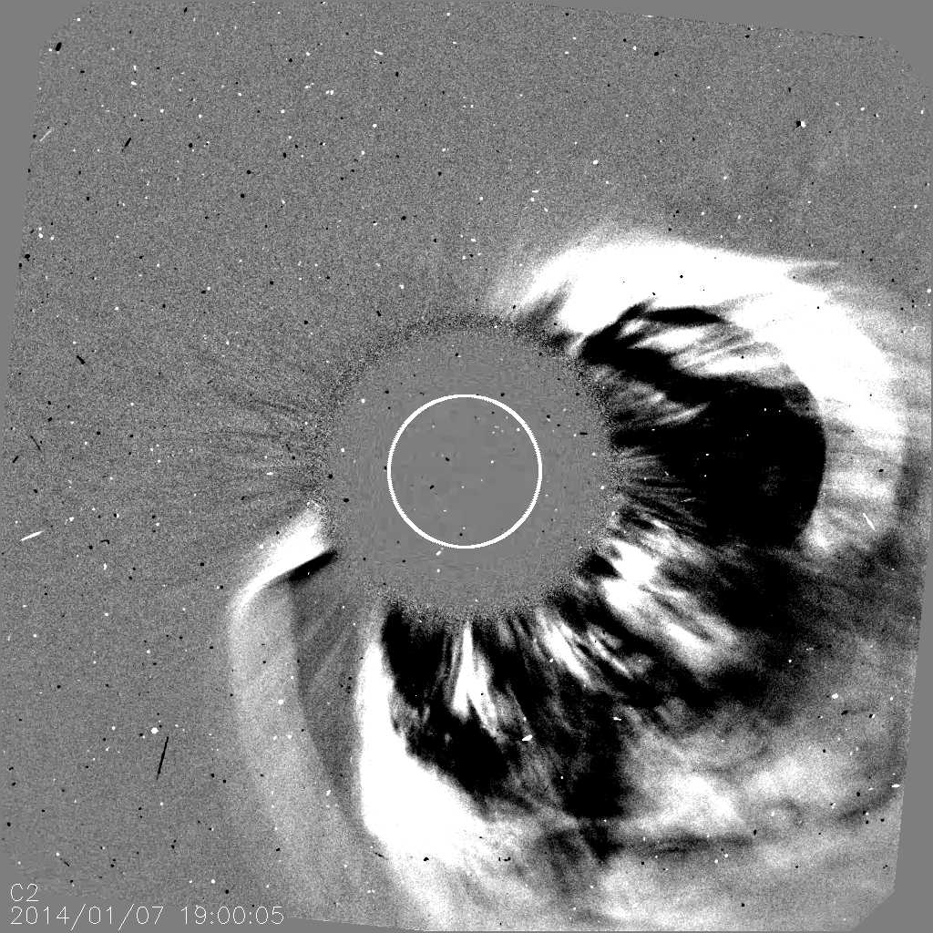
3) A Recent “Problem” Event: 7-9 January 2014
On 7 January 2014: X1.2 flare, onset 18:04 UT, at ~S15°W11° in AR1944 . Very fast LASCO halo CME; speed >2000 km/s. SEP event. A shock hit Earth on 9 January but there was only a weak ICME and no storm.
What happened to the CME? Possible deflection by coronal hole or during propagation?
Something else?

Slide 15
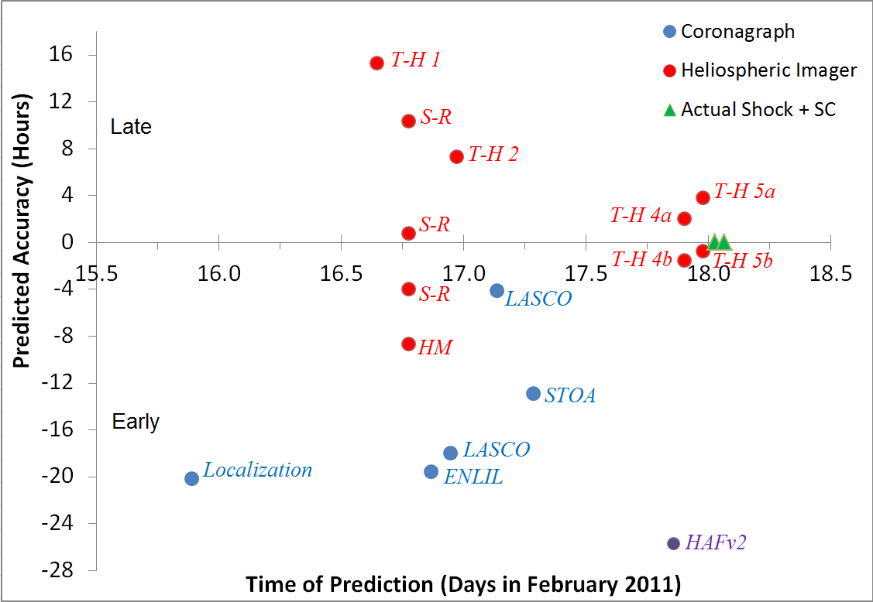
STEREO SWx Group Forecasting of Feb. 2011 Event
Courtesy T. Howard
See Webb (2014)
Comparison of different forecast model runs for a Sun-to-Earth event. Compares prediction “accuracy”, predicted vs actual Arrival Time (usually shock AT), with the time the prediction was made. NASA Space Weather Research Center (SWRC) now routinely collecting such forecast runs. I have these for most of WG4 events – not plotted yet.

Slide 16
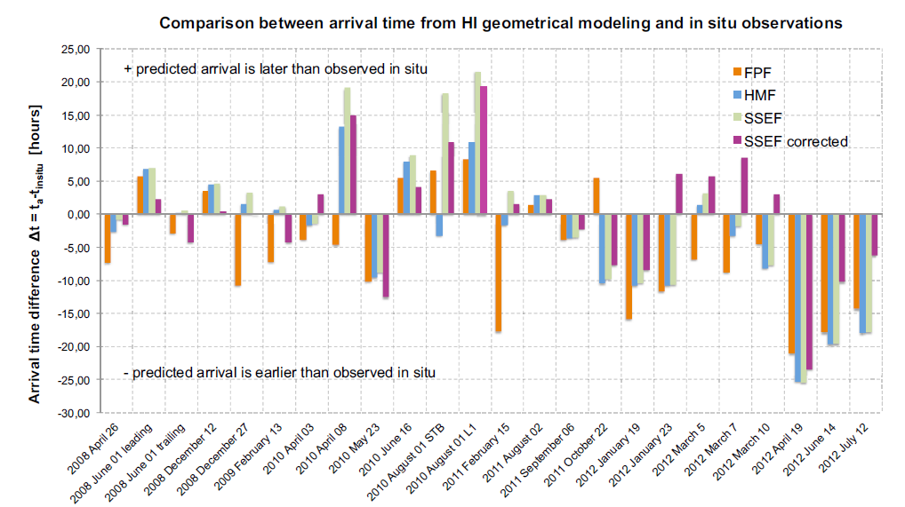
Forecast Arrival Time Accuracy for 22 CMEs
Using geometrical methods to predict ATs for 22 CMEs with STEREO HI data, Möstl et al., ApJ (2014), had an “accuracy” of 8 ± 6 hr., with a prediction lead time of 26 ± 15 hrs, similar to previous studies using STEREO data.

Slide 17
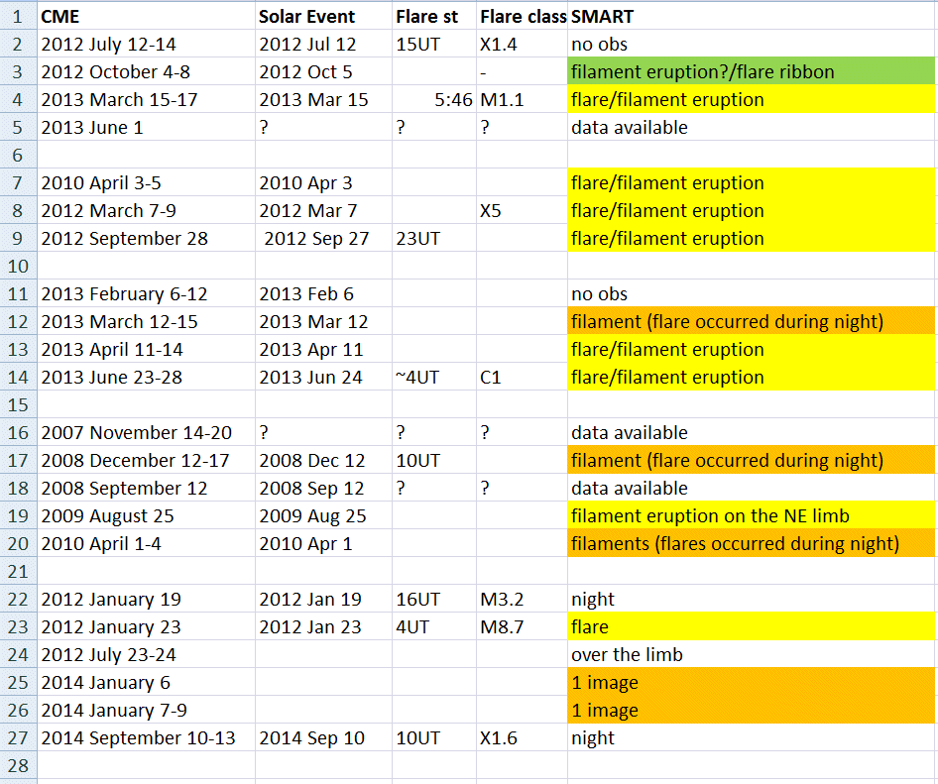
Flare/Filament Eruption Data from Hida Obs., Japan (courtesy A. Asai)

Slide 18
Conclusions for WG4
Integrate observations, theory and simulations to understand chain of cause-effect dynamics from Sun to Earth/1 AU for carefully selected events.
Develop/improve the prediction capability for these transients' arrival and their potential impacts at Earth.
Textbook cases: Complete chain of a well-observed event
Understood cases: Something missing in the chain, but we understand why.
Problem cases: The chain is not complete and we do not understand why.
- Such events are an important focus of WG4.
- Stealth events considered a subset of Problem events.
- ~20% of important geostorms have CMEs-ICMEs but no compelling signatures
in low corona or at Sun’s surface. We need to solve this!
10% due to CIR-HSSs. The shock sheath region is also important!
WG4 works with the other ISEST WGs. WG4 has a wiki site that will be updated: http://solar.gmu.edu/heliophysics/index.php/Working_Group_4
- Solicite your inputs for the ISEST Events or to add new events
- Solicite your inputs for WG4, especially on the wiki site.
- Create an account and add your comments and data.
WG4 encourages collaboration with the four VarSITI-wide campaign studies.
Please contact Dave Webb.

Slide 19
Thank you for your attention!
WG4 Contributors:
Asai, N. Gopalswamy*, B. Jackson, T. Nieves-Chinchil, N. Nitta*, Y. Liu, B. Schmieder, M. Temmer, Y. Wang*, J. Zhang* and C. Moestl
* = Meet at lunch today to discuss WG4?
david.webb@bc.edu

Slide 20
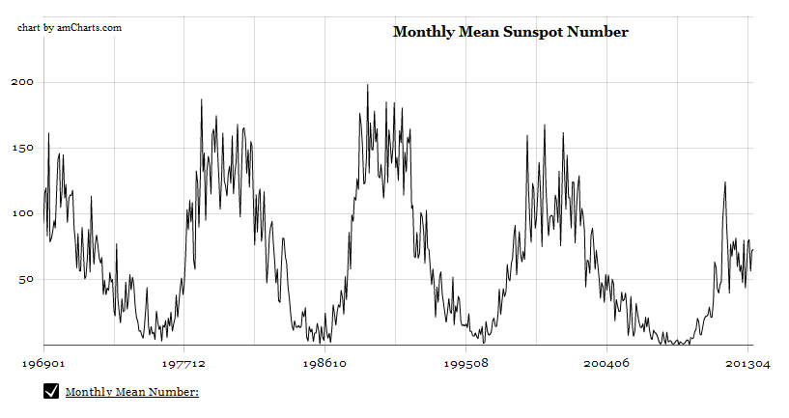
What is MiniMax24?
→ a year-long SCOSTEP campaign on Sun-Earth connection
→ intended to coordinate solar-terrestrial observations
Why „MiniMax24“?
21
22
23
24
(data from Kanzelhöhe Observatory, UNI Graz)
2013 is supposedly the year of solar cycle 24 maximum, so MiniMax24 is a year-long
SCOSTEP campaign on Sun-Earth Connections.
The activity level of cycle 24 is relatively low, suggesting weaker space weather effects.
Less radiation received at Earth may have climate implications.
The MiniMax24 campaign focus is to coordinate solar-terrestrial observations.
Notes:
SCOSTEP has declared the year 2013 – as the Year of MiniMax24
MiniMax24 is a year-long SCOSTEP campaign on Sun-Earth Connection
Marks that we are in the maximum phase of solar cycle 24
Marks that the activity level of cycle 24 is relatively low
Low activity means weaker space weather effects
Less radiation received at Earth: climate implications
The MiniMax24 campaign is intended to coordinate solar-terrestrial observations

Slide 22
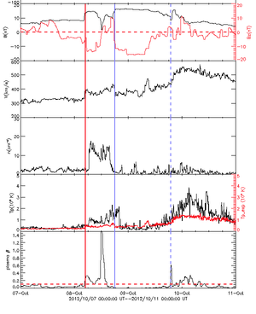
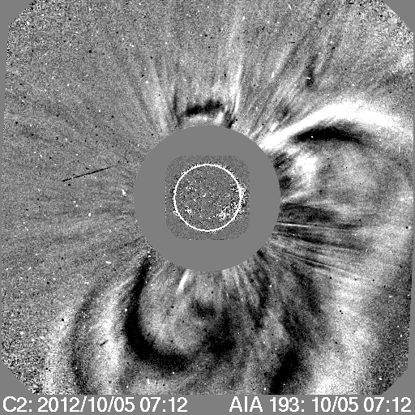
A Problem Event: 4 - 9 October 2012
Example of a "stealth" or problem event:
- A clear, bright CME and an ICME; drove small geostorm
- But no or very weak surface signatures (e.g., flares, dimmings, filament eruptions, etc.).
Also, there were multiple, weak eruptions.
B
Bz
V
Np
Tp
β
~20% of important geostorms have CMEs-ICMEs but no compelling signatures in low corona or at
Sun’s surface.
Finding the sources of very slowly evolving CMEs is particularly difficult, even with multiple views.
A challenge for SWx forecasting!

