Slide 1
How “Stealthy” can Earth-Affecting Eruptions be?
Nariaki Nitta (LMSAL), Manuela Temmer (Univ. Graz)

Slide 2
Problem Events
1. In-situ data show an ICME, but no halo CME is found in coronagraph (e.g. LASCO) data in a reasonable (~5 day) time window.
2. A halo CME is found for the ICME, but no low coronal signatures are found for the CME.
Category 2 may correspond to the stealth CME. Its definition varies with the workers. For example, like the original example of Robbrecht et al. (2009), we can allow limb signatures (e.g. slow prominence eruptions), and stealth CMEs do not leave signatures on the disk (Kilpua et al. 2014).
Some limit to only those events without signatures irrespective of the source locations (D’Huys et al. 2014). Then we are left largely with narrow CMEs, which are space-weather-insignificant.
10−30% of CMEs from the front side may be stealth CMEs (Yum. Wang et al. 2011, Akiyama et al. 2014).
3-Nov-2000 15:42:43
3-Nov-2000 20:11:43

Slide 3
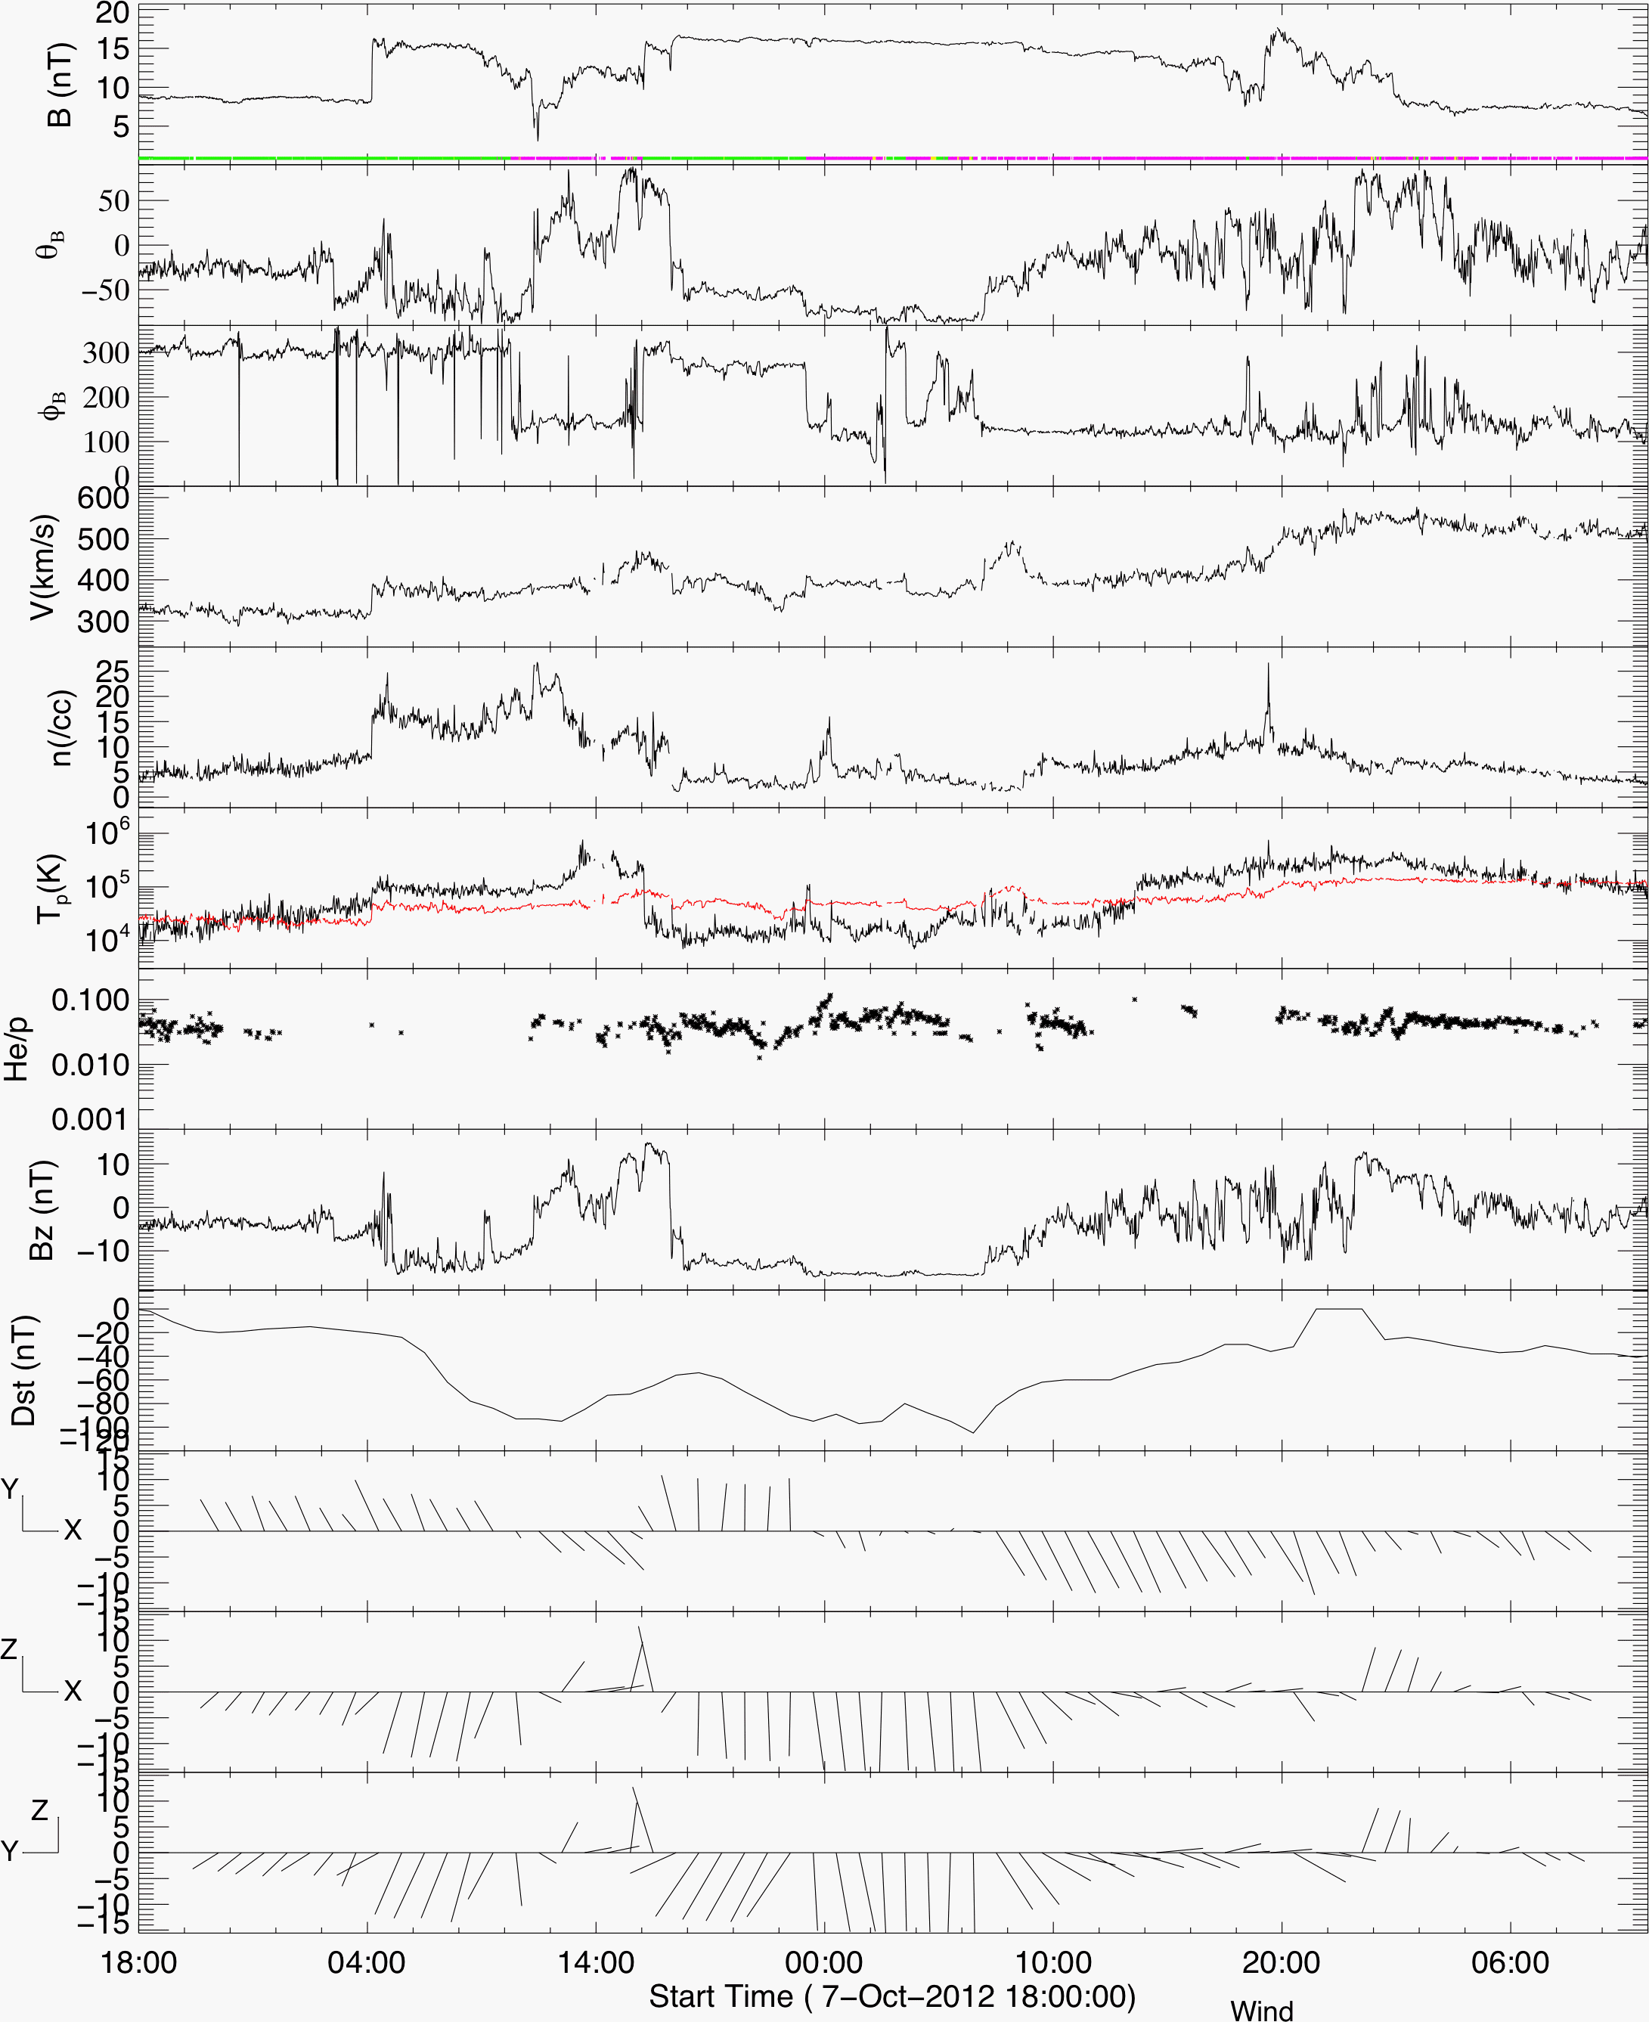
Campaign Event (from Dave Webb)
2012 October 4-8 (DW; KM) CME. This event has been recommended by ISEST and SPeCIMEN.
This is an excellent stealth CME, i.e., a strong CME in the inner corona and ICME, but the solar disk signatures are multiple and weak, and it had slow propagation to Earth.
At Earth a smaller storm, Dst=-105. Electron acceleration in the radiation belt has been studied by Reeves, G.D. et al (2013).
(P)roblem event.
URL: http://solar.gmu.edu/heliophysics/index.php/10/08/2012_05:00:00_UTC

Slide 4
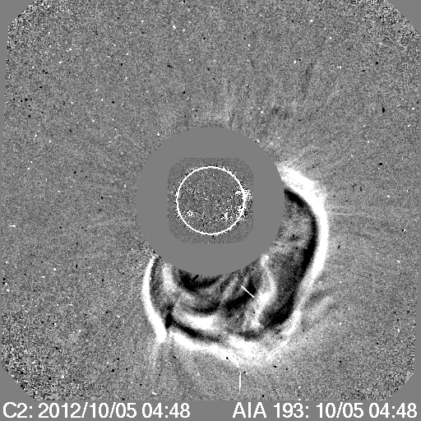
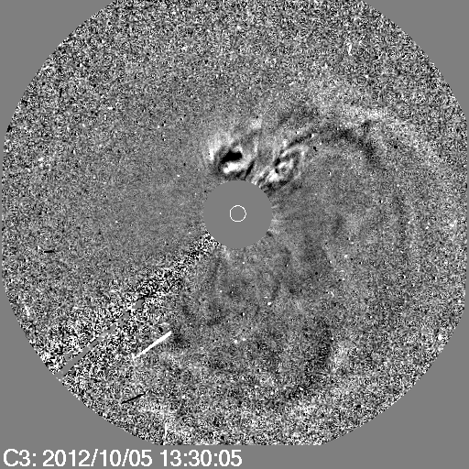
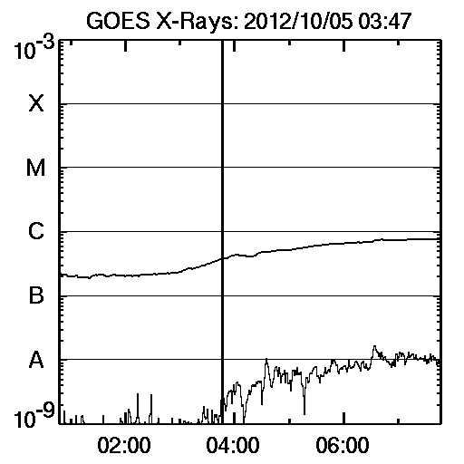
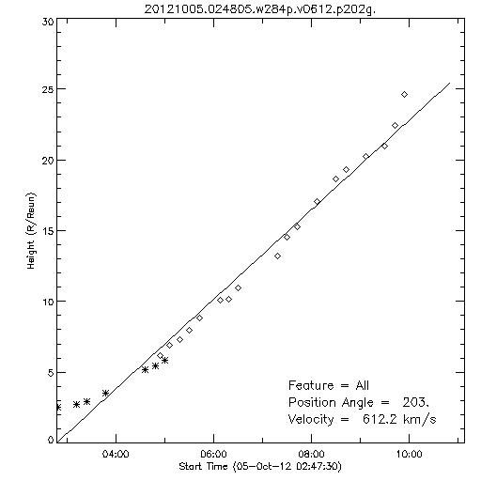
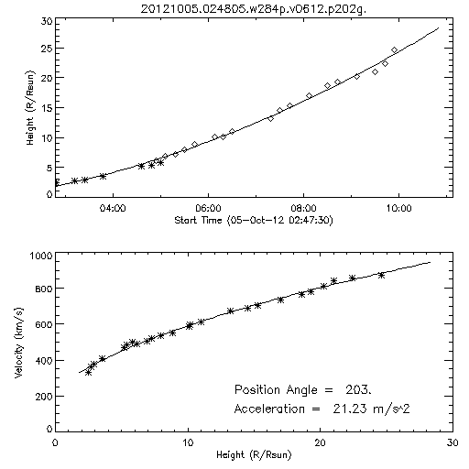
2012-10-08 ICME, 2012-10-05 CME
This was first selected by ISEST because of a possible stealth CME.
The only halo CME in the possible time
window that may account for the ICME is:
But How can this be a stealth CME?
The CME is quite bright.
It is not slow.
It is associated with a slow B8
flare.
V = 612 km s⁻¹
α = 21 m s⁻²

Slide 5
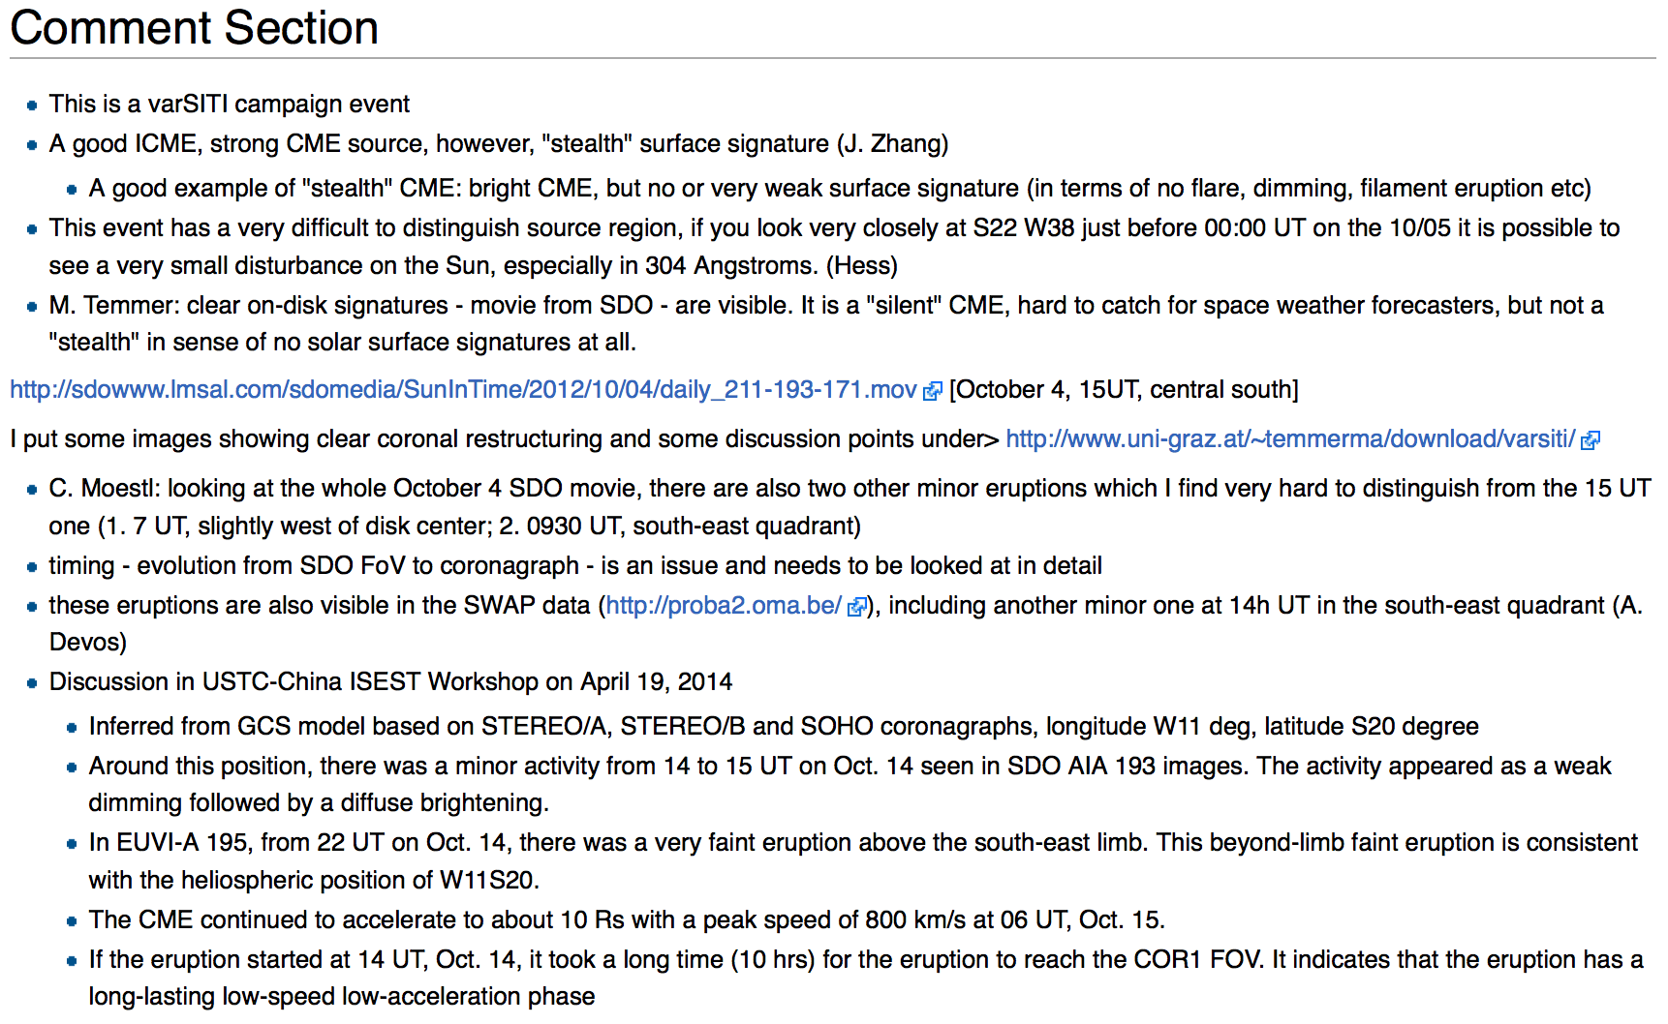
2012-10-05 CME

Slide 6
2012-10-05 CME (STEREO COR-1)
Indeed, it is extremely hard to find anything convincing in AIA intensity or running difference images.
First study data from STEREO, which gives a limb view of the regions close to the central meridian from Earth.

Slide 7
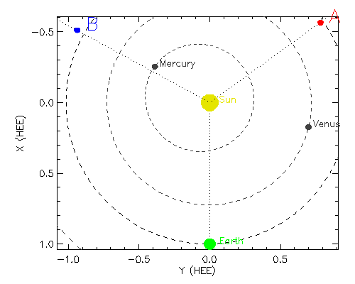
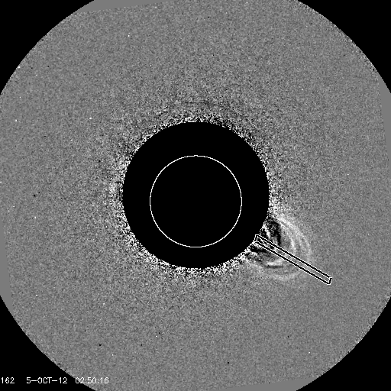
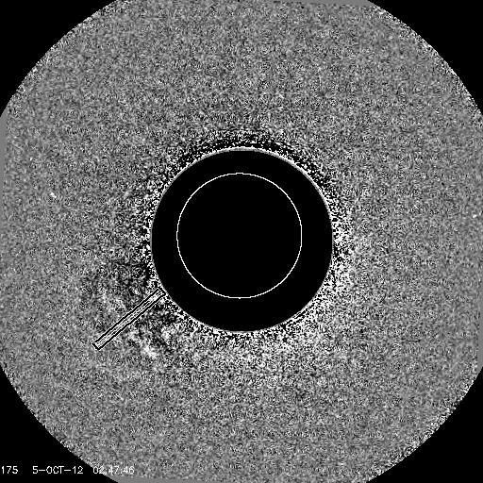
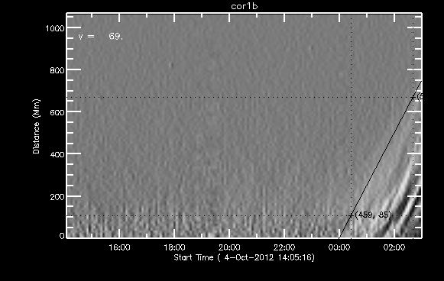
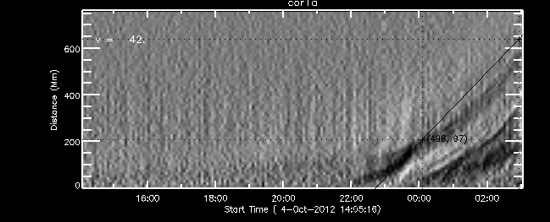
2012-10-05 CME (STEREO COR-1)
Time-distance profiles from COR-1 data, although not clean, indicate that the eruption reached ~1.5 Rs (heliocentric) only around 5 October 2012 00 UT.
COR-1B
COR-1A
COR-1B
COR-1A

Slide 8
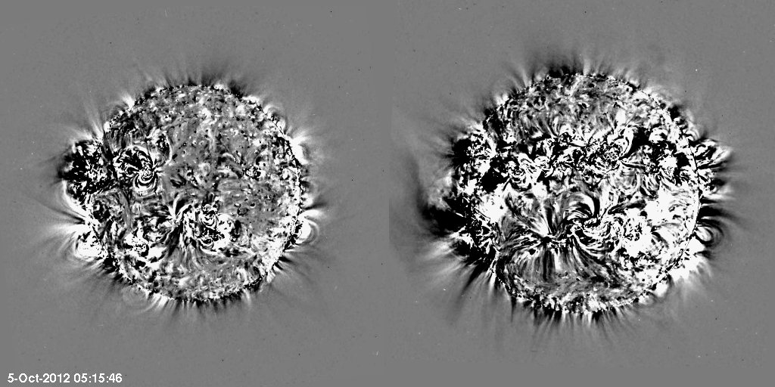
2012-10-05 CME (STEREO EUVI)
EUVI base difference images show that the outgoing motion got accelerated around 5 October 2012 00 UT. Dimming is marginal.
This dimming is seen by STA only. Probably from the west limb.

Slide 9
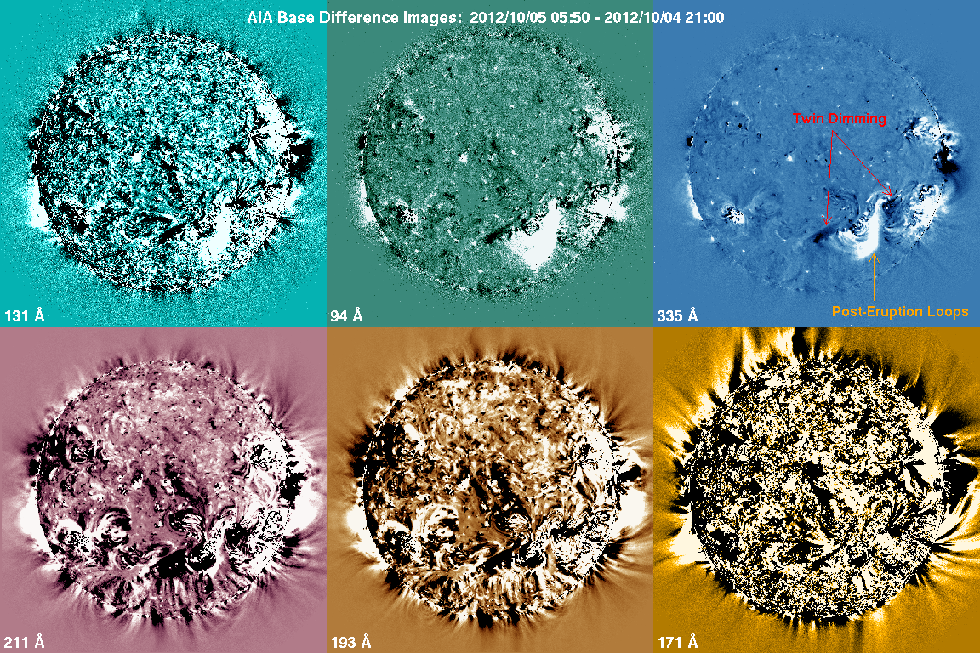
2012-10-05 CME (AIA)
Make AIA base difference images to find dimming. They clearly show post-eruption loops (at high temperatures) and twin dimming. The location is consistent with the UTSC-China finding of S20 W11 (see wiki). Note another dimming on the west limb, which was also seen by EUVI-A.
3-Nov-2000 15:42:43
3-Nov-2000 20:11:43

Slide 10
2012-10-05 CME (at low temperatures)
Hα and 304 Å images suggest that the elongated region to the southeast of the flare was involved in the CME. None of these images show a coherent filament eruption, but dynamic motions in the filament channel.
3-Nov-2000 15:42:43
3-Nov-2000 20:11:43

Slide 11
2012-10-05 CME (at low temperatures)
Hα and 304 Å images suggest that the elongated region to the southeast of the flare was involved in the CME. None of these images show a coherent filament eruption, but dynamic motions in the filament channel.
3-Nov-2000 15:42:43
3-Nov-2000 20:11:43
The AIA 304 Å movie shows the spreading flare ribbons.
Therefore we suggest that this is not a stealth CME. This is in accord with the initial expectation on the basis of the bright and fast CME and the B-class flare. We just need to examine base difference (ratio) images over a long period that extends to several hours after the CME detection.

Slide 12
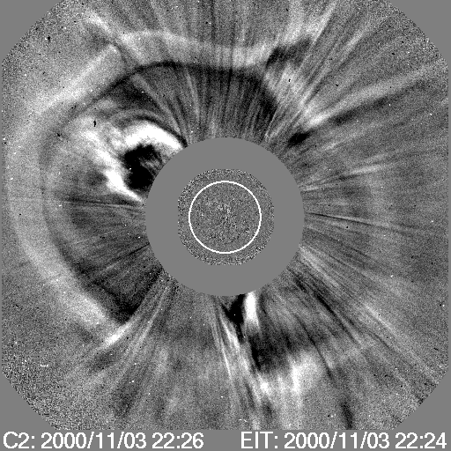
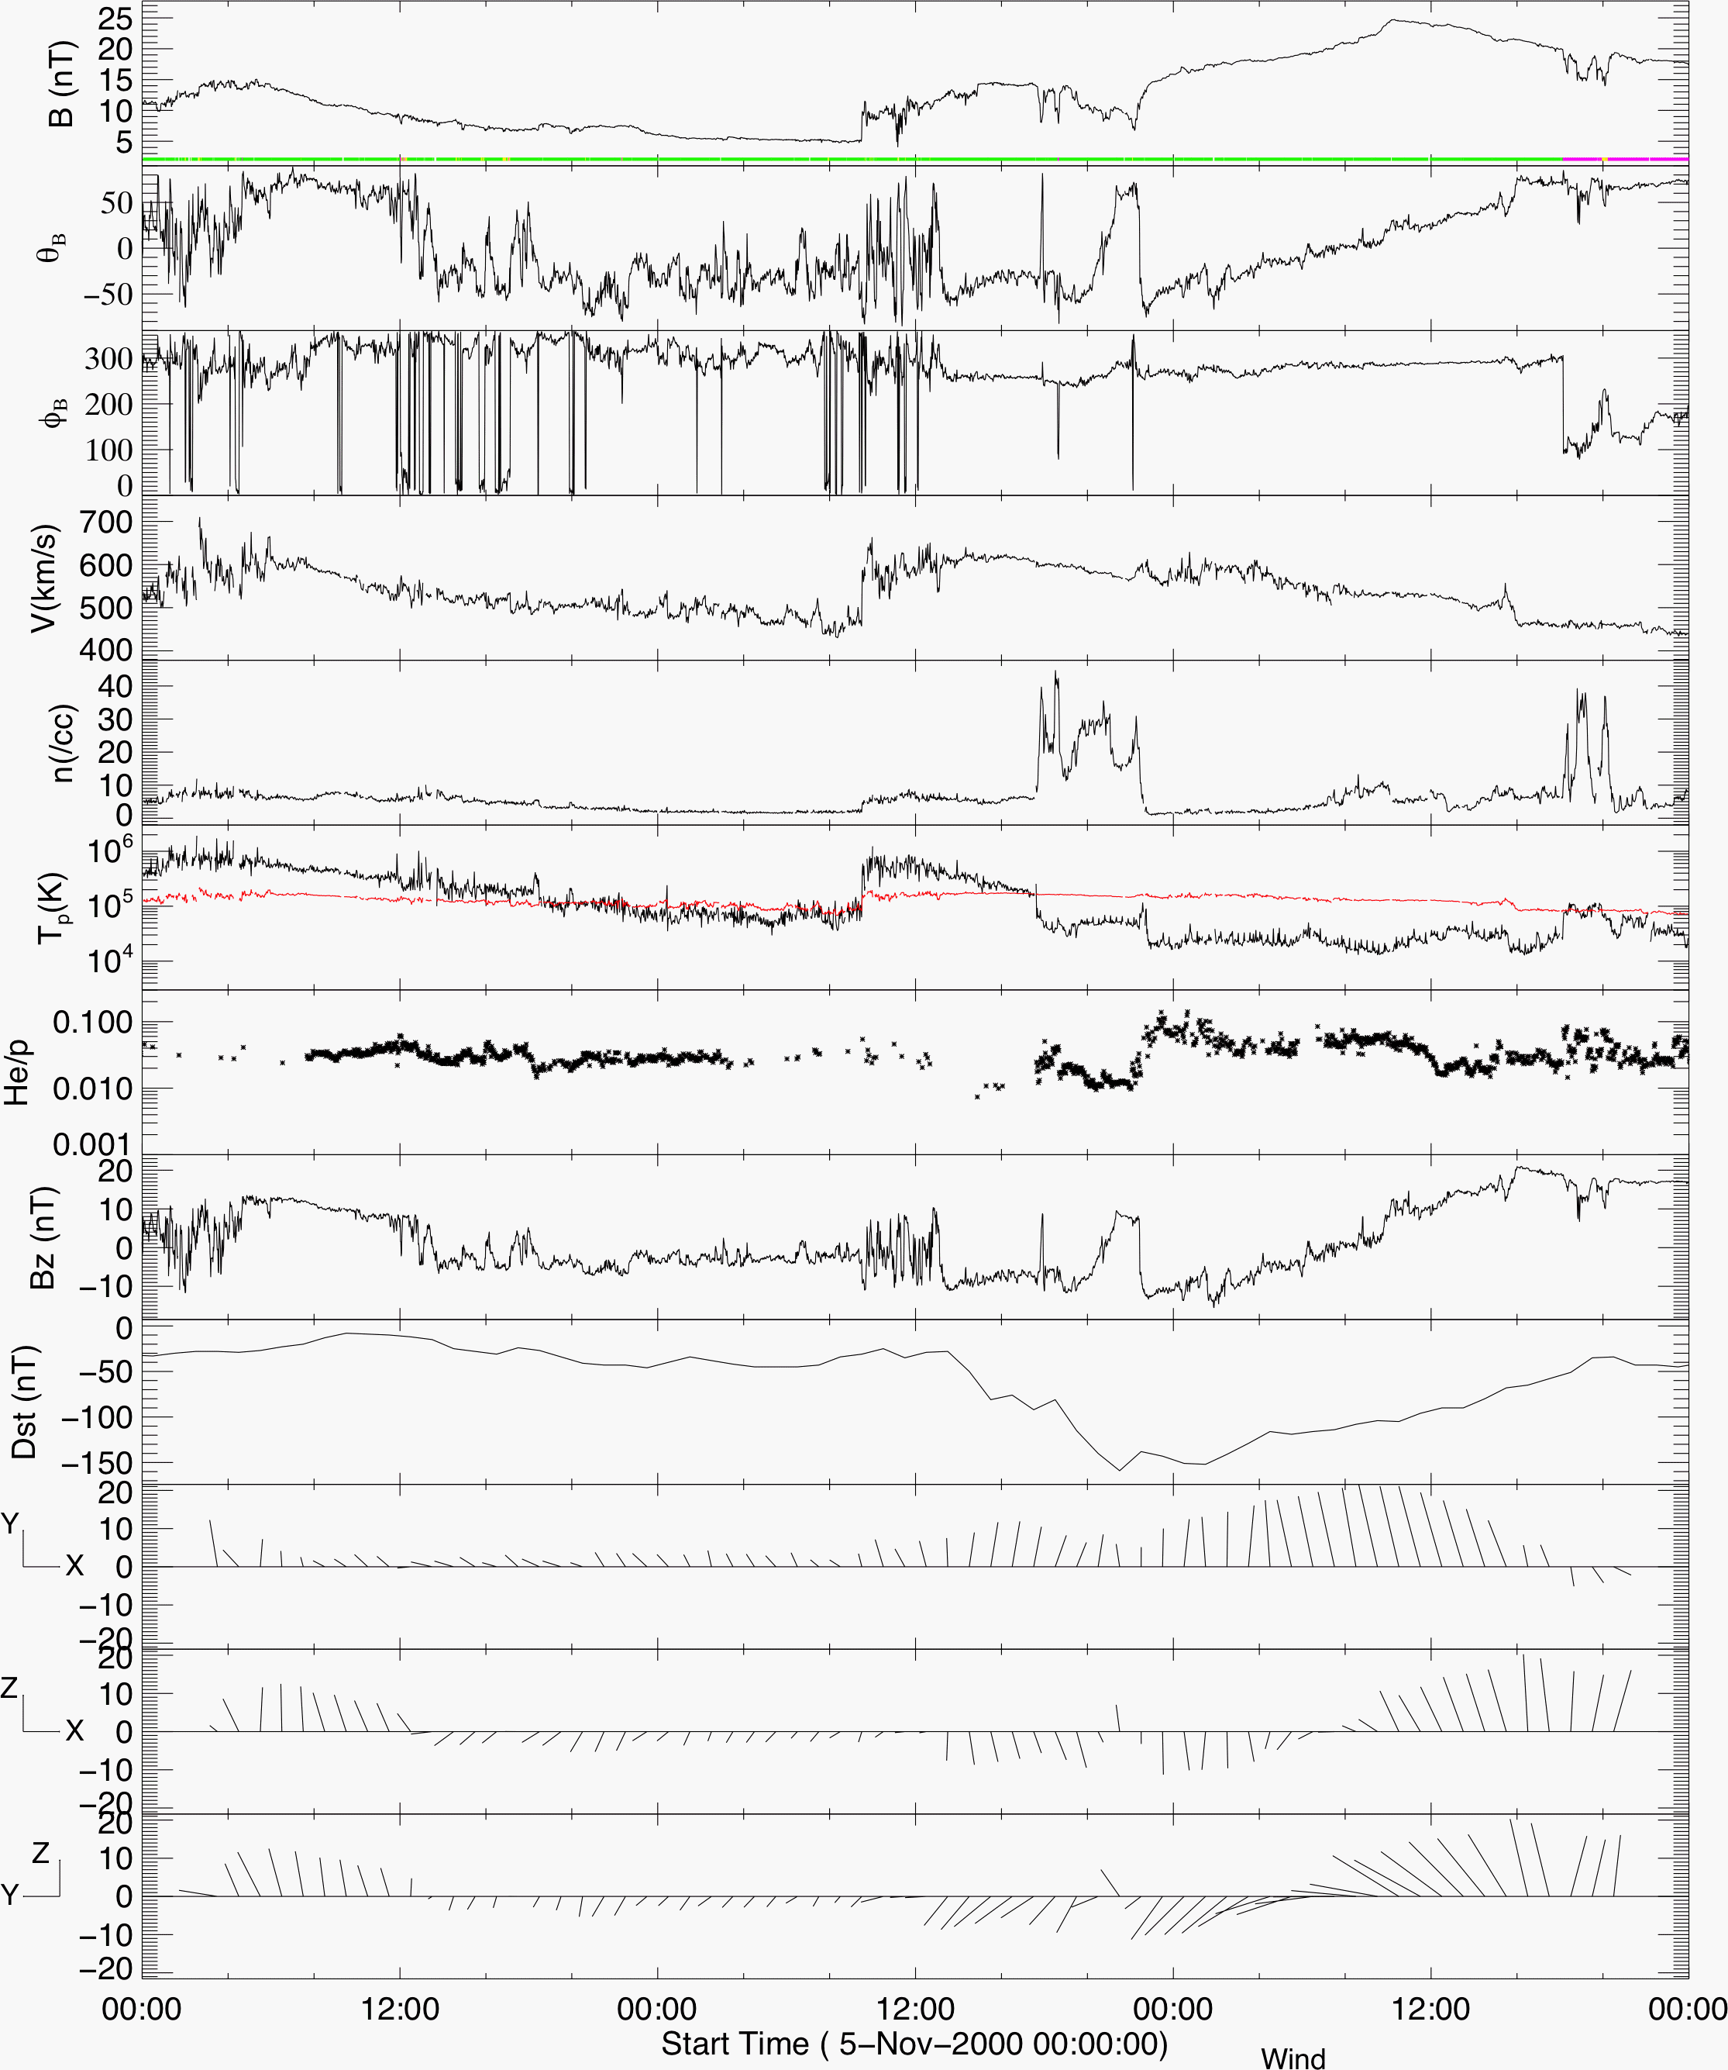
The 2012-10-05 CME reminds us of this event from 2000. This CME resulted in a storm of Dst = -159 nT.

Slide 13
EIT Difference Movies of 2000-11-03 CME

Slide 14
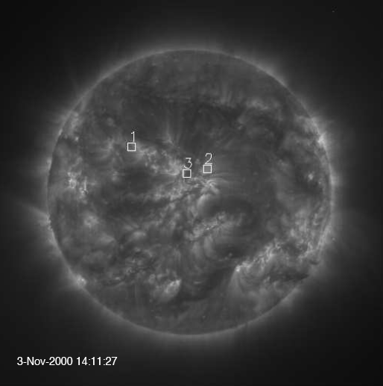
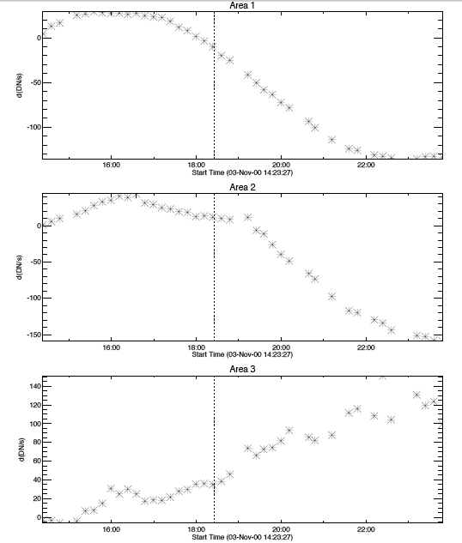
Dimming
3-Nov-2000 15:42:43
3-Nov-2000 20:11:43
This dimming developed slowly, and became clearer after the CME was first seen. It could have been overlooked in running difference images.

Slide 15
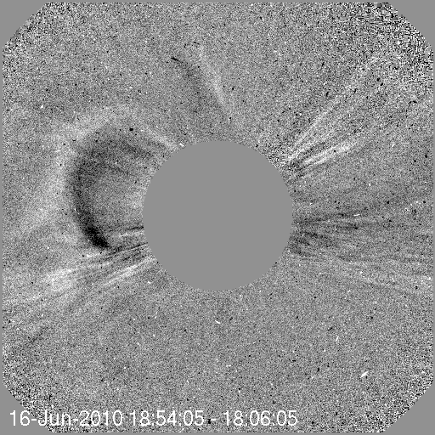
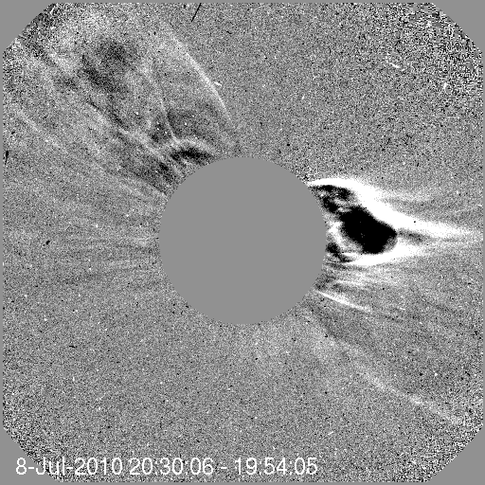
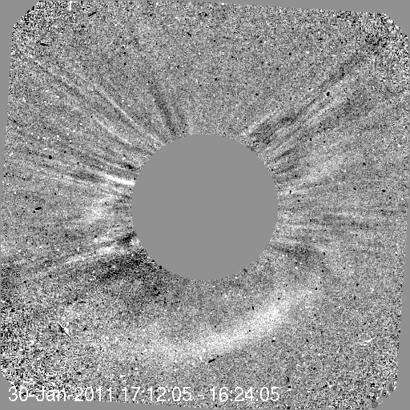
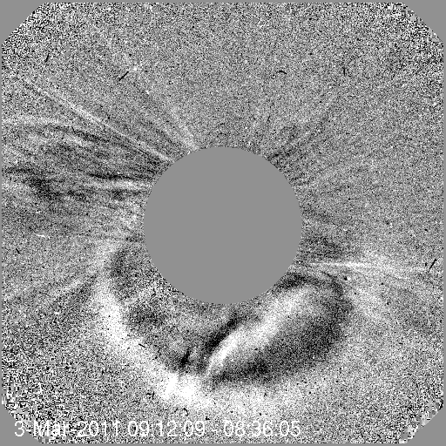
Real Stealth CMEs??
With the base difference (ratio) technique on EUV images over an extended time, we may find weak signatures from those CMEs that probably start at high altitudes. Therefore the previous two CMEs may not be stealth CMEs. On the other hand, if one looks for slow and diffuse CMEs, it is relatively easy to encounter stealth CMEs.
3-Nov-2000 15:42:43
3-Nov-2000 20:11:43
These are all front-side CMEs, as confirmed by STEREO observations, but slow (<300 km s⁻¹). Although they are wider than 100°, they are hardly Earth-affecting.

Slide 16
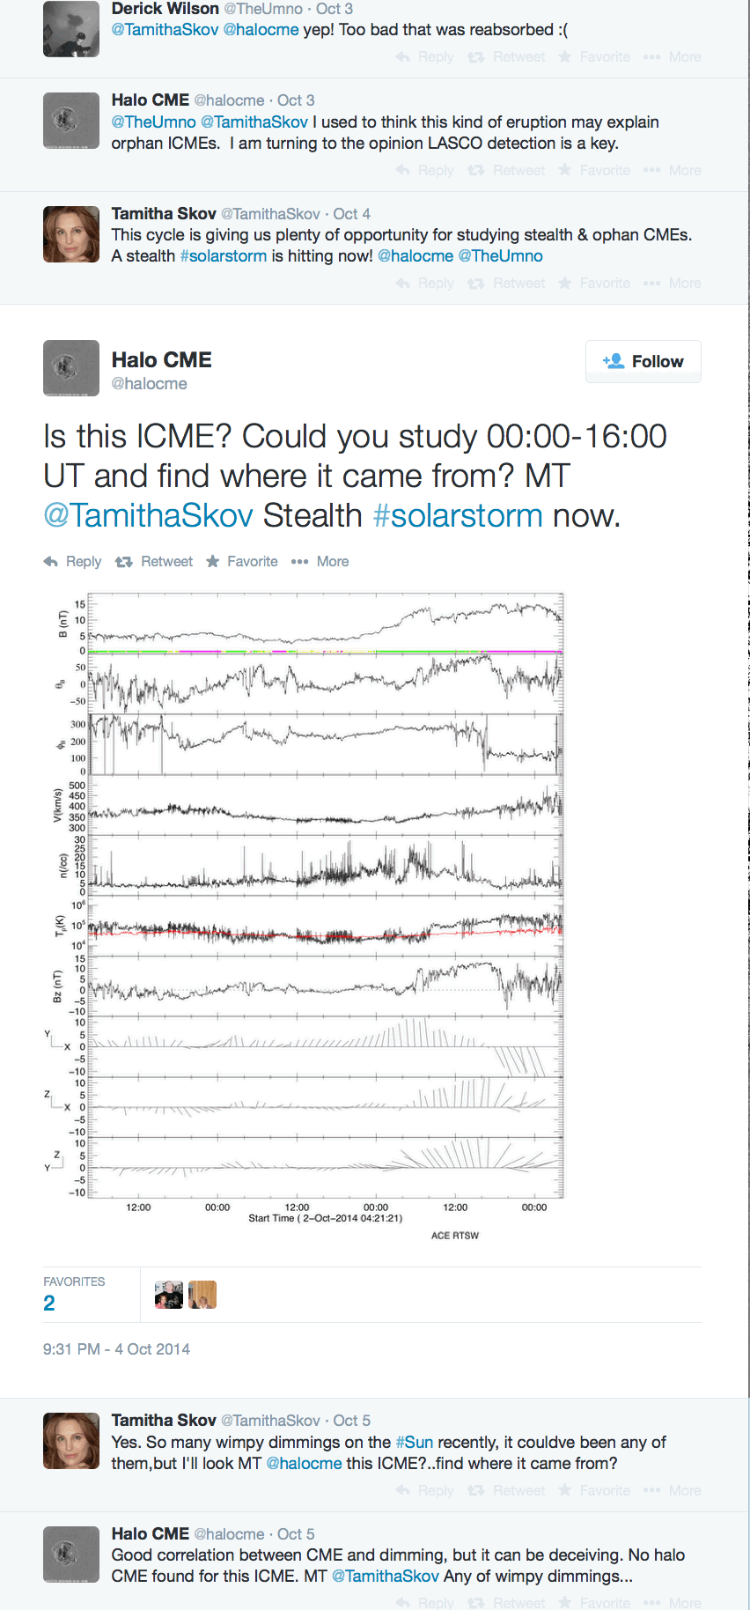
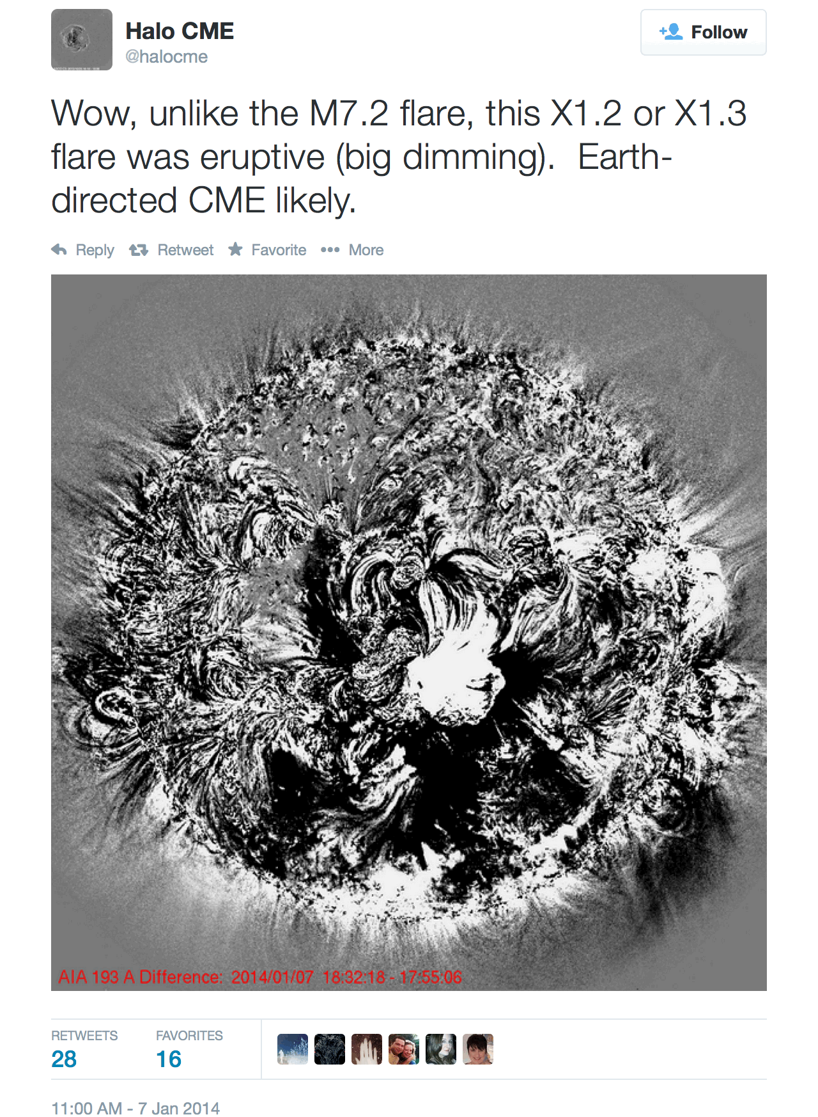
Real-time Interest
Hoping to reach out taxpayers???
3-Nov-2000 15:42:43
3-Nov-2000 20:11:43

Slide 17
Summary
Helped by STEREO observations, especially during 2010−2012, AIA can in principle observe the nascence of all CMEs from the visible side.
In reality, however, there are still some stealth CMEs, which may not be negligible. Most of them may not give rise to strong ICMEs.
Closer examination of data may disqualify some of the apparent stealth CMEs, including our campaign event (CME: 2012 Oct 5, ICME: 2012 Oct 8).
From 1 AU observations, a significant number of ICMEs with B > 10nT may have no confirmed parent CME. This will be given in the subsequent meetings.
3-Nov-2000 15:42:43
3-Nov-2000 20:11:43

